Slide 1
AI-based NFV Management
and Orchestration
Ph.D. Thesis Defense

Slide 2
Table of Contents
Introduction
Background and Related Work
AI-based NFV Management and Orchestration
Implementation
Evaluation
Conclusion

Slide 3
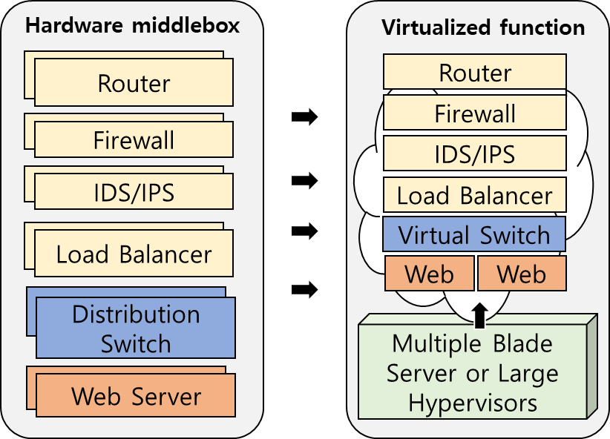
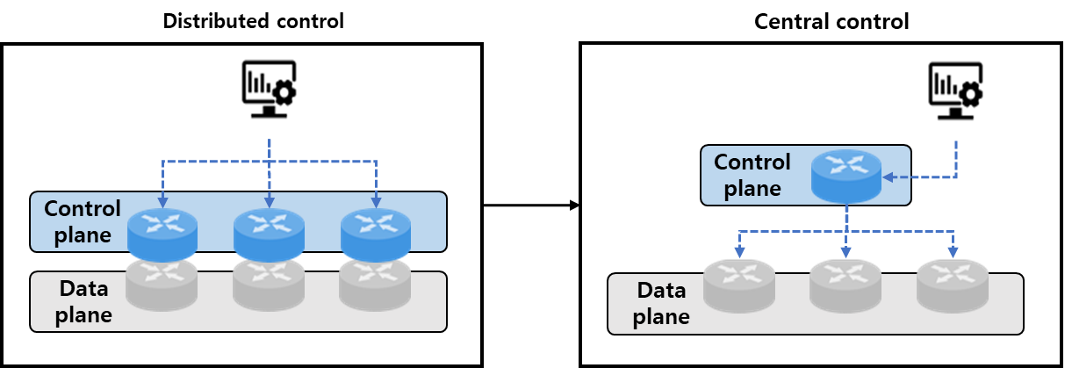
Introduction (1/5)
The emergence of SDN and NFV
Software Defined Network (SDN) separates the control and data forwarding functions of the network, allowing centralized management
NFV virtualizes network services as software components called Virtual Network Functions (VNFs) that run on commercial servers
➔ Reduce CAPEX / OPEX
➔ Maximize network flexibility and management efficiency
Software Defined Network (SDN)
Virtual Network Functions (VNFs)

Slide 4
Introduction (2/5)
NFV Management and Orchestration (NFV MANO)
Manage and orchestrate network functions and services in an NFV environment
E.g., Managing virtualized infrastructure resources or orchestrating the deployment of network services
Key functions:
VNF Deployment: Optimizes placement of VNFs on physical servers
Auto-scaling: Automatically adjusts the number of VNF instances in response to network demands
Service Function Chaining: Efficiently routes traffic through service function chains (SFCs)
VNF Consolidation: Reduces resource fragmentation cost by consolidating VNFs onto fewer physical servers

Slide 5
Introduction (3/5)
AI in Network Management
Challenges in traditional NFV management
Complex network environments require significant effort to create optimal management policies
Traditional optimization techniques are often inadequate due to runtime constraints and hardware limitations
Expected Benefits of AI Integration
AI-driven management systems can monitor, analyze, and optimize network operations continuously
AI models enhance the overall efficiency of network resource utilization
AI-based solutions can scale with the network and adapt to changing conditions quickly

Slide 6
Introduction (4/5)
Problem Statement
Complexity in Network Environments
High levels of automation and diverse virtualization stacks increase the complexity of network management
Limitations of Traditional Optimization Techniques
Traditional techniques are often ineffective due to runtime constraints and hardware limitations
These techniques struggle to adapt to the dynamic and complex nature of modern network environments
Challenges in Applying AI
Dynamic Variability: AI models, especially reinforcement learning-based ones, can perform poorly when network environments change rapidly
Learning Time: AI models often require significant retraining time to adapt to new conditions, leading to potential service disruptions
Policy Conflicts: Different NFV management modules may generate conflicting policies, causing inefficiencies and performance degradation
Notes:
Data-driven approaches of generating ABR algorithms which can adapt to various network conditions
Interactive video services exert a challenging demand on network conditions such as latency
- Low tolerance to e2e delay: Multi-party video conferencing’s tolerable delay is around 400 ms [11]
Mobile users often experience a decline in quality
- The dynamic nature of network conditions can significantly degrade QoS of video conferences
1. 정답을 모르지만, 행동에 대한 보상/다음 상태가 주어질 수 있는 경우
2. 현재의 의사결정이 미래에 영향을 미치는 경우
3. 문제의 구조를 정확히 알 수 없는 경우

Slide 7
Introduction (5/5)
Research Goals
AI-based NFV Management and Orchestration
Automated NFV Management System
Deploy VNFs with GNN model
Auto-scale SFCs with DQN model
Update SFCs with DQN model
Consolidate VNFs with PPO model
Compartmentalized and Orchestrated Management Policies
Divide NFV management into separate, well-defined policies to minimize conflicts among different functions
Avoid operational inefficiencies and service quality degradation by harmonizing management policies
Proactive Learning and Adaptive System
Develop a proactive learning system that can load pre-trained AI models tailored to real-time network environments
Digital Twin System
Provide a digital twin of the NFV environment to simulate network conditions and AI model
Notes:
Precisely estimate users’ available bandwidth
- Replace the GCC’ bandwidth estimation algorithm with DRL agent
- DRL model learns diverse and dynamic network conditions
Deliver better quality's video streams to users
- Adjust a mechanism of allocating video streams by DRL agent
- DRL model optimizes the utilization of link capacity

Slide 8
Table of Contents
Introduction
Background and Related Work
AI-based NFV Management and Orchestration
Implementation
Evaluation
Conclusion

Slide 9
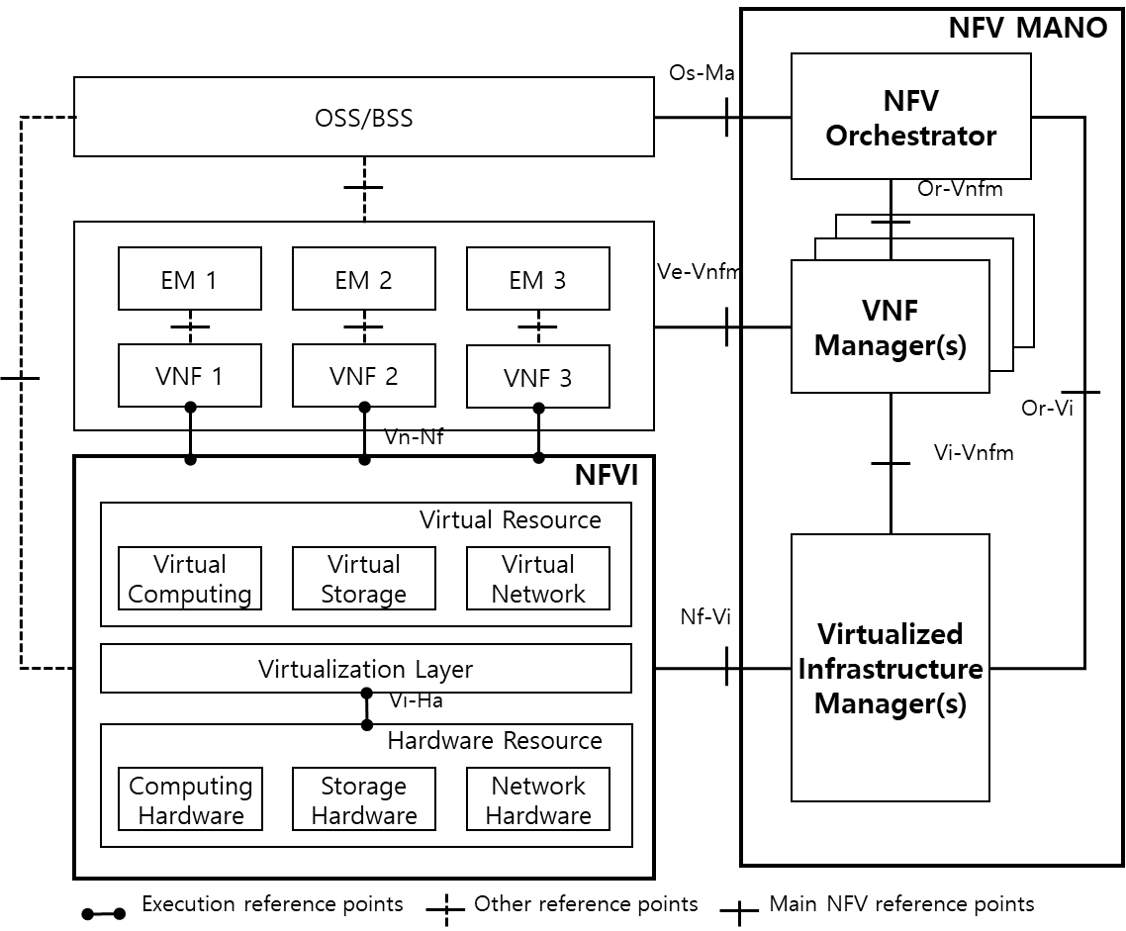
Background (1/4)
NFV MANO
A framework defined by ETSI* for managing and orchestrating Network Services (NSs) and VNFs
NFV Infrastructure (NFVI)
Provide physical hardware and virtualized resources
Virtualized Infrastructure Manager (VIM)
Manage NFVI resources and monitor the state of the NFVI
VNF Manager (VNFM)
Create, initialize, and configure VNFs
NFV Orchestrator (NFVO)
Create, remove, monitor, scale, and upgrade
network services
NFV MANO defined by ETSI
ETSI : European Telecommunications Standards Institute
Notes:
UDP is a Transport Layer protocol. It is a part of Internet Protocol suite.
Real-Time Transport Protocol (RTP) is a internet protocol which is used for delivering audio and video over networks.

Slide 10
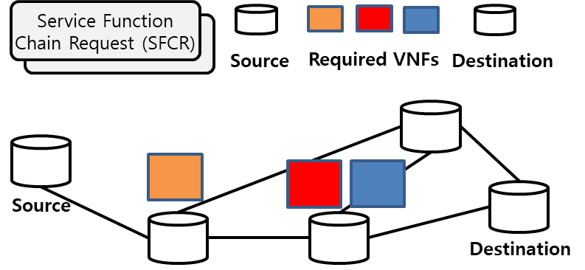
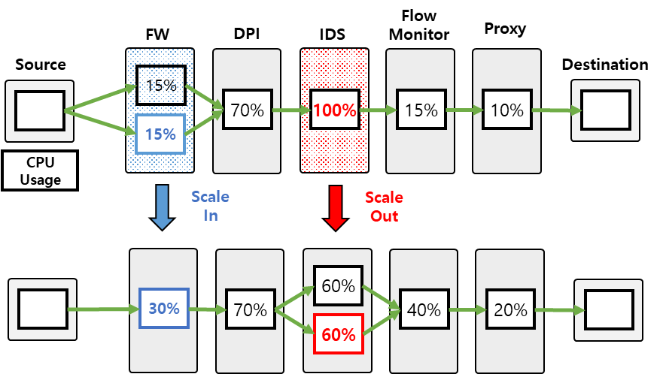
Background (2/4)
VNF Deployment
prepare and install VNFs according to the requirements of specific network services
Flexible deployment of VNFs on suitable physical servers
Effective resource utilization while delivering high-quality services
Auto-scaling
Adjust the number of VNF instances to optimize performance and availability
Maintain network performance during traffic fluctuations
Reduce costs by optimizing resource usage
VNF Deployment
Auto-scaling (scale out/in)
Notes:
In general, media servers such as the SFU in WebRTC-based video conferencing systems implement GCC as the congestion control algorithm to maintain compatibility with client-side components like web browsers.
So, the delay-based controller of the SFU mainly consists of a remote rate controller, overuse detector, and arrival-time filter. The process through which the SFU estimates the available bandwidth of receivers using GCC can be summarized as follows.
The arrival-time filter measures the one-way delay gradient of packets through RTCP messages (e.g., REMB and TWCC) and utilizes a Kalman filter to remove jitter noise and make more accurate predictions. Then, the overuse detector generates a signal based on the delay gradient and its threshold. At this point, the estimated one-way delay gradient of the arrival-time filter serves as input to the over-use detector.
If the delay gradient exceeds the threshold of the detector as shown in Figure 3.2, the overuse detector produces an overuse signal, which is considered as the occurrence of congestion. Finally, the remote rate controller runs a control algorithm (Equation 3.1) to estimate the available bandwidth based on a finite state machine (FSM) and state transitions as shown in Figure 3.3.
For instance, if an overuse signal occurs in the previous state resulting in a transition to the Decrease state, the available bandwidth of next state Ar(ti) is predicted as αRr(ti), where α is a decreasing rate smaller than 1, and Rr(ti) represents the recently measured receiving rate.
To enhance the overall QoS of video conferencing environments, it is necessary to estimate users’ available bandwidth more accurately and adaptively, according to various network conditions. To this end, this research proposes a new approach to apply DRL to the bandwidth estimation by replacing the overuse detector with my proposed DRL agent.

Slide 11
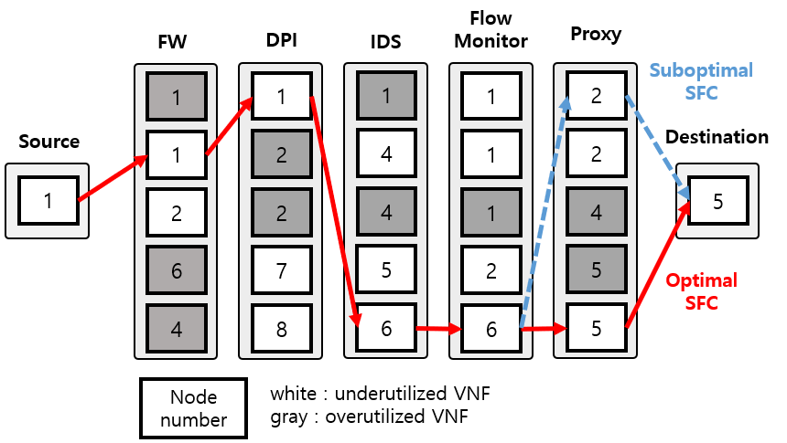
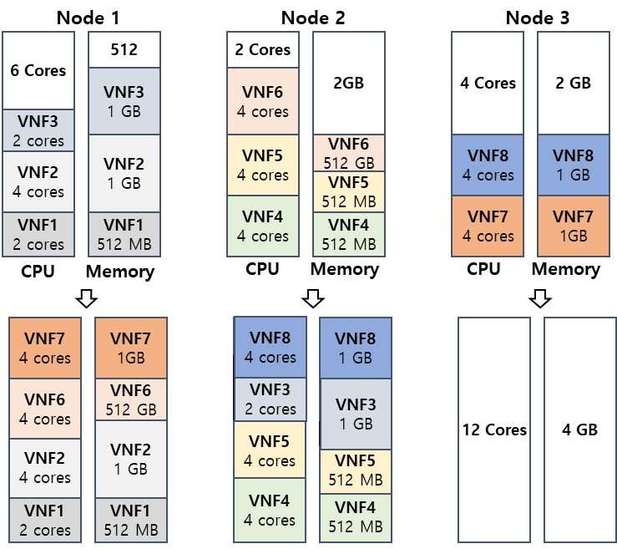
Background (3/4)
Service Function Chaining
Determine the sequence of network function chain for SFCs
Prevent service quality degradation
Minimize service latency by ensuring the shortest path
Service Function Chaining
VNF Consolidation
Consolidate multiple VNF instances onto fewer physical servers
Reduce unnecessary resource wastage and prevent resource fragmentation
Increase power efficiency by concentrating power consumption on fewer servers.
VNF Consolidation
Notes:
In general, media servers such as the SFU in WebRTC-based video conferencing systems implement GCC as the congestion control algorithm to maintain compatibility with client-side components like web browsers.
So, the delay-based controller of the SFU mainly consists of a remote rate controller, overuse detector, and arrival-time filter. The process through which the SFU estimates the available bandwidth of receivers using GCC can be summarized as follows.
The arrival-time filter measures the one-way delay gradient of packets through RTCP messages (e.g., REMB and TWCC) and utilizes a Kalman filter to remove jitter noise and make more accurate predictions. Then, the overuse detector generates a signal based on the delay gradient and its threshold. At this point, the estimated one-way delay gradient of the arrival-time filter serves as input to the over-use detector.
If the delay gradient exceeds the threshold of the detector as shown in Figure 3.2, the overuse detector produces an overuse signal, which is considered as the occurrence of congestion. Finally, the remote rate controller runs a control algorithm (Equation 3.1) to estimate the available bandwidth based on a finite state machine (FSM) and state transitions as shown in Figure 3.3.
For instance, if an overuse signal occurs in the previous state resulting in a transition to the Decrease state, the available bandwidth of next state Ar(ti) is predicted as αRr(ti), where α is a decreasing rate smaller than 1, and Rr(ti) represents the recently measured receiving rate.
To enhance the overall QoS of video conferencing environments, it is necessary to estimate users’ available bandwidth more accurately and adaptively, according to various network conditions. To this end, this research proposes a new approach to apply DRL to the bandwidth estimation by replacing the overuse detector with my proposed DRL agent.

Slide 12
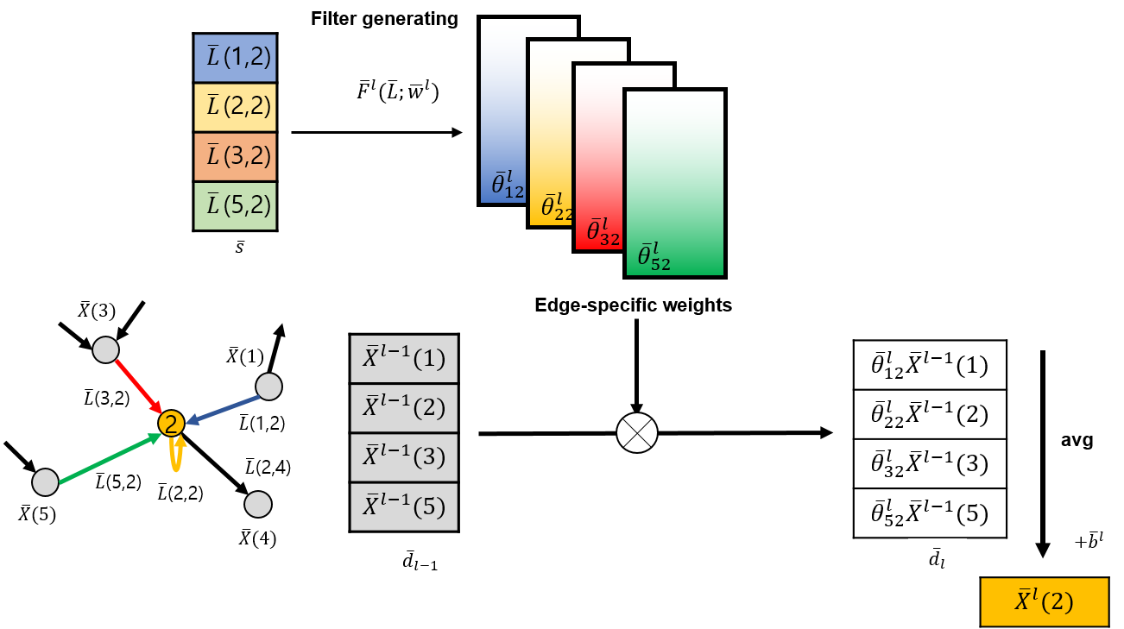
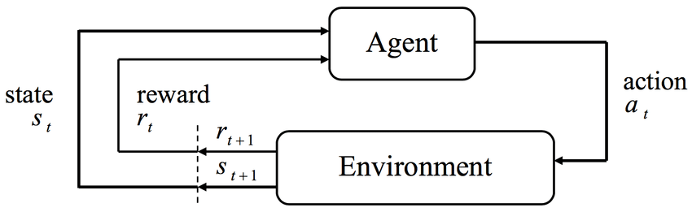
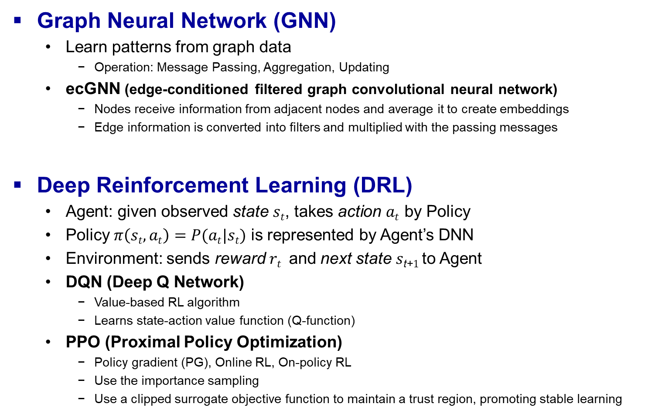
Background (4/4)
Graph Neural Network (GNN)
Learn patterns from graph data
Operation: Message Passing, Aggregation, Updating
ecGNN (edge-conditioned filtered graph convolutional neural network)
Nodes receive information from adjacent nodes and average it to create embeddings
Edge information is converted into filters and multiplied with the passing messages
Deep Reinforcement Learning (DRL)
Agent: given observed state $st$, takes action $at$ by Policy
Policy $π\left(st,at\right)=P(at|st)$ is represented by Agent’s DNN
Environment: sends reward $rt$ and next state $s\text{t}\text{+}1$ to Agent
DQN (Deep Q Network)
Value-based RL algorithm
Learns state-action value function (Q-function)
PPO (Proximal Policy Optimization)
Policy gradient (PG), Online RL, On-policy RL
Use the importance sampling
Use a clipped surrogate objective function to maintain a trust region, promoting stable learning
<ecGNN>
<RL framework>
Notes:
Introduction to PPO
Type: Reinforcement Learning Algorithm
Designed for training deep neural networks to make decisions in complex environments.
Key Features
Balances exploration and exploitation efficiently.
Robust to hyperparameter settings, making it user-friendly for a variety of problems.
Uses a clipped surrogate objective function to maintain a trust region, promoting stable learning.
How PPO Works
Policy Update Rule: PPO updates policies by taking small steps to improve performance while avoiding drastic changes that could harm learning.
Clipping Mechanism: Limits the policy update, ensuring the new policy isn’t too far from the old, maintaining stability.
Advantage Estimation: Uses the advantage function to understand how much better an action is compared to the average.
Advantages of PPO
Stability and Reliability: Less prone to hyperparameter tuning issues.
Sample Efficiency: Makes better use of data compared to older methods.
Ease of Implementation: Simpler to implement than many other advanced algorithms.
Applications
Widely used in robotics, game playing (like Dota 2, chess), and any domain requiring decision-making under uncertainty.
Conclusion
PPO has become a go-to algorithm in reinforcement learning for its efficiency, ease of use, and strong performance across a variety of tasks.
PPO에서는 policy와 value function의 parameter sharing이 되는 구조의 neural network architecture를 사용하는데, 이를 위해 loss function이 policy surrogate와 value function error와 관련된 term을 결합되어 설계된다.
------
1. 정답을 모르지만, 해동에 대한 보상/다음 상태가 주어질 수 있는 경우
2. 현재의 의사결정이 미래에 영향을 미치는 경우
3. 문제의 구조를 정확히 알 수 없는 경우
—> 강화학습을 써야함 (supervised learning 대신)

Slide 13
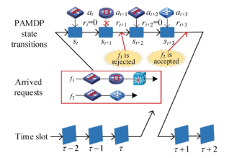



Related Work
NFV Management with ML
H2O-Deployment [1]
MEC-DQN [2]
DQN-QOR [3]
SDN-Lullaby [4]
NFV MANO
OPNFV [5]
Open-Baton [6]
Tacker [7]
Cloud4NFV[8]
AI-based NFV MANO
ETSI Experiential Network Intelligence (ENI) [9]
Limitation: Limited scalability and adaptability in diverse network environment
Network Intelligence [10]
Limitation: Slow adaptation and not support orchestration
DQN-QOR
Open source project of NFV MANO

Slide 14
Table of Contents
Introduction
Background and Related Work
AI-based NFV Management and Orchestration
Implementation
Evaluation
Conclusion

Slide 15
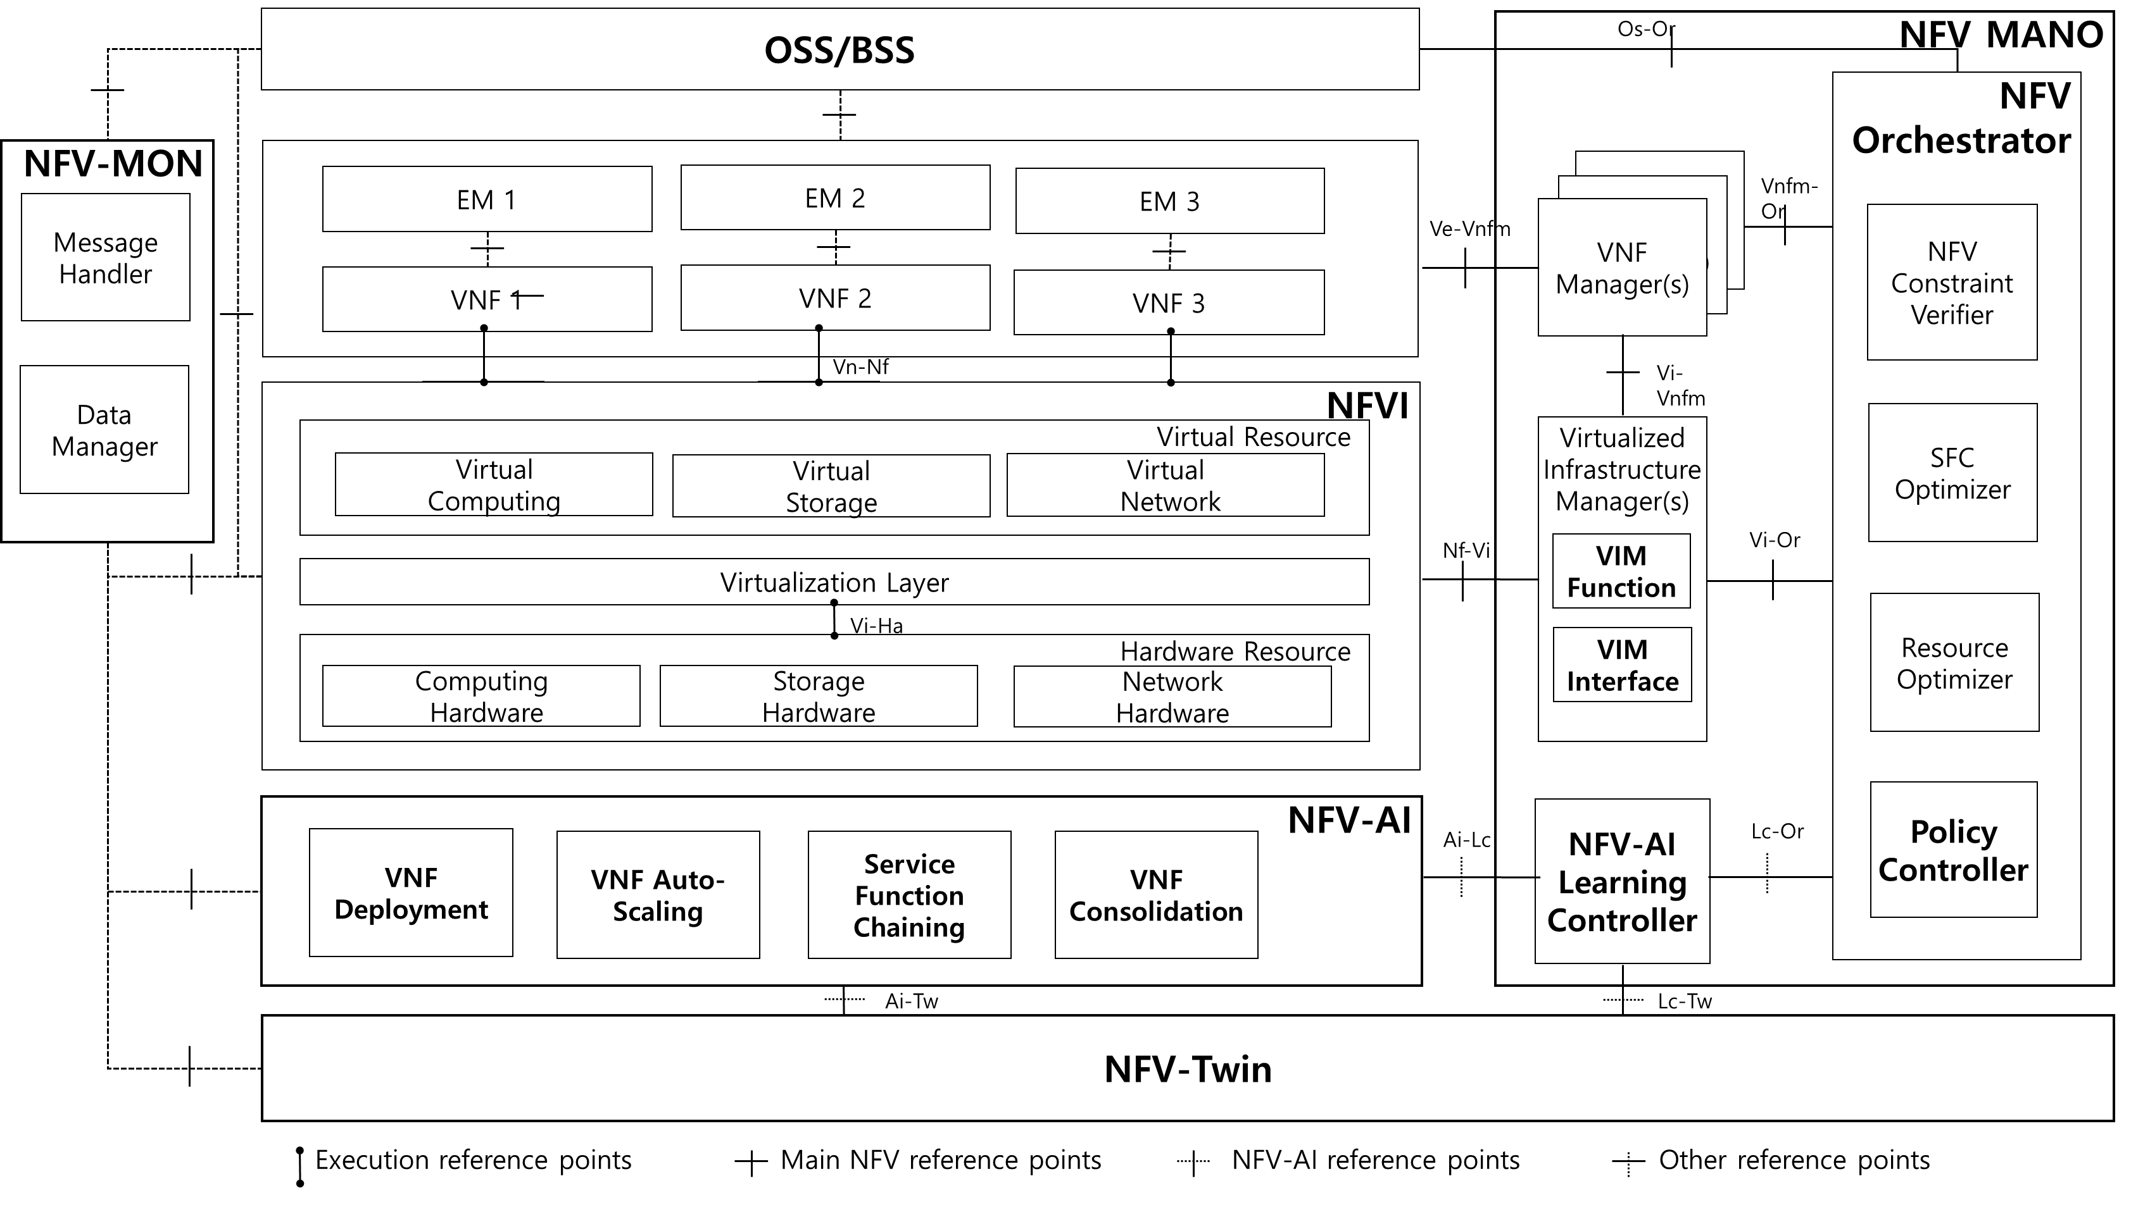
Design of AI-based NFV MANO (1/8)
Overall Architecture
NFVI (Openstack), NFV-MON, NFV-MANO, NFV-AI, NFV-TWIN

Slide 16
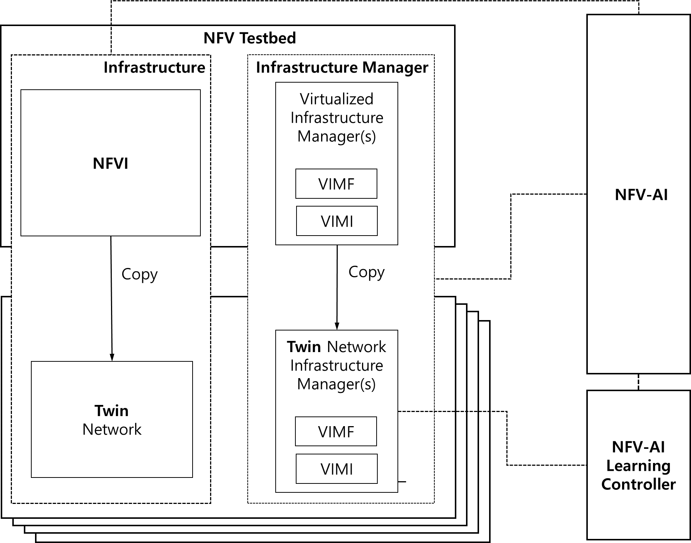
Design of AI-based NFV MANO (2/8)
NFV-Twin
Replicate the actual network environment
Include all objects provided by the NFVI
Include all operations provided by the VIM
VIM Function
VIM Interface
Allow comprehensive analysis and simulation of the network environment
Stable Learning Environment:
Proactive Learning

Slide 17
Design of AI-based NFV MANO (3/8)
NFV-AI
Optimize VNF deployment, auto-scaling, service function chaining, and consolidation
Compartmentalize of management functions
Minimize potential conflicts between management tasks by defining each function with a precise scope
operates independently for different targets (one for all -> multi one for one)
 | Broad Definition | Precise Definition
VNF Deployment | Target : Entire Network, Entire SFCRs Action : Deployment, Migration, Removal | Target : Single SFCR Action : Deployment
Auto-scaling | Target : Entire VNFs, Entire SFCs Action : Deployment, Removal, Chaining | Target : Entire VNFs, Single SFC Action : Deployment, Removal, Chaining
Service function chaining | Target : Entire VNFs, Entire SFCs Action : Deployment, Migration, Removal, Chaining | Target : Entire VNFs, Single SFC Action : Chaining
consolidation | Target : Entire VNFs, Entire SFCs Action : Deployment, Migration, Removal | Target : Entire VNFs, Entire SFC Action : Migration

Slide 18
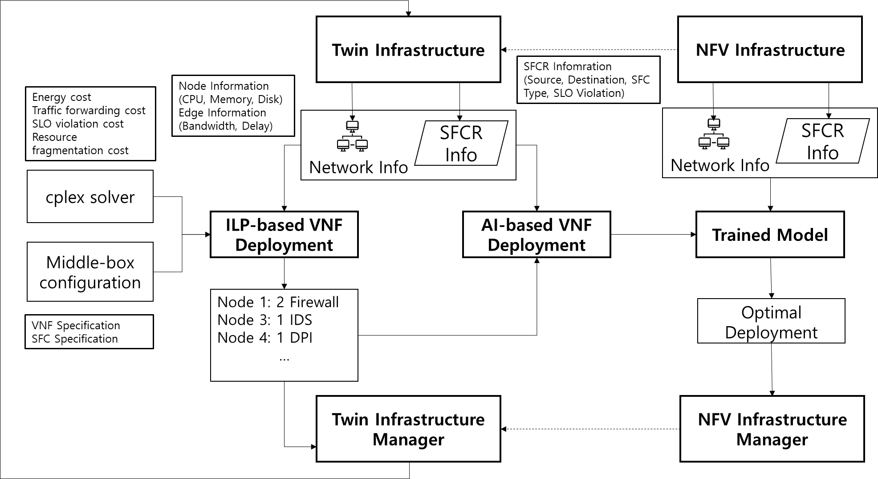
Design of AI-based NFV MANO (4/8)
VNF Deployment
Optimize the placement of VNFs in response to network service requests.
Leverage GNN Algorithm with Integer Linear Programming (ILP)

Slide 19
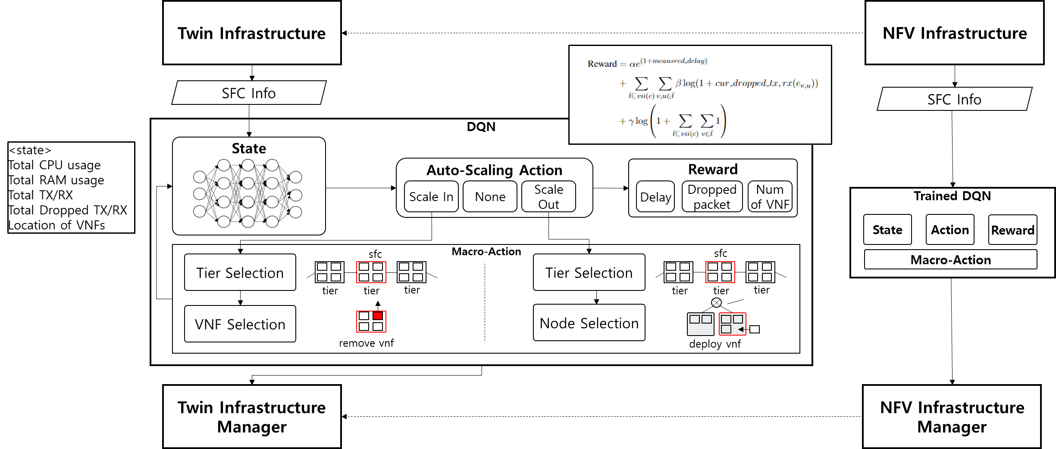
Design of AI-based NFV MANO (5/8)
Auto-scaling
Optimally scale VNF instances according to changes in network traffic
Leverage DQN Algorithm with macro-action

Slide 20
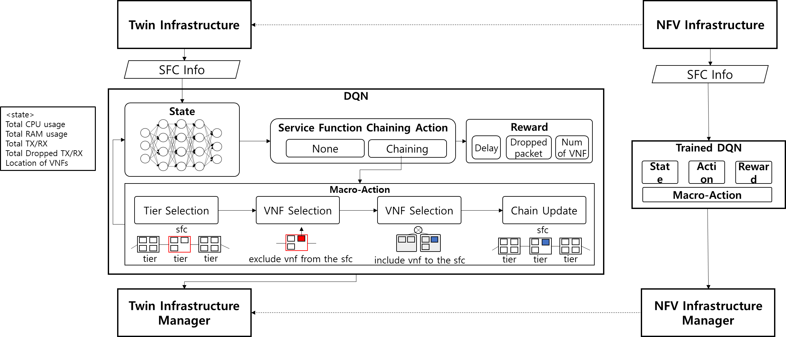
Design of AI-based NFV MANO (6/8)
Service Function Chaining
Improve service quality by altering the SFC chain without creating or deleting additional VNFs
Leverage DQN Algorithm with macro-action

Slide 21
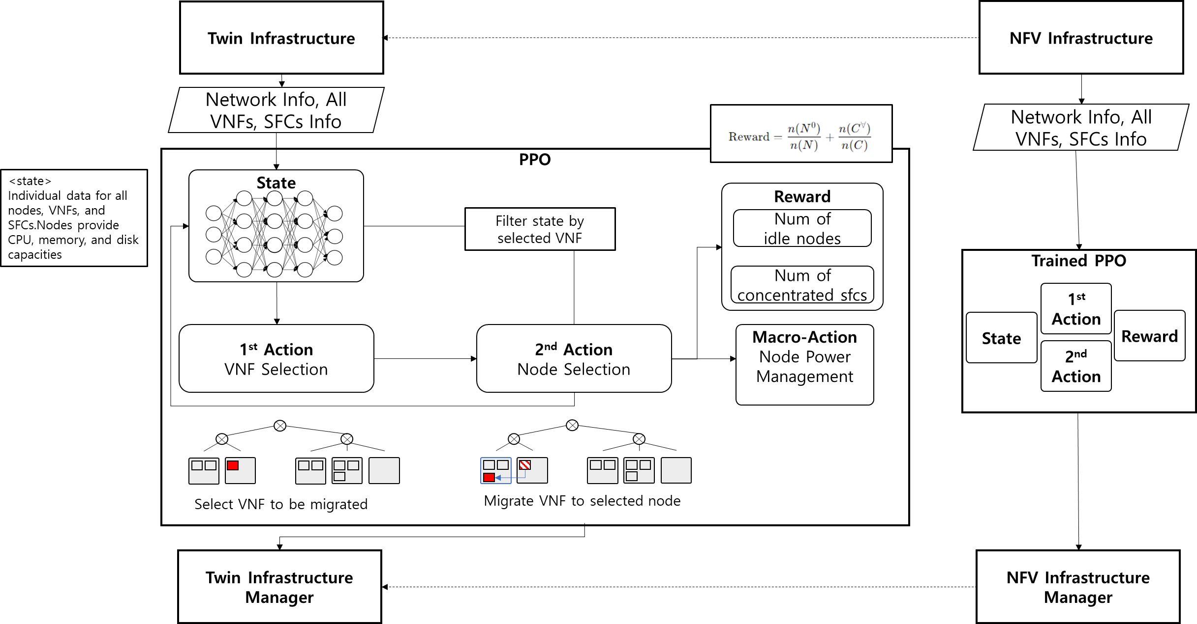
Design of AI-based NFV MANO (7/8)
Consolidation
Achieve resource and power efficiency by concentrating distributed VNFs on nodes
Leverage PPO Algorithm with two-staged action (VNF Selection, Node Selection)

Slide 22
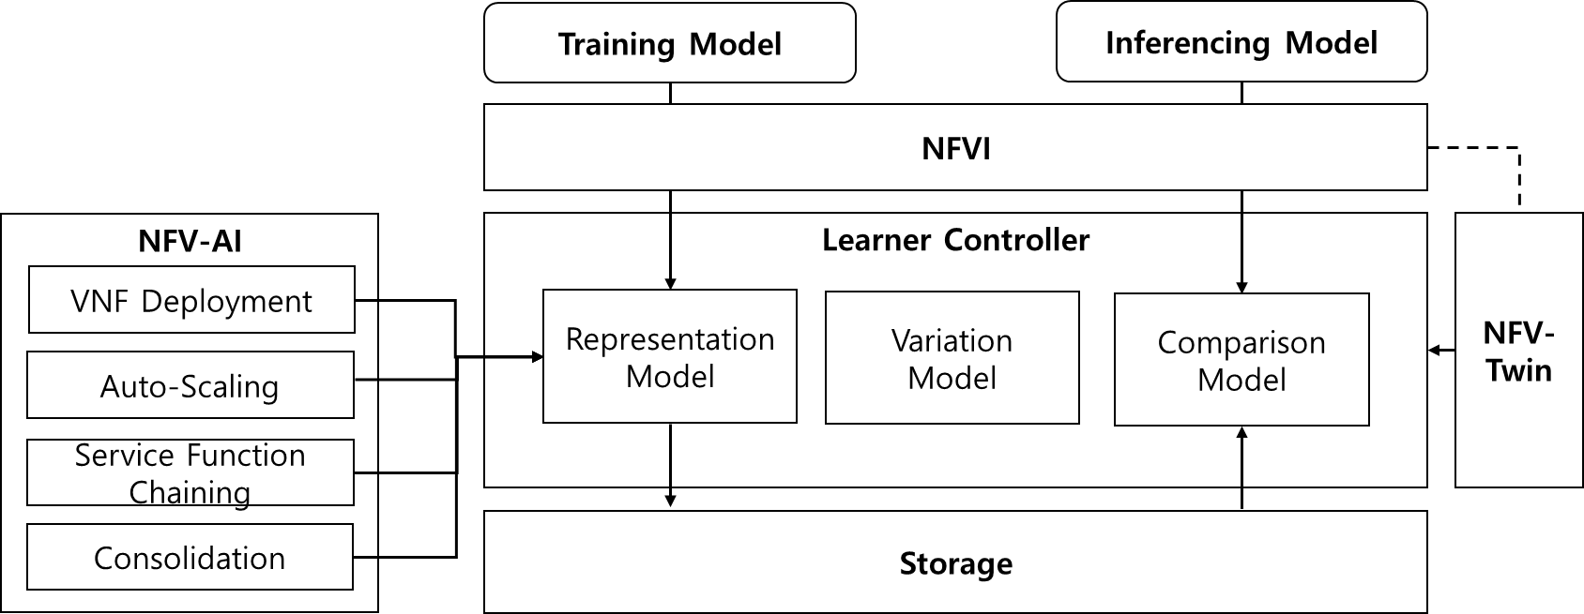
Design of AI-based NFV MANO (8/8)
Learner Controller
Ensure machine learning models provide optimal network management policies in response to network
Representation Model
Whenever finish training the model, save the model with input data
Variation Model
Create variations to network environment using NFV-Twin
Comparison Model
Calculate cosine similarity between input data and select trained model

Slide 23
Table of Contents
Introduction
Background and Related Work
AI-based NFV Management and Orchestration
Implementation
Evaluation
Conclusion

Slide 24
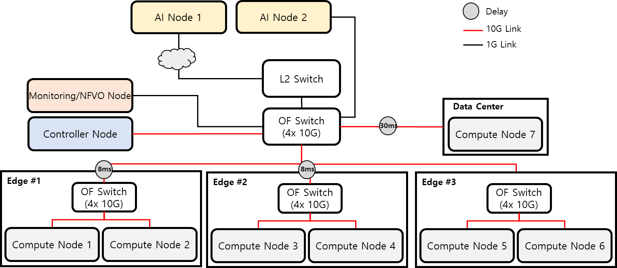
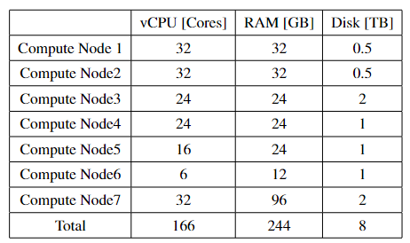
Implementation (1/6)
Physical Testbed
Consist of controller node, monitoring node, AI nodes, and Compute nodes.
Use Openstack Heat and Tacker to mange basic NFV environment
Use KVM Hypervisor to run VM and use DEMU* to generate delay
Specification of Compute Nodes
Testbed Topology
DEMU: DPDK-based Delay Emulator
Notes:
Edge1 Edge2 Edge3 엣지 그림 고치기
딜레이 잘못됫음..

Slide 25
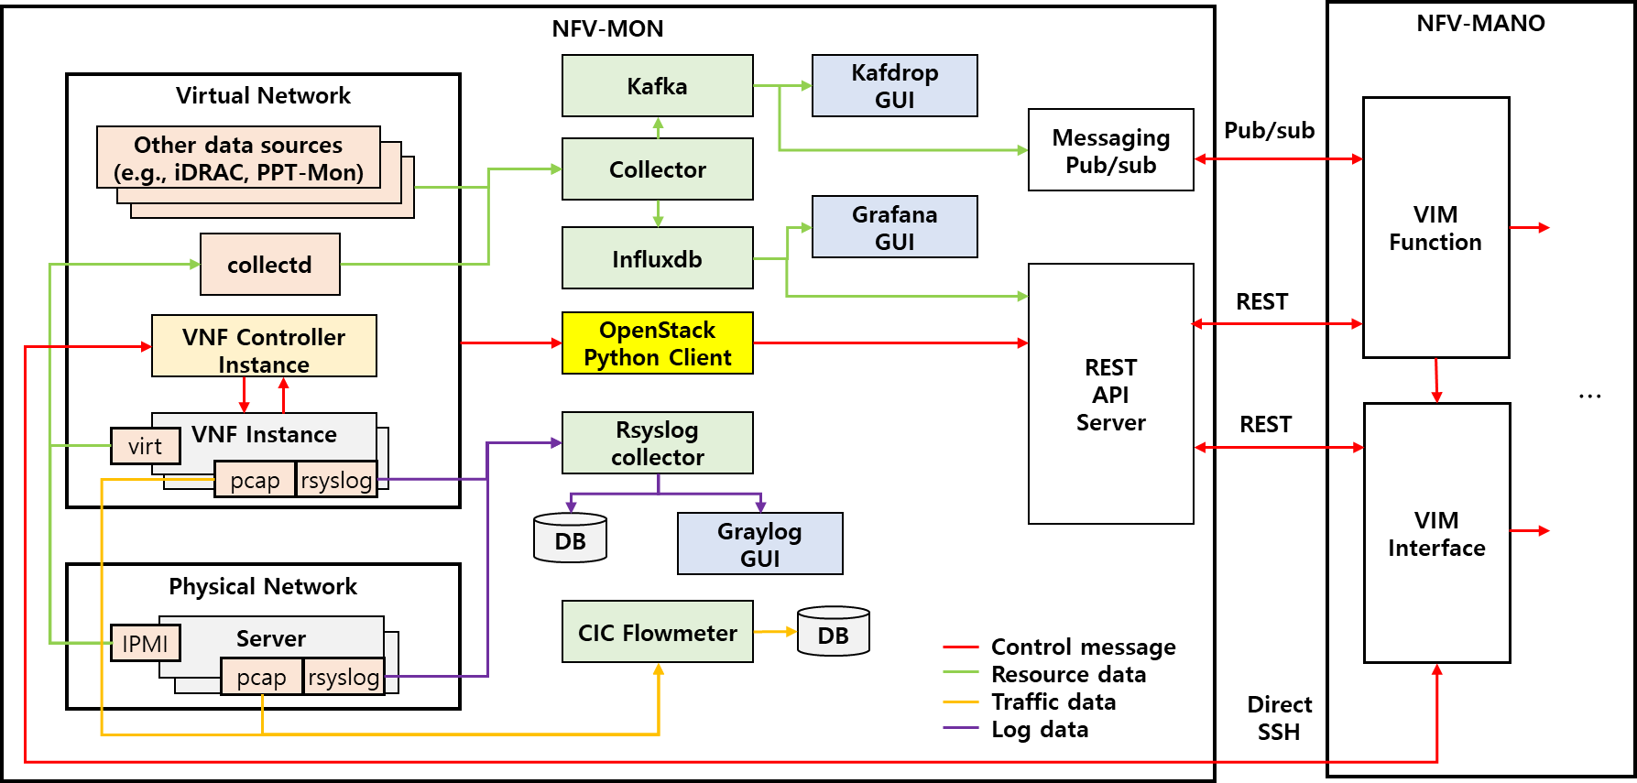
Implementation (2/6)
NFV-MON
Collects resource usage and log information of VNFs and physical servers

Slide 26
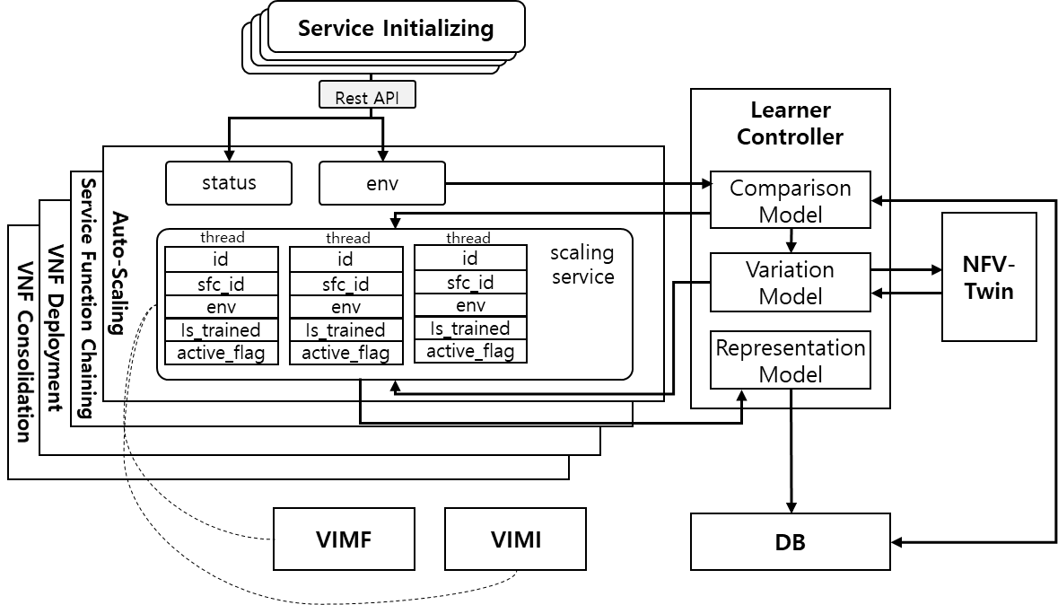
Implementation (3/6)
NFV-AI
Each NFV management function is provided as a modular service
Functionality offered via REST API for managing NFVI using VIMF and VIMI

Slide 27
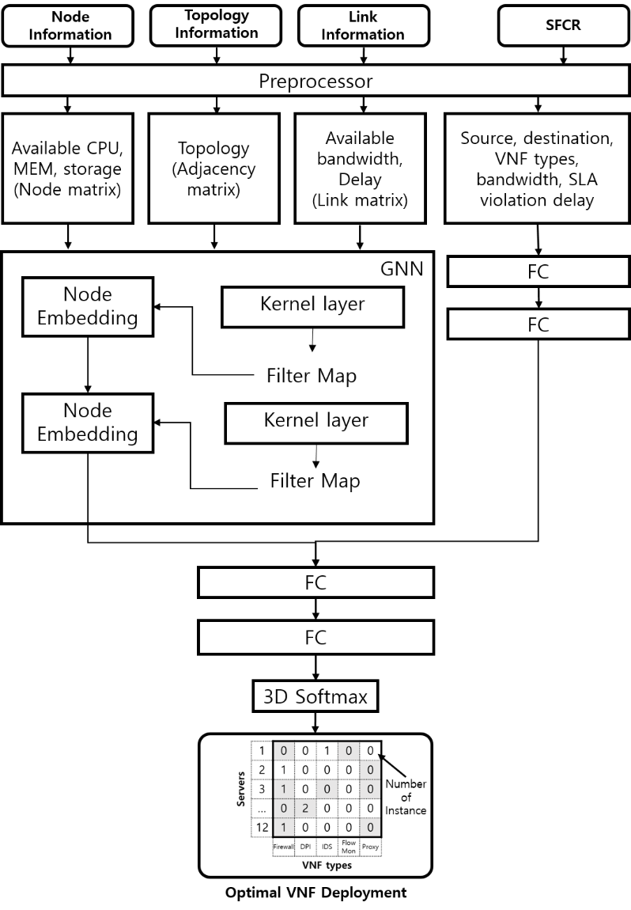
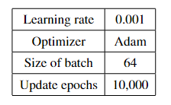
Implementation (4/6)
VNF Deployment
Service registration
single SFCR are registered to get optimal VNF deployment
Feature extraction
Two graph neural network layers with 512 neurons each for node embedding
SFCR data embedded via fully connected (FC) layers with 128 neurons each
Data processing
Embeddings are flattened and concatenated.
Combined data passes through two FC layers (512, 120 neurons)
Convert as a labeling data using 3D softmax layer
Loss calculated via categorical cross-entropy
Hyperparameter
GNN based VNF Deployment

Slide 28
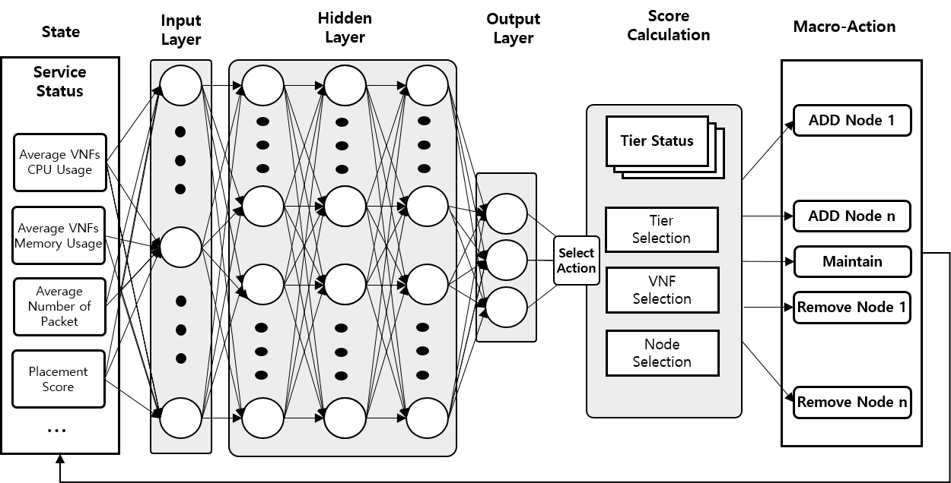
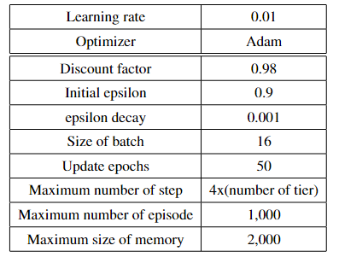
Implementation (5/6)
Auto-scaling & Service Function Chaining
Service registration
Several SFCs are registered and independently managed
Q-Function Approximation
Five fully connected layers with 128 neuron
Hyperparameter
DQN-based Auto-scaling

Slide 29
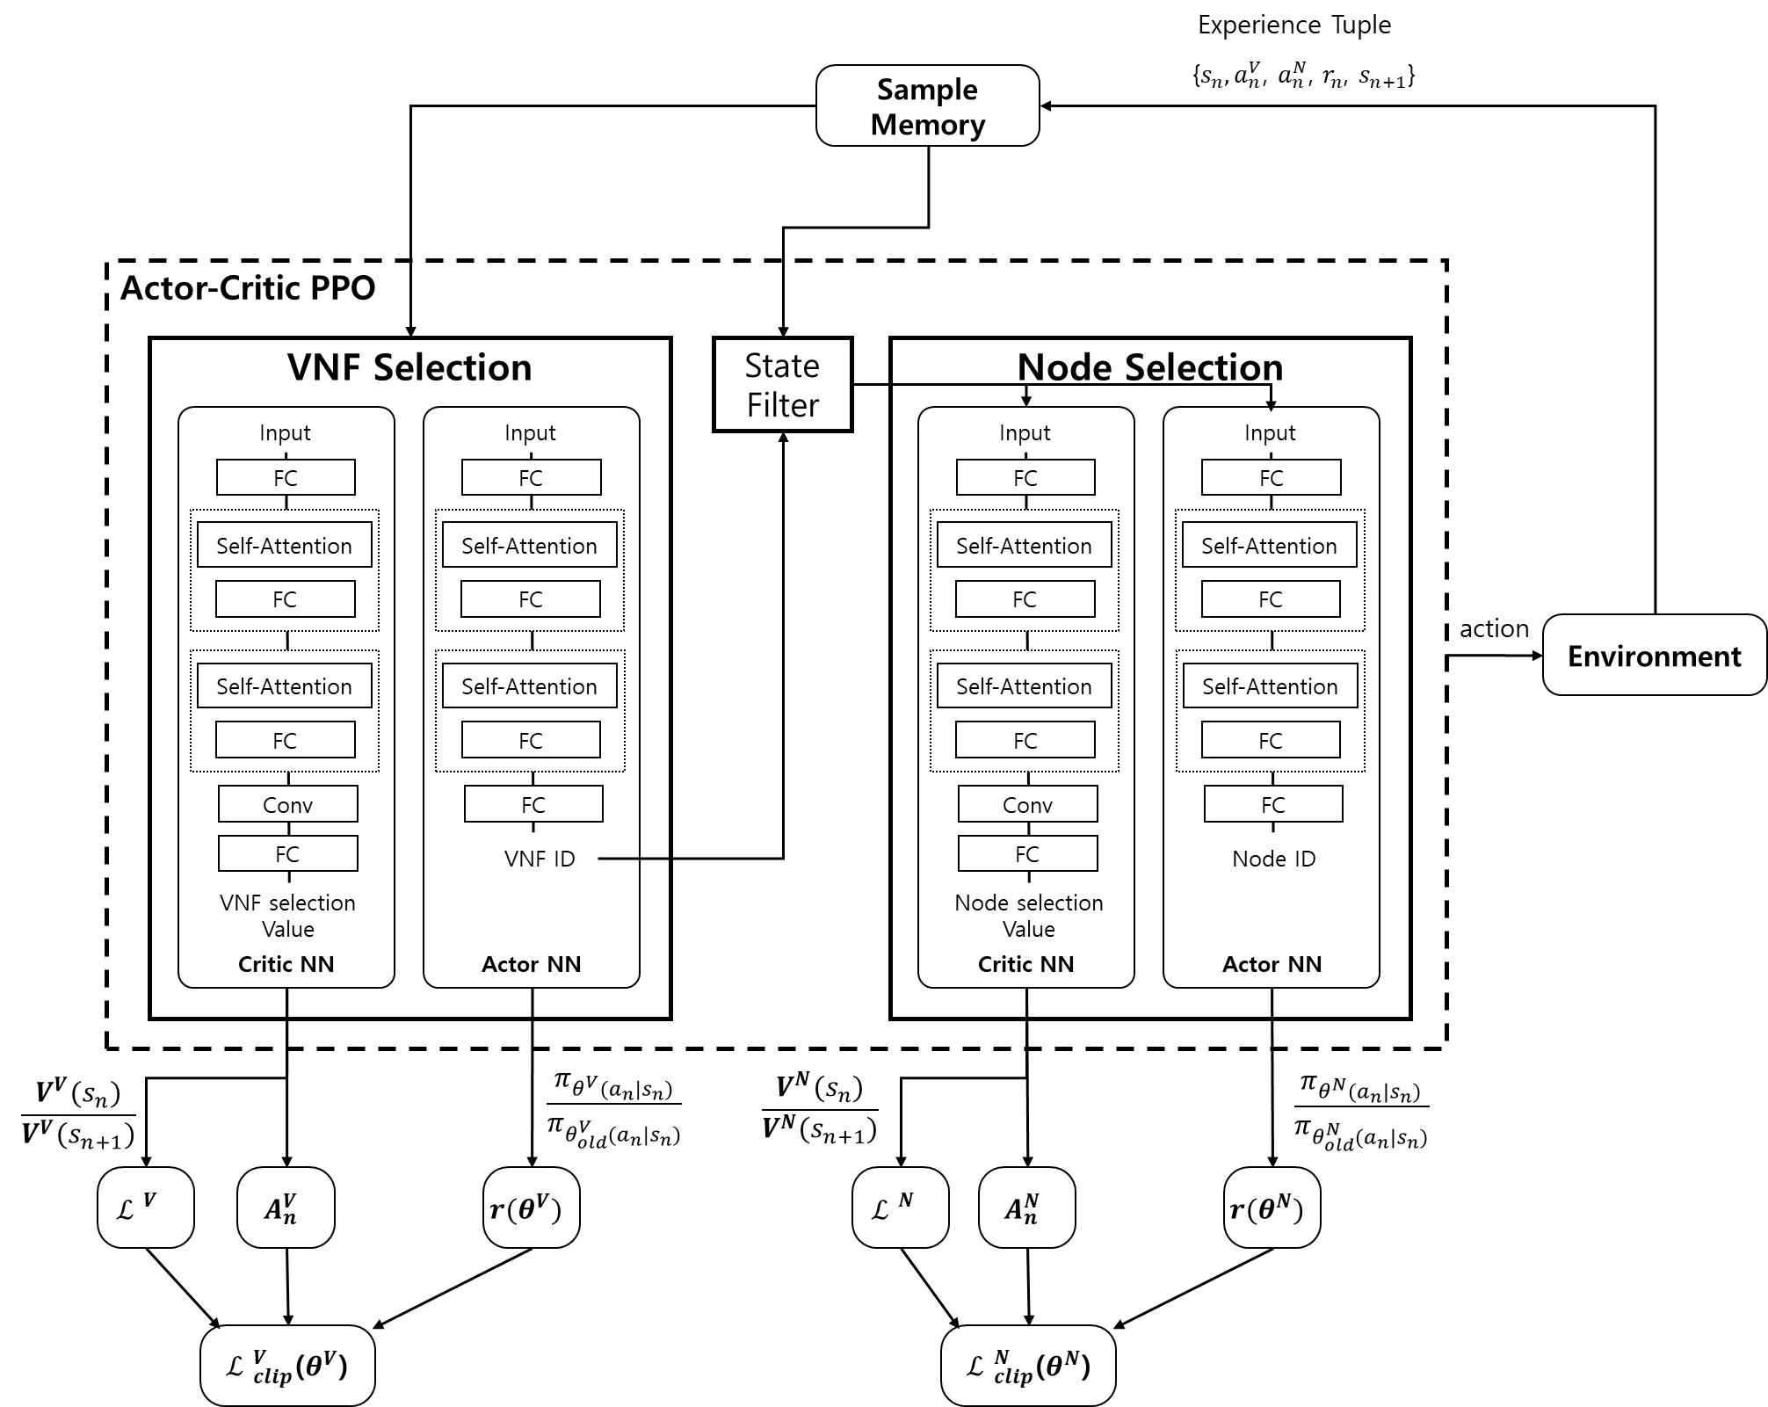
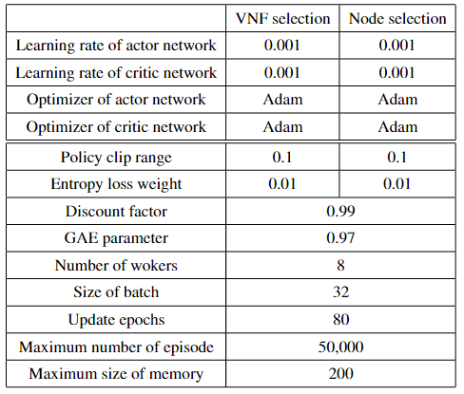
Implementation (6/6)
Consolidation
Two learning process
VNF selection, Node selection
Feature extraction, Self Attention Mechanism (SAM) for actor and critic network
Hyperparameter
PPO based VNF Consolidation

Slide 30
Table of Contents
Introduction
Background and Related Work
AI-based NFV Management and Orchestration
Implementation
Evaluation
Conclusion

Slide 31
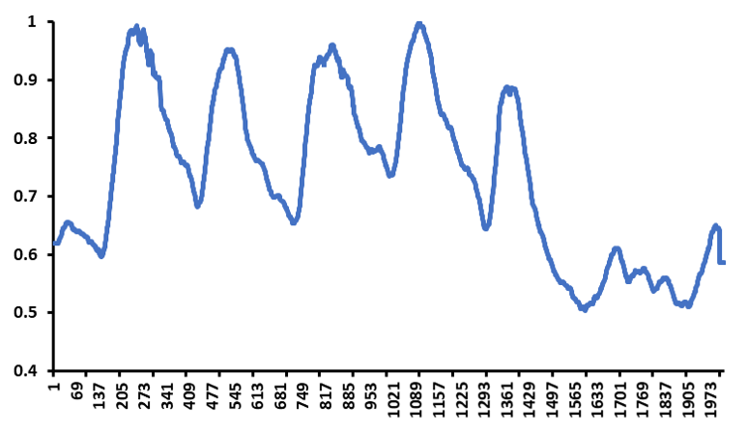
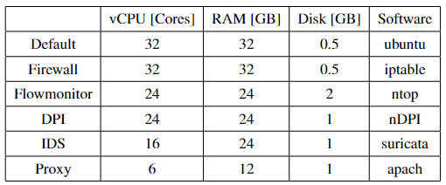
Evaluation (1/6)
Experiment Setup
Traffic Generator
NFVI supports to create test traffic using Iperf3
Traffic is generated as flow unit
Flows are generated following bandwidth fluctuation of Internet2
VNF specification
VNF flavors are deployed to setup required system resource
VNF image are deployed to install software and support network function
Bandwidth fluctuation of Internet2
Specification of VNFs

Slide 32
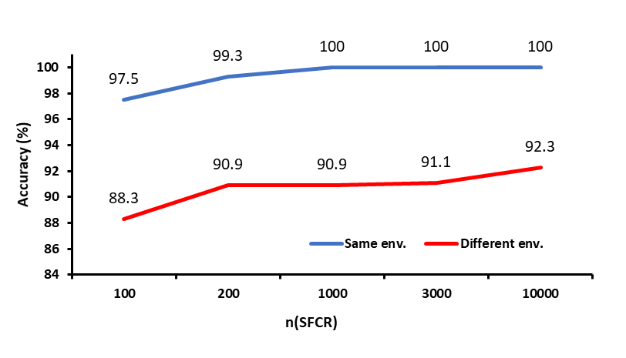
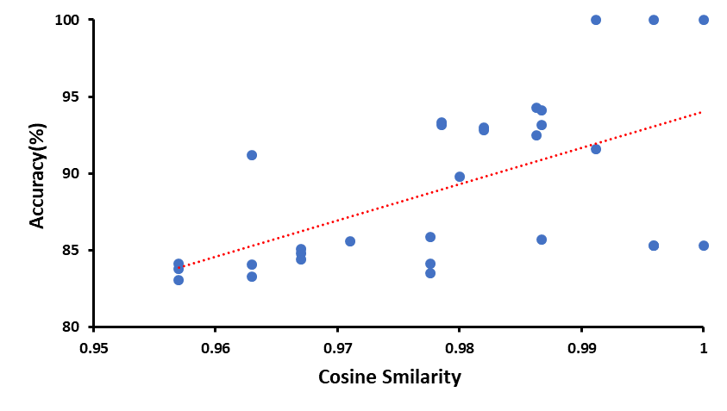
Evaluation (2/6)
VNF Deployment
Changing the number of variation of SFCR: 100, 200, 1000, 3000, 10000
Evaluating pre-trained model with different cosine similarity
Accuracy based on number of variation of SFCR
Accuracy based on Cosine Similarity

Slide 33
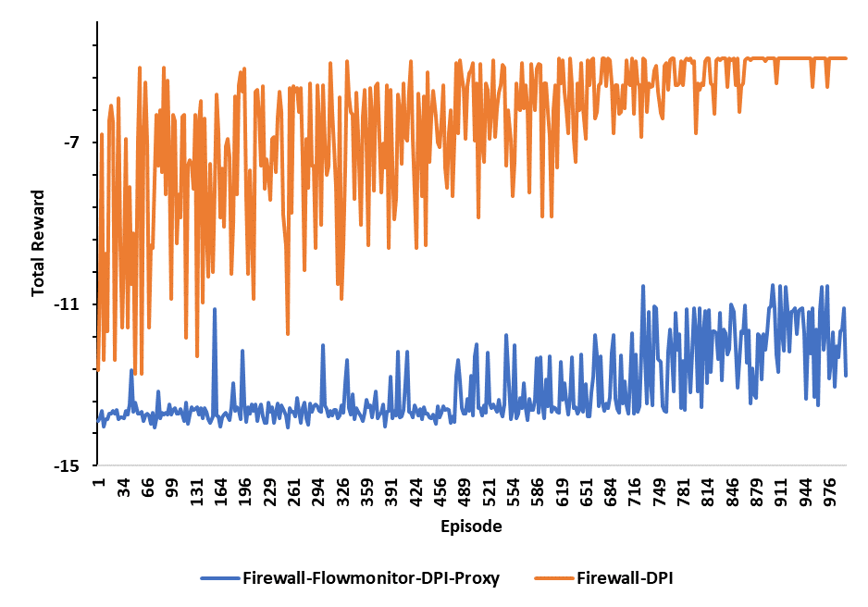
Evaluation (3/6)
Auto-scaling
Changing the type of SFC
Reward obtained per each episode

Slide 34
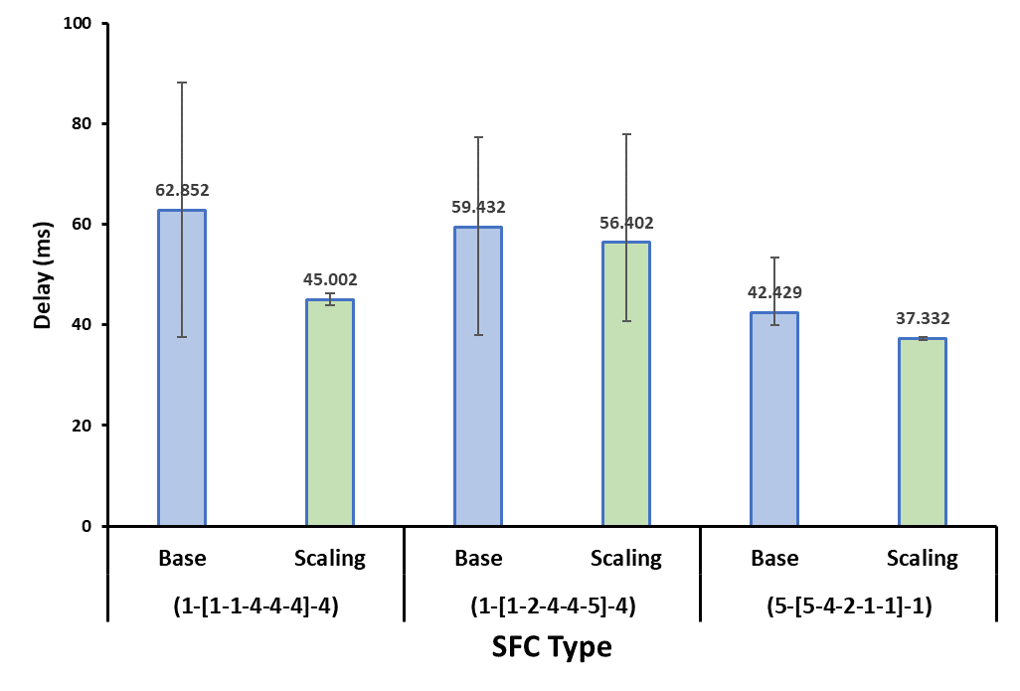
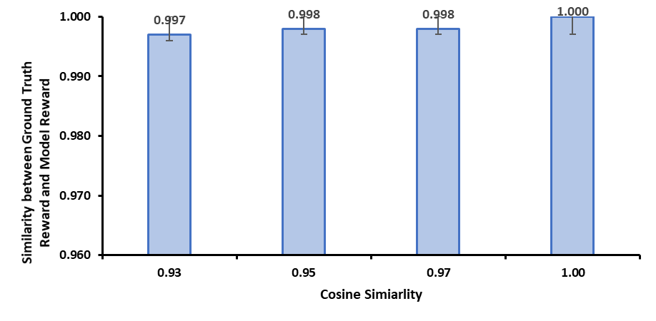
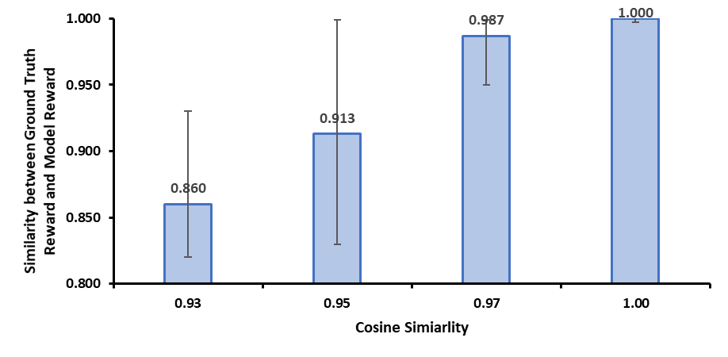
Evaluation (4/6)
Auto-scaling
Measuring delay based on SFC type
Evaluating pre-trained model with different cosine similarity
Cosine similarity with SFC
Cosine similarity with network environment
Delay measured based on SFC type
Performance difference based on cosine similarity
For SFC
Performance difference based on cosine similarity
For network environment

Slide 35
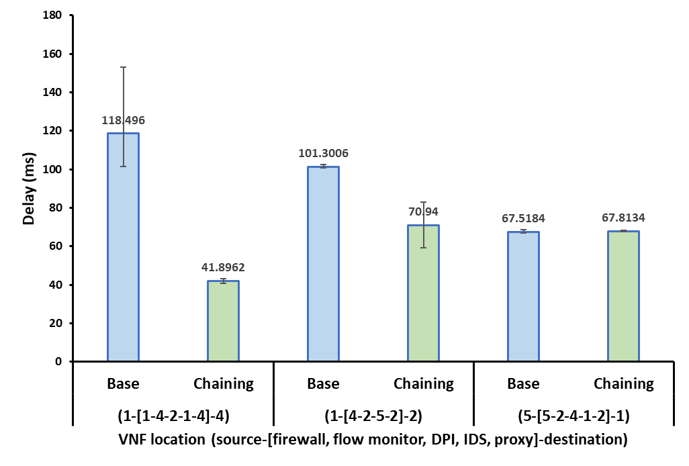
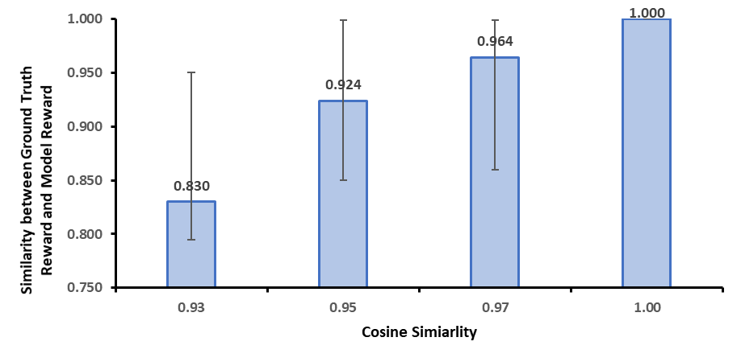
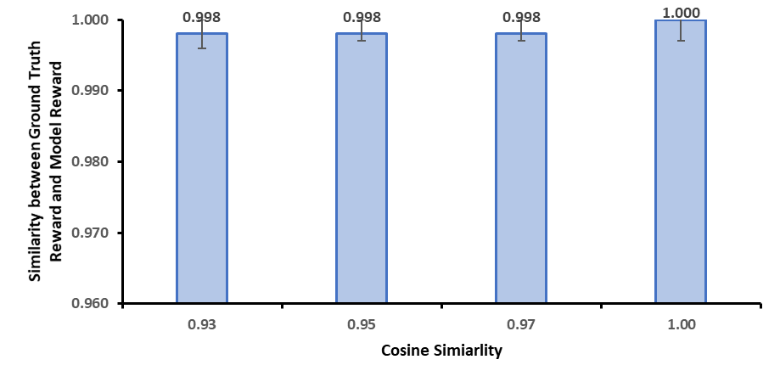
Evaluation (5/6)
Service Function Chaining
Measuring delay based on SFC type
Evaluating pre-trained model with different cosine similarity
Cosine similarity with SFC
Cosine similarity with network environment
Delay measured based on SFC type
Performance difference based on cosine similarity
for SFC
Performance difference based on cosine similarity
for network environment

Slide 36
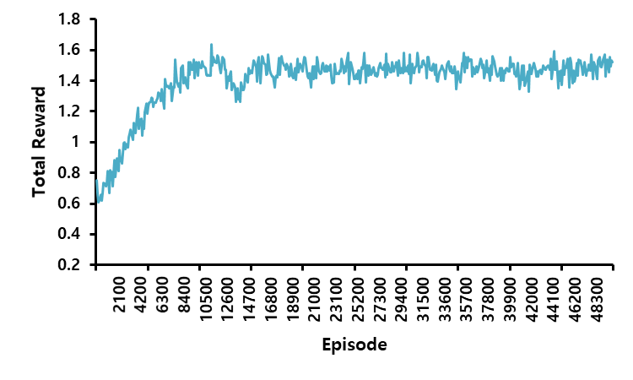
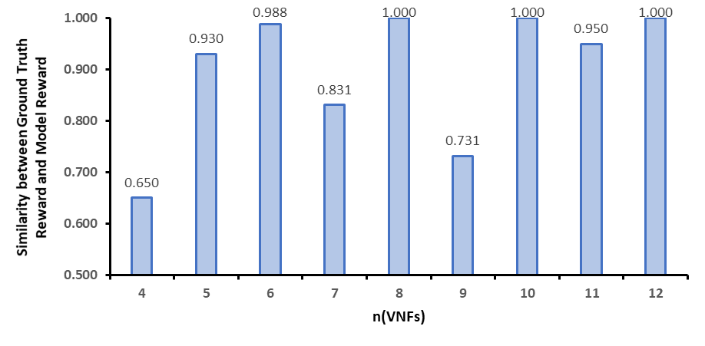
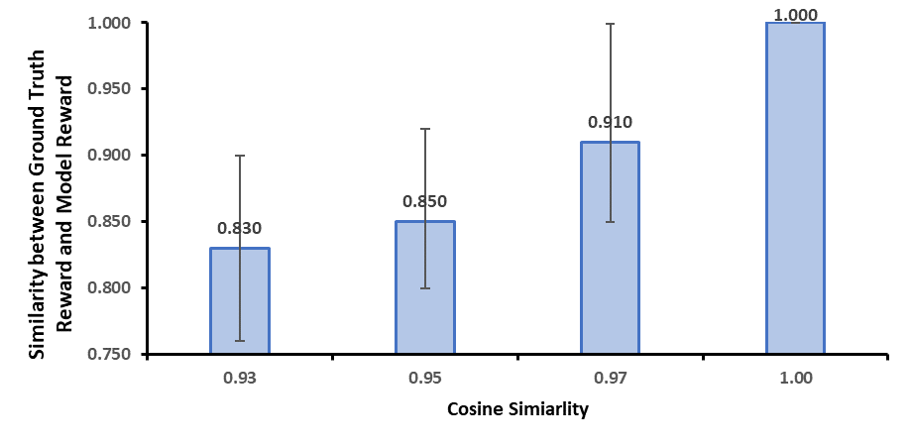
Evaluation (6/6)
Consolidation
Changing the number of VNFs: 4~12
Evaluating pre-trained model with different cosine similarity
Reward obtained per each episode
Performance difference based on the number of VNFs
Performance difference based on cosine similarity

Slide 37
Table of Contents
Introduction
Background and Related Work
AI-based NFV Management and Orchestration
Implementation
Evaluation
Conclusion

Slide 38
Conclusion
Summary
Automates data collection, preprocessing, and evaluation for VNF deployment, auto-scaling, service function chaining, and consolidation
AI-based NFV MANO provide NFV managements with high performance
Minimizes conflicts by using precise scope of each management function
Pre-trains models for various environments, ensuring optimal policies are always in place
Develop NFV digital twin system to simulates NFV environment for AI model training and proactive preparation
Receiving rate (14.1%), Loss rate (-3.3%), Delay (15.3%)
Future Work
Improve models adaptable to diverse network conditions
Implement mechanisms for continuous learning and adaptation
Validate system performance in various network scenarios to improve practical deployment

Slide 39
References
[1] Lange, Stanislav, et al. "Machine learning-based prediction of VNF deployment decisions in dynamic networks." 2019 20th Asia-Pacific Network Operations and Management Symposium (APNOMS). IEEE, 2019.
[2] Jeong, Seyeon, et al. "Machine learning based link state aware service function chaining." 2019 20th Asia-Pacific Network Operations and Management Symposium (APNOMS). IEEE, 2019.
[3] Chen, Jing, Jia Chen, and Hongke Zhang. "DRL-QOR: Deep reinforcement learning-based QoS/QoE-aware adaptive online orchestration in NFV-enabled networks." IEEE Transactions on Network and Service Management 18.2 (2021): 1758-1774.
[4] Jeong, Eui-Dong, Jae-Hyoung Yoo, and James Won-Ki Hong. "SDN Lullaby: VM Consolidation for SDN using Transformer-Based Deep Reinforcement Learning." 2023 19th International Conference on Network and Service Management (CNSM). IEEE, 2023.
[5] Opnfv, https://www.opnfv.org/
[6] Openbaton, https://github.com/openbaton
[7] Openstack tacker, https://wiki.openstack.org/wiki/Proposal_Tacker
[8] Soares, Joao, et al. "Cloud4nfv: A platform for virtual network functions." 2014 IEEE 3Rd international conference on cloud networking (cloudnet). IEEE, 2014.
[9] Experiential Networked Intelligence (ENI), https://www.etsi.org/technologies/experiential-networked-intelligence
[10] Stanislav Lange, Nguyen Van Tu, Se-Yeon Jung, Do-Young Lee, Hee-Gon Kim, Jibum Hong, Jae-Hyoung Yoo, James Won-Ki Hong, "A Network Intelligence Architecture for Efficient VNF Lifecycle Management", IEEE Transactions on Network and Service Management (TNSM) (SCIE), August 2020

Slide 40

Q&A

Slide 41

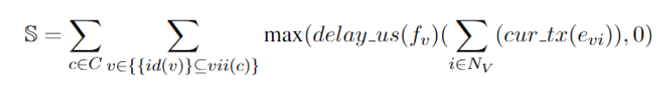

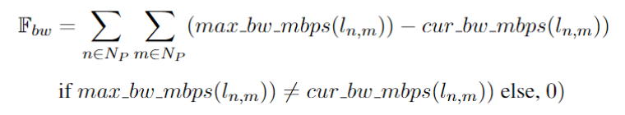
Appendix
Deployment ILP Equation
Energy consumption cost
Bandwidth cost
SLO violation cost
Resource fragment cost

Slide 42

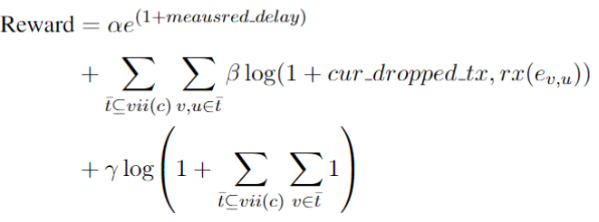
Appendix
Auto-scaling Macro Action
Scale-out cost function
Scale-in cost function
Resource utilization
Reward

Slide 43
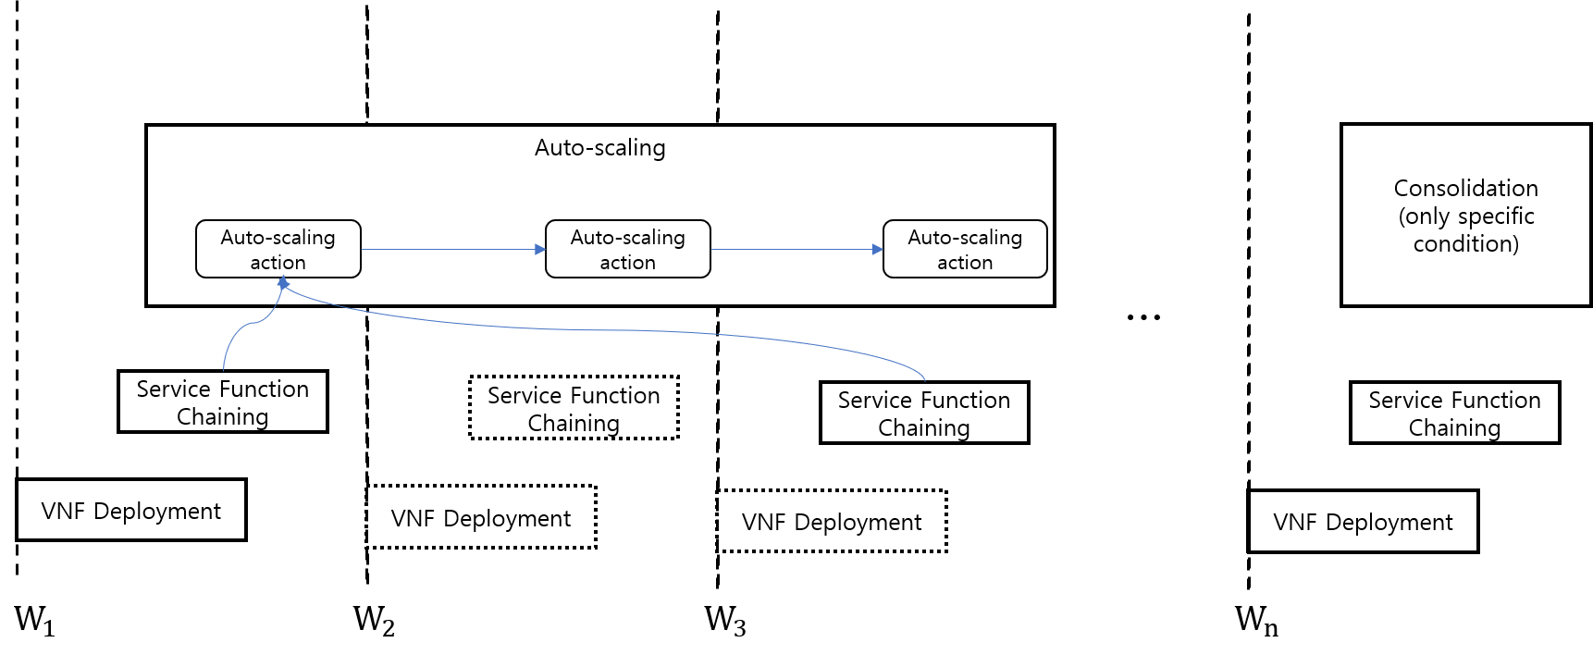
Appendix
Policy Controller

Slide 44
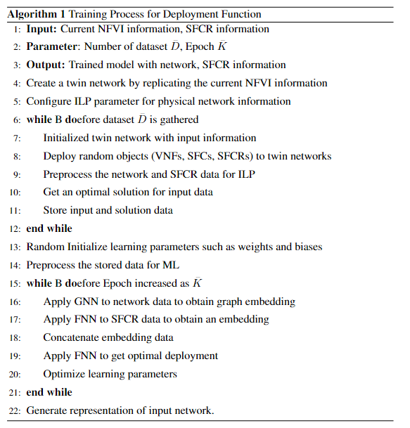
Appendix
Deployment Algorithm

Slide 45
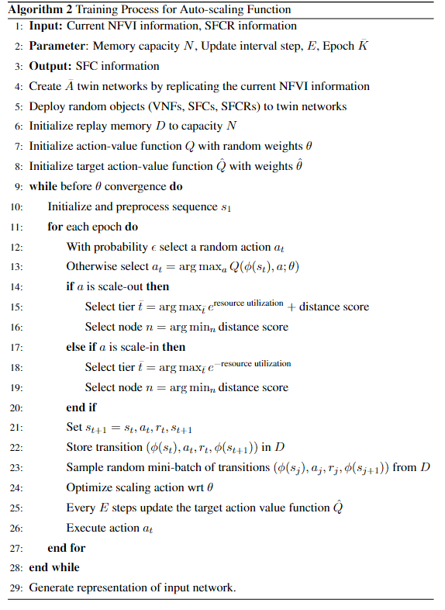
Appendix
Auto-scaling Algorithm

Slide 46
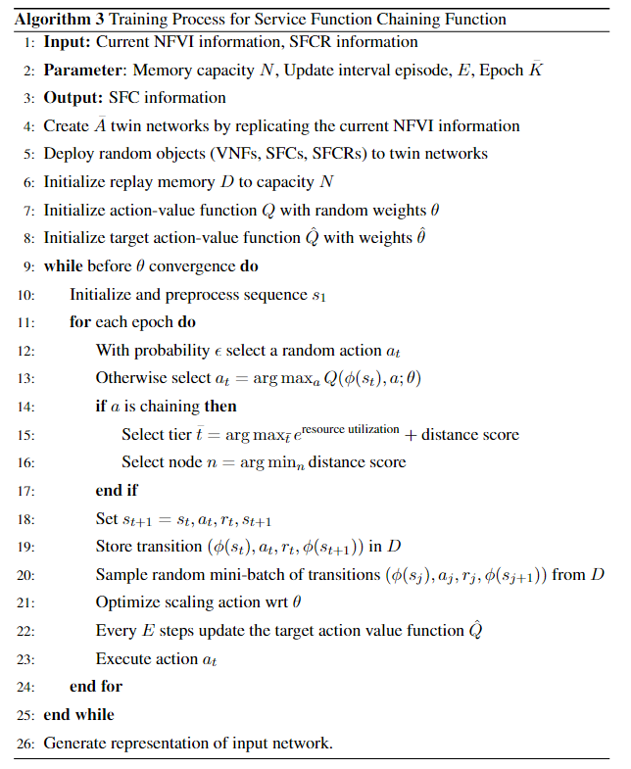
Appendix
Service Function Chaining Algorithm

Slide 47
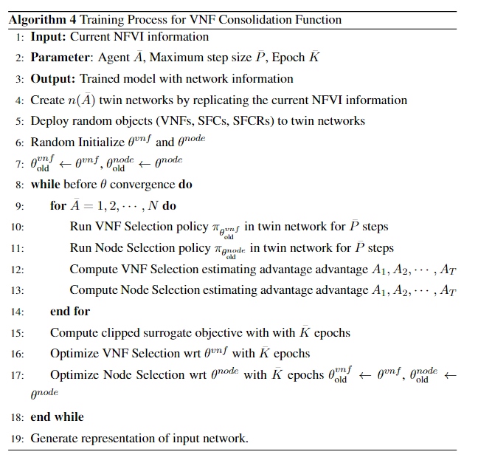
Appendix
VNF Consolidation Algorithm

Slide 48

Appendix
Openstack

Slide 49

Appendix
Swagger UI

Slide 50

Appendix
Grafana

Slide 51


Appendix
Power Management
 | Power Consumption (W) | After Consolidation (W) | Redemption (%)
1 | 614 | 199 | 67.59
2 | 619 | 302 | 51.21
3 | 613 | 298 | 51.39
Average | 615.3 | 266.3 | 56.73

