Slide 1
Dynamic Service Placement in
Edge Computing Environment using
Reinforcement Learning-based Live Migration
Ph.D. Thesis Defense

Slide 2
Table of
Contents
Introduction
Background and Related Work
Dynamic Service Placement Control using Reinforcement Learning-based Live Migration
Implementation
Evaluation
Conclusion

Slide 3
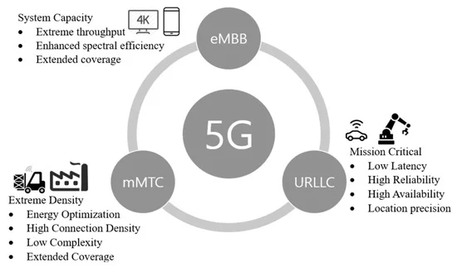
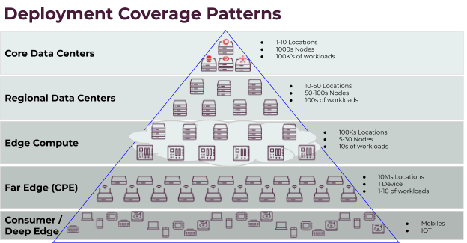
Introduction (1/6)
Edge Computing in 5G era
  Hierarchical structure of data center (DC) networks
    Resources distributed from network edges to core
  Different requirements of service applications and network functions
    Factory automation: <5ms latency, 99.9999% availability [11]
    AR/VR: 10ms latency, 1Gbps throughput
  Optimal service placement strategy can provide operators with improvement in QoS and resource mgmt.
Source: MIRANTIS
Source: Siddiqi et al. [1]
Notes:
https://www.mirantis.com/blog/edge-computing-challenges/
https://www.mdpi.com/2079-9292/8/9/981

Slide 4
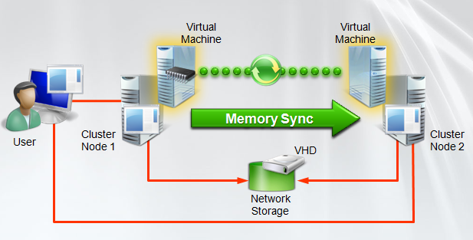
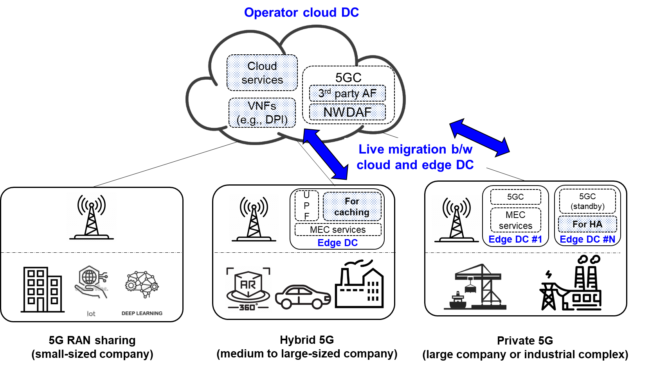
Introduction (2/6)
Source: Eduardo Popovici
Live Migration
  Moving a service instance (VM/container) to a remote host
  while preserving the availability
    vs. cold migration: service resumes with cold state
  Used for load balancing and system maintenance in DC
Live Migration in Private 5G
  Multi-access Edge Computing (MEC) allows
  service deployment in user/enterprise proximity
  Services can be dynamically placed among
  cloud DC and edge DCs via live migration
    Caching for low latency
    High Availability in case of failure
<VM live migration>
5GC: 5G Core Network
AF: Application Function
NWDAF: NetWork Data Analytics Function
Notes:
https://www.eduardopopovici.com/2018/07/migracao-ao-vivo-de-maquinas-virtuais.html
https://www.rfglobalnet.com/doc/g-core-network-architecture-network-functions-and-interworking-0001

Slide 5
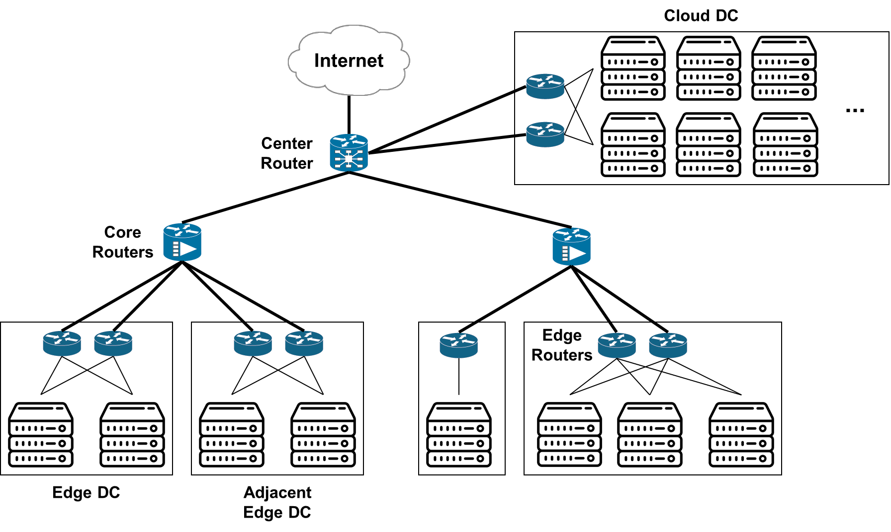
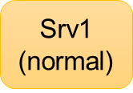
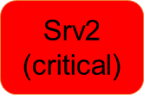
Introduction (3/6)
Edge Computing Dynamic Service Placement Scenario #1
  Possible migration policies
    Which services: Srv1
    When: before deployment of Srv2
    Where: cloud DC or adjacent edge DC
@T2: Srv1 migrated
to cloud DC
for high availability
@T0: Srv1 placed
in edge DC
for low latency
@T2: Srv1 migrated
to edge DC
for low latency
@T1: req. for Srv2
to dedicated server
Live Migration

Slide 6


Introduction (4/6)
Edge Computing Dynamic Service Placement Scenario #2
  Possible migration policies
    Which: Srv1, Srv2
    When: before failure of the host server
    Where:
    Srv1 ➔ cloud DC
    Srv2 ➔ adjacent edge DC
@T1: Srv2 migrated
to cloud DC
for high availability
@T0: server/network failure is predicted
@T1: Srv1 migrated
to edge DC
for low latency
Live Migration

Slide 7
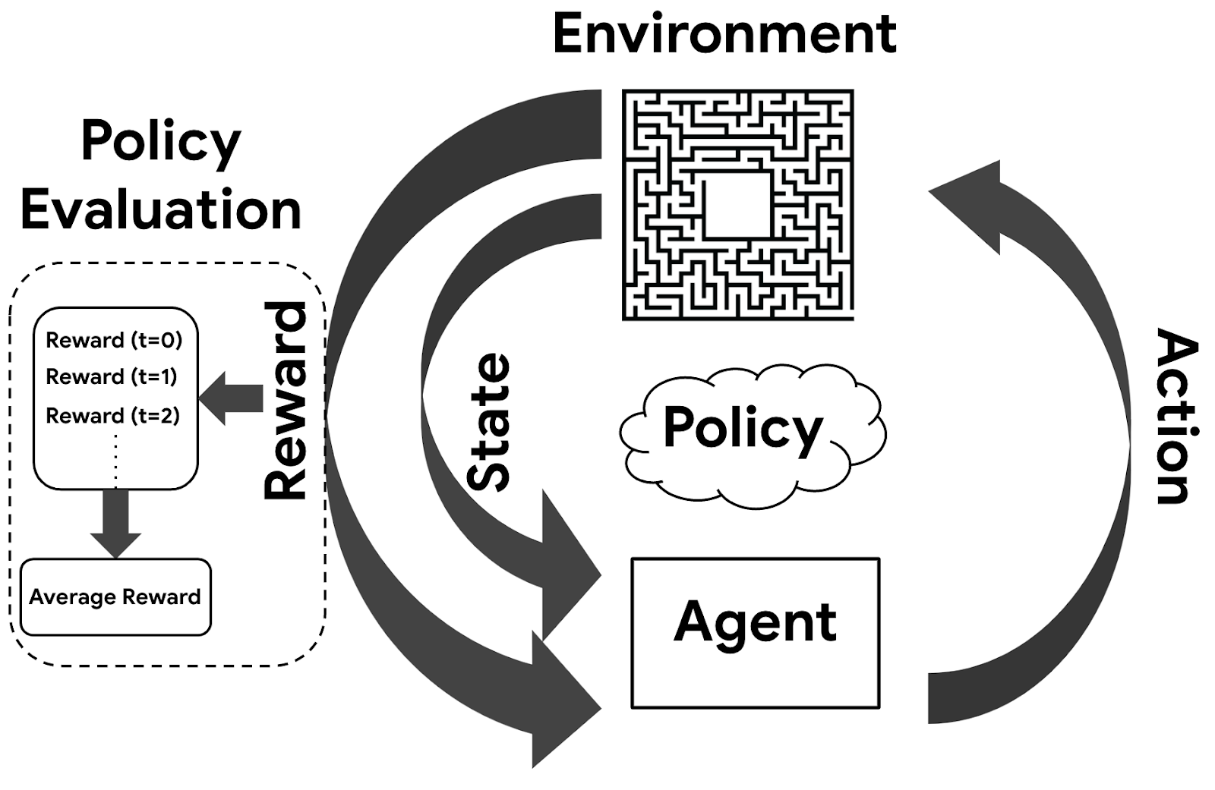
Introduction (5/6)
Problem Statement
  Edge computing environment with multiple host servers across cloud DC and edge DCs
  Service instances with different SLAs, request arrivals, user locations and demanding resources
  Dynamic service placement to maximize the objective function
Research Goals
  Derive optimized migration policy using Deep Reinforcement Learning (DRL)
    Dynamics of edge computing environment ➔ RL environment, RL state
    Live migration controller (policy generator) ➔ RL agent
    A series of dynamic service placement decisions ➔ RL policy
    Live migration by placement decision ➔ RL action
    Evaluation of the benefit of live migration ➔ RL reward
  Evaluate the performance gains by dynamic service placement
    vs. static service deployment
Source: Google AI Blog
Notes:
https://ai.googleblog.com/2020/04/off-policy-estimation-for-infinite.html

Slide 8
Introduction (6/6)
DRL-based Dynamic Service Placement
Srv1
Srv2
Srv5
Srv2
Srv4
Srv1
Srv1
Srv3
Srv5
Srv3
Srv2
Srv4
<Static service deployment>
<Dynamic service placement via live migration>
Solution: there exists a sequence of migrations for max performance, depending on service request patterns
How to quickly search the policy space in complex scenario?
  Linear programming / meta heuristic ➔ not robust to environment dynamics (server failure, unseen service requests, etc.)
DRL can approximate the optimal policy by training Deep Neural Network from iterative interaction w/ env.

Slide 9
Table of
Contents
Introduction
Background and Related Work
Dynamic Service Placement Control using Reinforcement Learning-based Live Migration
Implementation
Evaluation
Conclusion

Slide 10
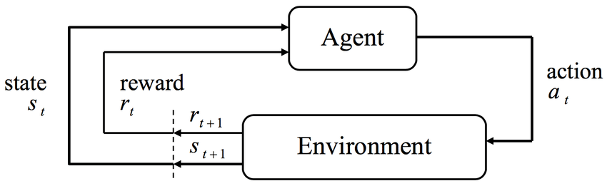

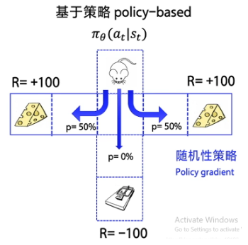

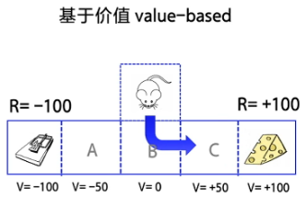



Background
Deep Reinforcement Learning (DRL)
  Agent: given observed state $st$, takes action $at$ by Policy
  Policy $π\left(st,at\right)=P(at|st)$ is represented by Agent’s DNN
  Environment: sends reward $rt$ and next state $s\text{t}\text{+}1$ to Agent
Value-based Agent
  Deep Q-Network (DQN) algorithm
    Mostly takes action w/ max Q (exploitation) vs. rarely random action (exploration)
    Approximates Q-function by updating DNN
Actor-Critic Algorithm
  Loss function of policy-based algorithm
  Uses two DNNs; Actor (policy) + Critic (value)
<RL framework>
Policy-based Agent
  Sample action ~$P\left(A | st\right)$
  Adjust prob. of taking action
  according to cumulative reward $Rt$
$$Q\left(st,at\right)=E\left[Rt \right| st,at]=E\left[r\text{t}\text{+}1+r\text{t}\text{+}2+r\text{t}\text{+}3…\right]=E\left[r\text{t}\text{+}1+R\text{t}\text{+}1\right]$$
<Policy-based>
<Value-based>
$$L=−Rt∗\log{π\left(st, at\right) }$$
Source: Programmer Group
Notes:
https://programmer.group/pg-algorithm-based-on-policy-gradient.html

Slide 11
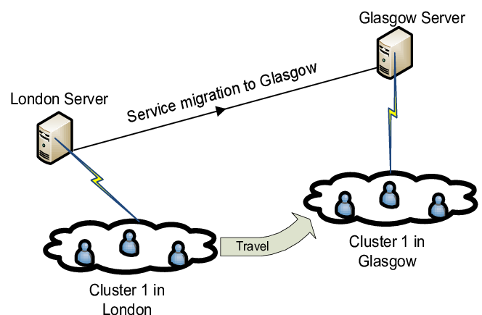
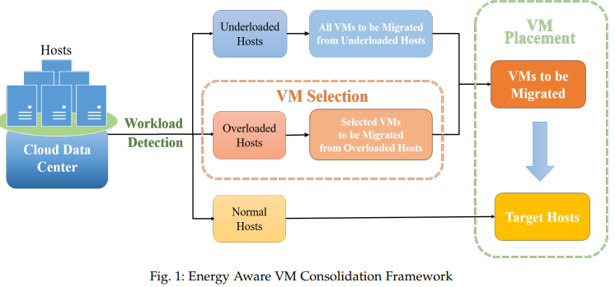
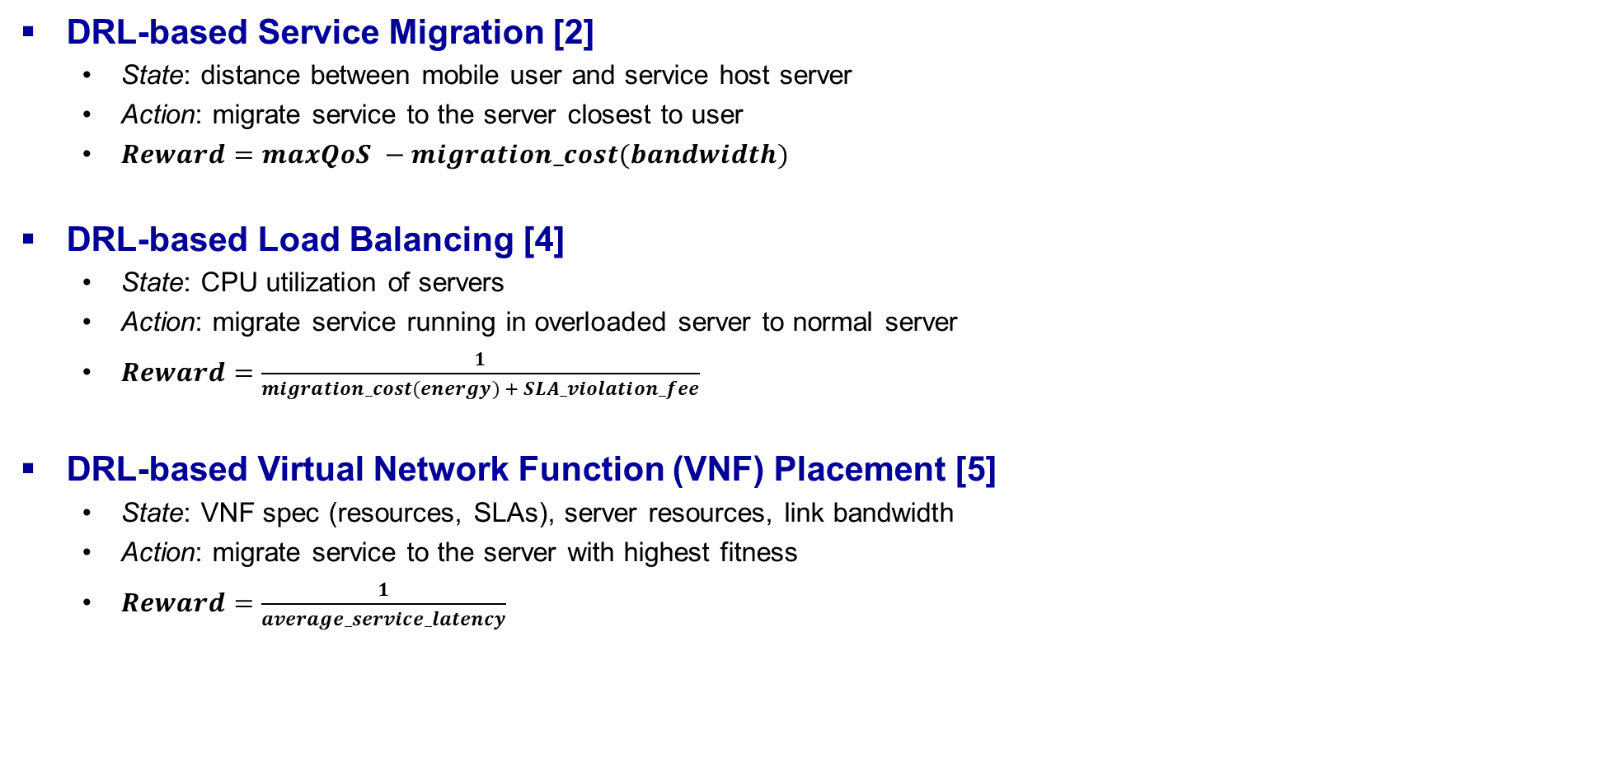
Related Work (1/2)
DRL-based Service Migration [2]
  State: distance between mobile user and service host server
  Action: migrate service to the server closest to user
  $Reward=maxQoS −migration_cost(bandwidth)$
DRL-based Load Balancing [4]
  State: CPU utilization of servers
  Action: migrate service running in overloaded server to normal server
  $Reward=\frac{1}{migration_cost(energy) + SLA_violation_fee}$
DRL-based Virtual Network Function (VNF) Placement [5]
  State: VNF spec (resources, SLAs), server resources, link bandwidth
  Action: migrate service to the server with highest fitness
  $Reward=\frac{1}{average_service_latency}$
<Service migration>
<Load balancing via migration>
Notes:
Image source: https://www.researchgate.net/figure/Service-migration-example_fig3_267253125

Slide 12
Related Work (2/2)
<Comparison of related work in DRL-based dynamic service placement via migration >
Reference | DRL algorithm | State | Action | Reward (objectives) | Support concurrent migration | Consider SLA latency | Consider SLA availability | Edge computing topology
Zhang et al. 2019 [2] | DQN | Distance b/w user and service | Migrate service to closest server | Min. BW consumption | X | X | X | O
Wang et al. 2020 [3] | DQN | Service delay, # of service request, VM size | Migrate service to server whose migration cost is least | Min. service latency, Min. BW consumption | O | X | X | O
Zeng et al. 2022 [4] | DQN | Predicted server loads | Migrate service in overloaded server to another | Min. energy consump., Min. # SLA violation (CPU util. 100%) | O | X | O | X
Dalgkitsis et al. 2020 [5] | DDPG | VNF request, Server loads, Link BW | Migrate VNF to server w/ highest fitness | Min. service latency | O | O | X | O
Dai et al. 2021 [6] | Multi-agent Actor-Critic | Service request, Server loads | Migrate service to server w/ highest fitness | Min. BW consump. | O | O | X | X
Proposed | Multi-agent DQN / Actor-Critic | Service request (spec), DC loads | Migrate service to DC w/ highest fitness | Min. service latency, Max. service availability | O | O | O | O

Slide 13
Table of
Contents
Introduction
Background and Related Work
Dynamic Service Placement Control using Reinforcement Learning-based Live Migration
Implementation
Evaluation
Conclusion

Slide 14
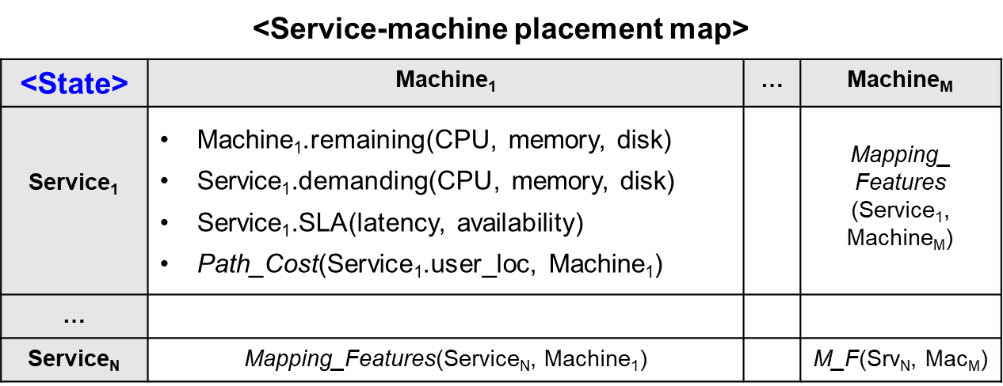
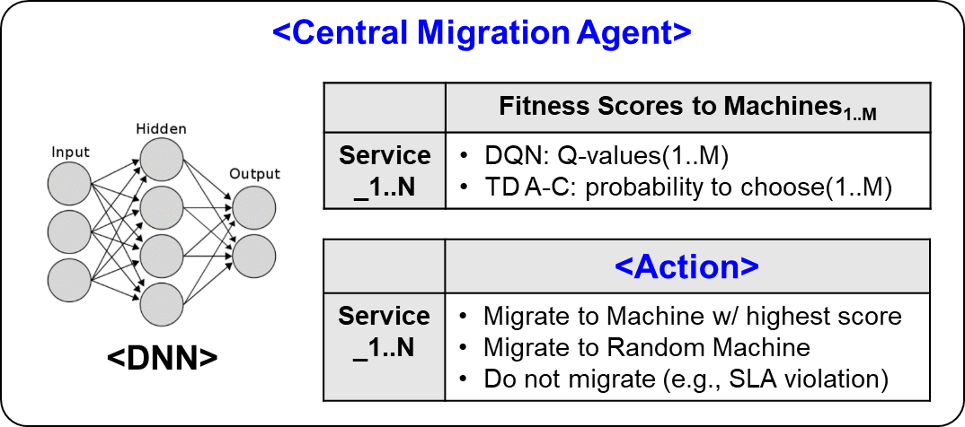
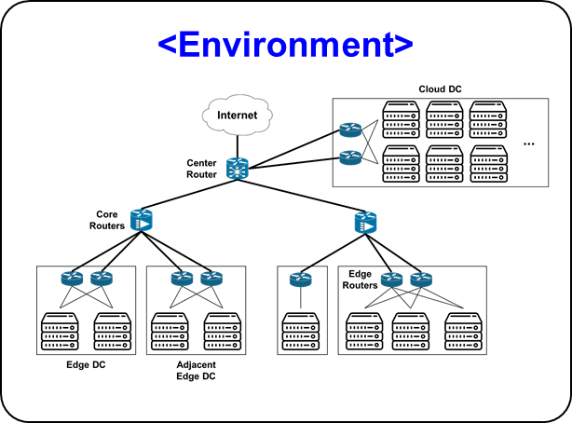
Design of Dynamic Service Placement Control (1/5)
Single-agent DRL Model for Dynamic Service Placement
  Service-machine map includes current metric to evaluate fitness b/w services and machines
  Fitness score of each service-machine pair represents how well they are matched in the given state (context)
  Placement criteria: a service instance should be placed in the machine with highest fitness score
② Input to Agent
① Monitored observation
⑥ Generate Reward
⑦ Update policy (DNN)
③ Compute fitness
⑤ Perform
live migration of Service_{1..n}
④ Generate action

Slide 15
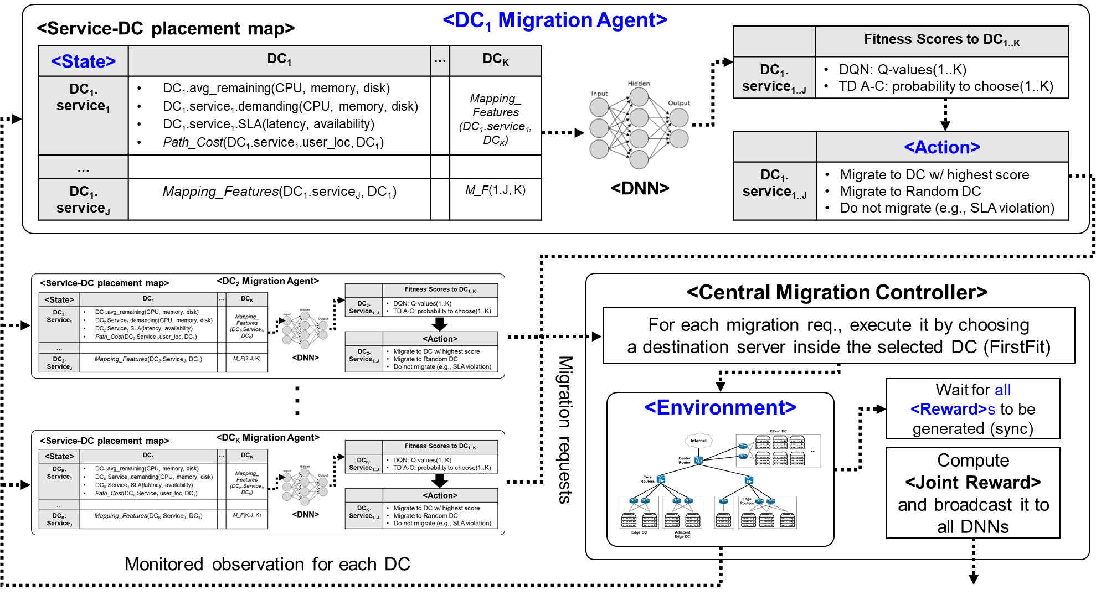
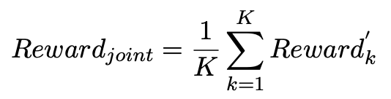
Design of Dynamic Service Placement Control (2/5)
Multi-agent DRL Model for Dynamic Service Placement (proposed) ➔ Scalability
  Assign a dedicated migration agent to each (edge) DC in edge computing env.
  Each agent (DNN) makes placement decisions between its local services and destination DCs (not machines)
  Central migration controller arbitrates concurrent behavior of multiple agents (e.g., reward in whole system perf., conflict)

Slide 16
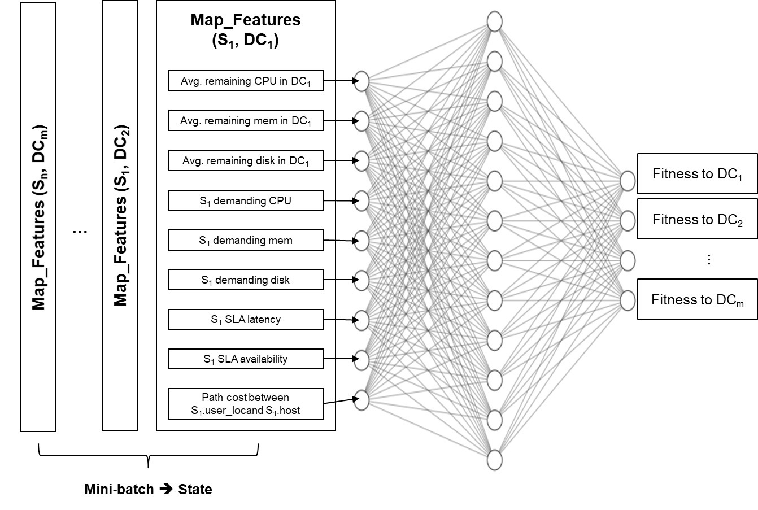

Design of Dynamic Service Placement Control (3/5)
Multi-agent DRL Model for Dynamic Service Placement (proposed)
  Map_Features: feature vector to represent fitness between service and DC
  State size per agent
    Single-agent model: $\# of all services \left(N\right)∗\# of all machines \left(M\right)∗length(Map_Features$)
    Multi-agent model: $\# of DC local services \left(n\right) ∗ \# of all DCs \left(m\right)∗length(Map_Features$)

Slide 17
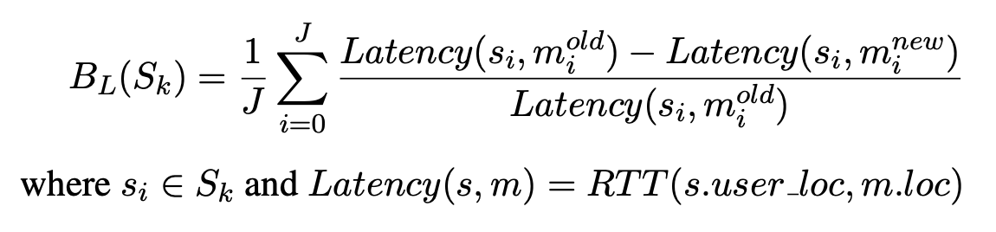
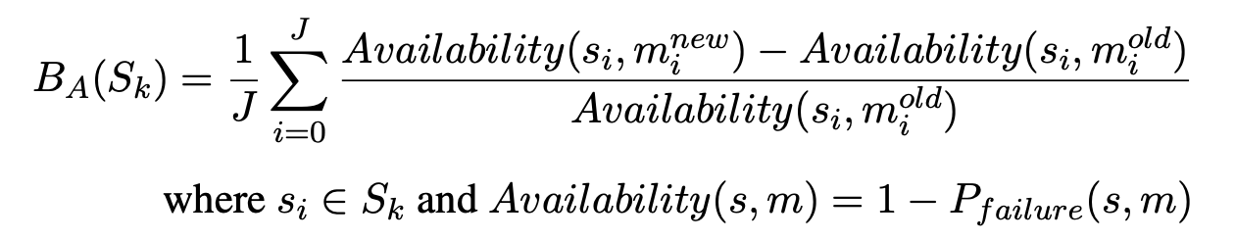
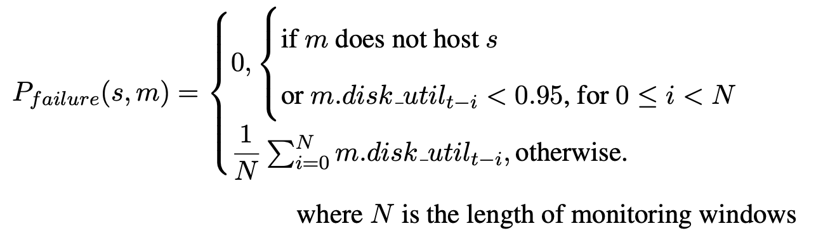
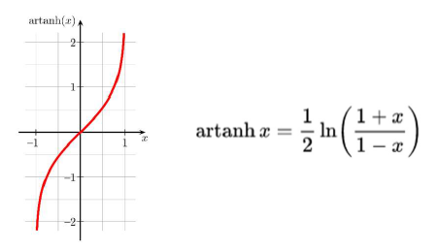
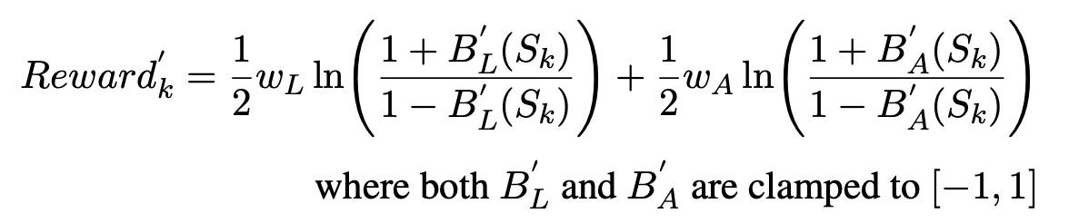

Design of Dynamic Service Placement Control (4/5)
Reward Model
  $Rewardk=wLBL+wABA$ ➔ avg. service latency benefit + avg. service availability benefit
    Evaluate performance benefit before and after migration actions by Agent_{k}
  Server/service availability
    If a server shows 95% disk utilization for N monitoring intervals in a row, treat the server as failed with its running service instances [7]
    Stability of storage is highly related to live migration since
    NAS (Network Attached Storage) is effective inside a DC
  Reward calibration
    Project Reward_{k} on
    a non-linear function
    to accelerate learning

Slide 18
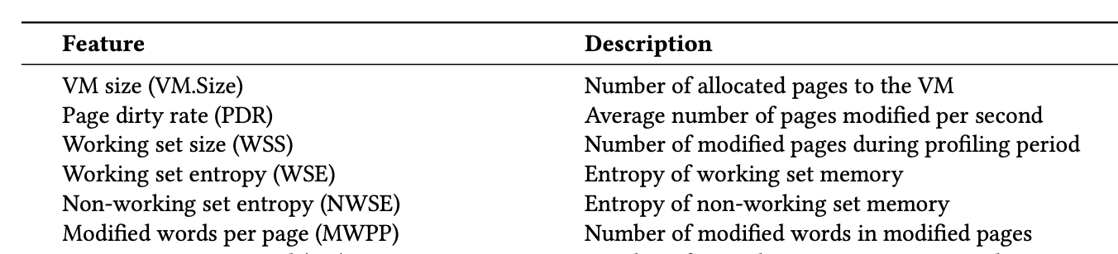
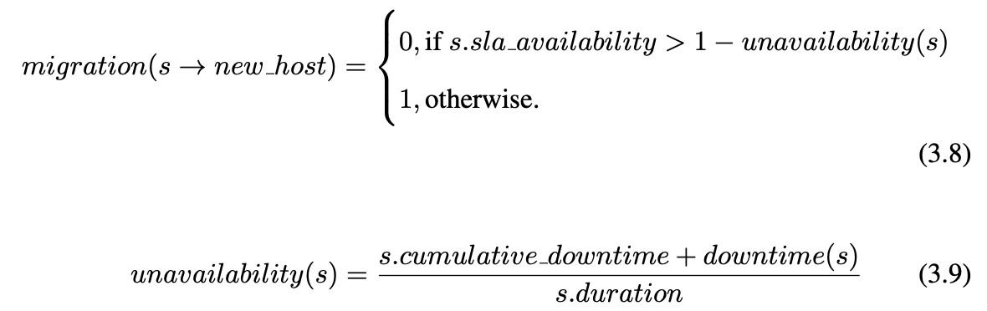
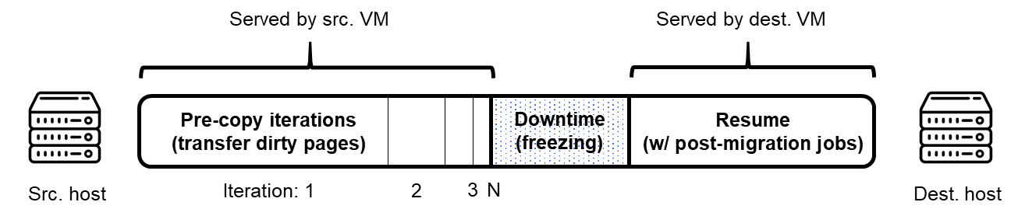
Design of Dynamic Service Placement Control (5/5)
Migration Cost Model
  Live migration service downtime
    Live migration in real cloud operating system (e.g., OpenStack) involves service downtime of 500~2000ms [8]
      Post-migration overhead: binding virtual network interfaces, IP address reconfiguration (DHCP), etc.
    Relate estimated migration downtime to memory usage intensity of the service app. and network condition
Source: Jo et al. [9]
$downtime\left(s\right)= \frac{s.memory}{s.duration} ∗ \frac{1}{avail. BW}+constant_postmig$
  Condition to permit migration
    If the migration action is expected to violate SLA, revoke the action (“do not migrate”) ➔ reduce # of total migrations
<Features related to migration downtime>
SLA availability (e.g., 99.9%)
Ratio of downtime over total service duration (e.g., 0.2%)
<VM live migration (pre-copy)>

Slide 19
Table of
Contents
Introduction
Background and Related Work
Dynamic Service Placement Control using Reinforcement Learning-based Live Migration
Implementation
Evaluation
Conclusion

Slide 20
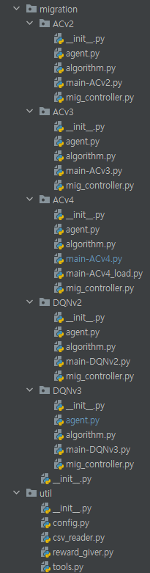
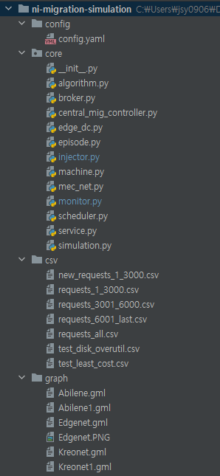
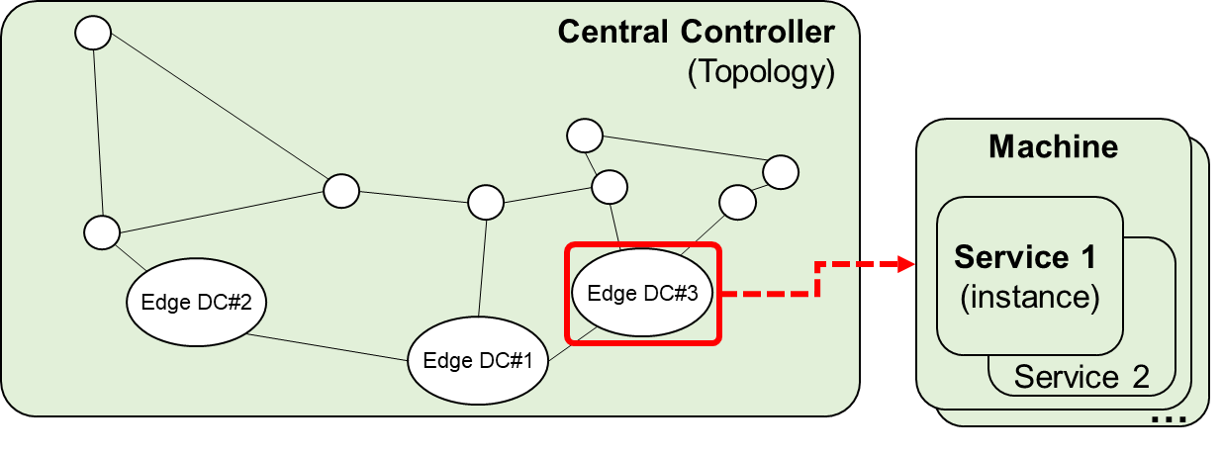
Implementation (1/5)
Edge Computing Simulator
  Supports development of service orchestration algorithms and
  evaluation in edge computing environment
    Library: SimPy, NetworkX, PyTorch, scikit-learn, NumPy
  Edge computing components
    Python objects to abstract topology, service instances, machines,
    resources and migration controller
https://github.com/dpnm-ni/ni-migration-simulation-public

Slide 21
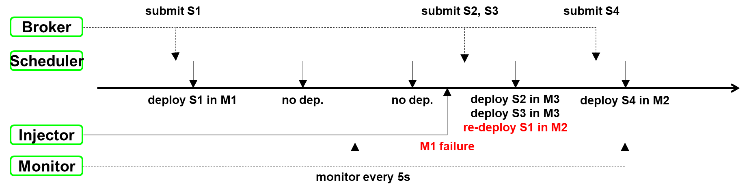
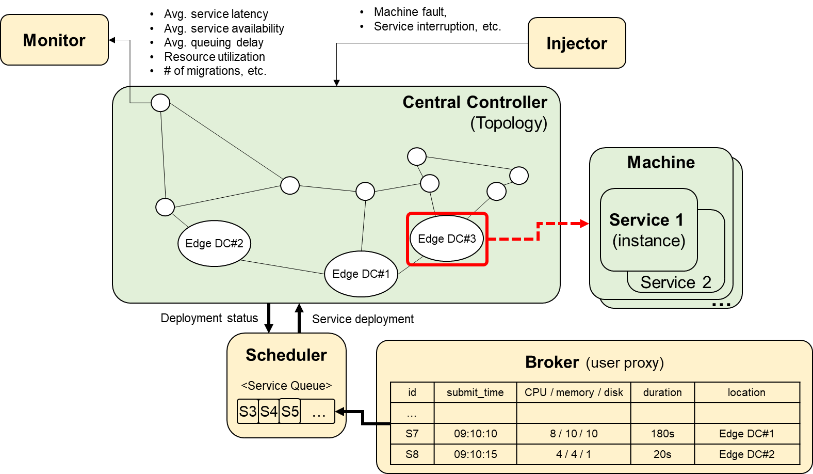
Implementation (2/5)
Edge Computing Simulator (cont’d)
  Simulation components
    SimPy processes aligned with the common simulation timeline
    Event-driven discrete simulation for service request arrival, service deployment, server failure, etc.

Slide 22
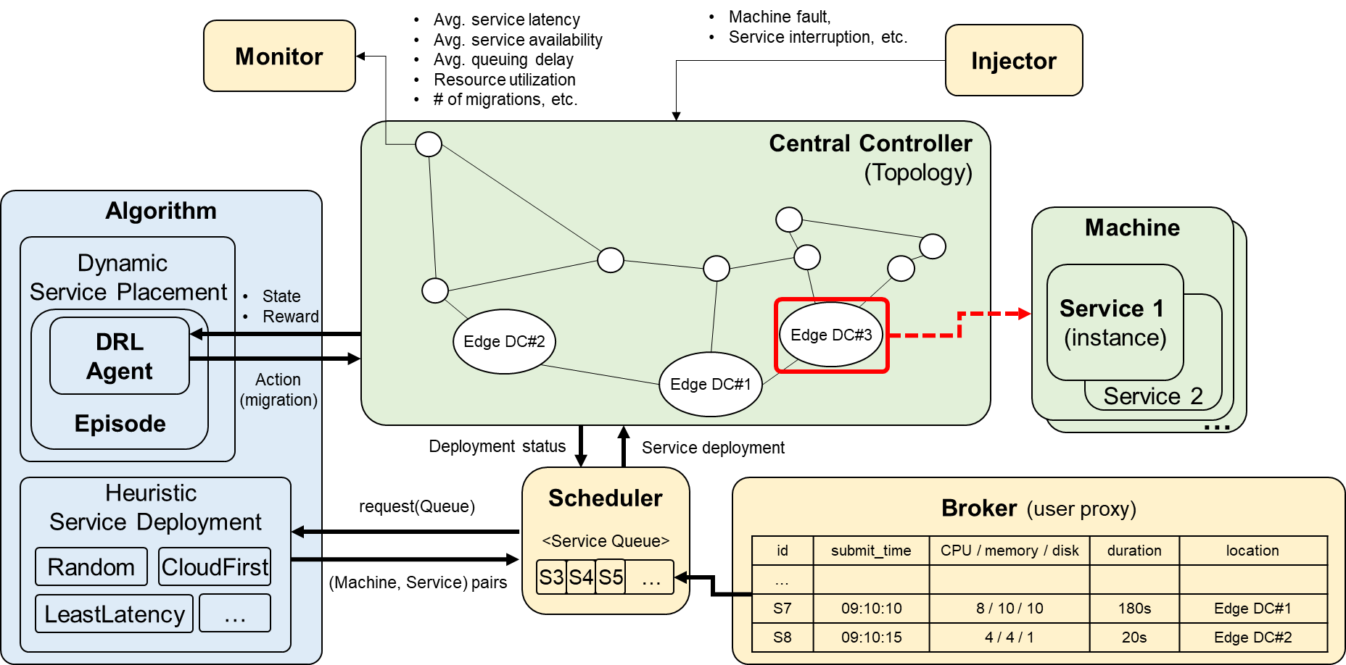
Implementation (3/5)
Edge Computing Simulator (cont’d)
  DRL components
    Python objects and deep learning framework to support development of DRL-based service orchestration algorithms

Slide 23
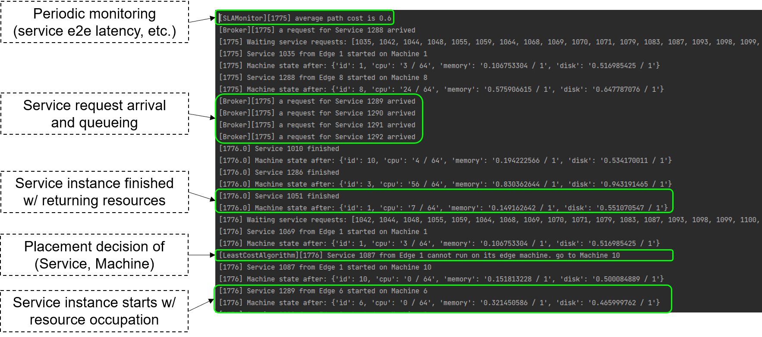
Implementation (4/5)
Edge Computing Simulator (cont’d)

Slide 24
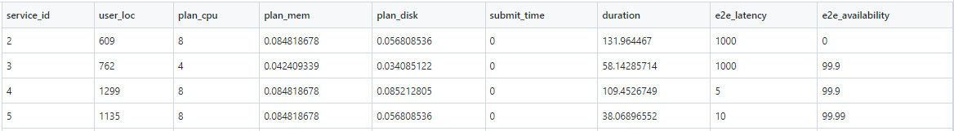
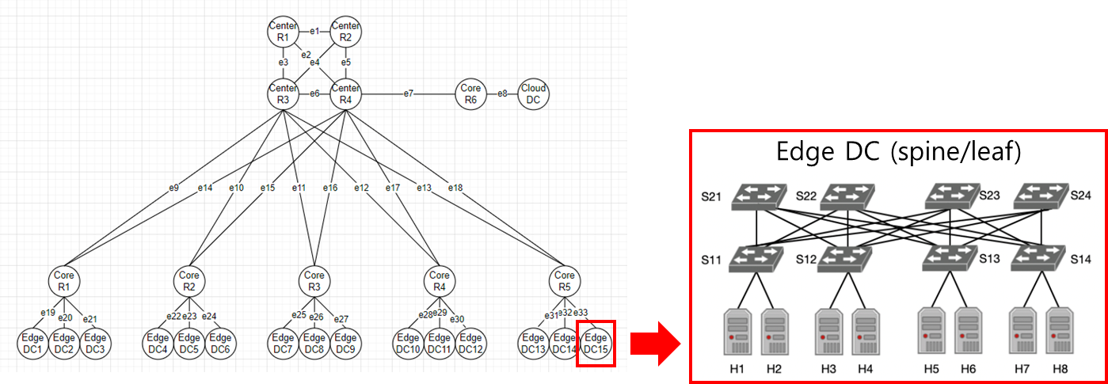
Implementation (5/5)
Reference Topology and Service Requests
  1 cloud/central DC: large resource capacity, high end-to-end latency
  15 edge DCs: small resource (➔high failure prob.), low end-to-end latency
Service request records in Alibaba’s production DC [10]
➔ Convert to MEC service requests w/ SLAs and user location [11]
Baseline service deployment along w/ request arrival
(Random, CloudFirst, LeastLatency)
DRL-based live migration alg.
Monitoring/
fault injection

Slide 25
Table of
Contents
Introduction
Background and Related Work
Dynamic Service Placement Control using Reinforcement Learning-based Live Migration
Implementation
Evaluation
Conclusion

Slide 26
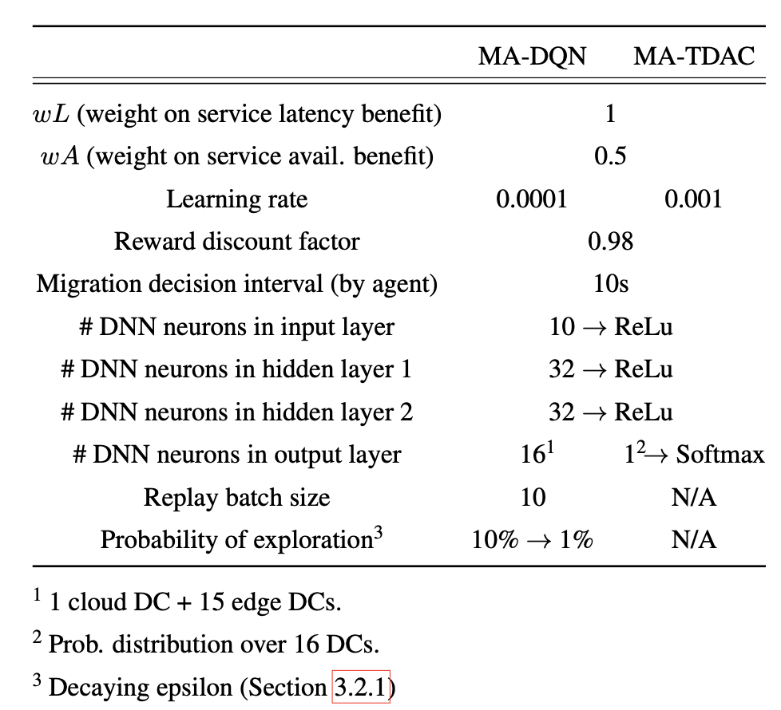
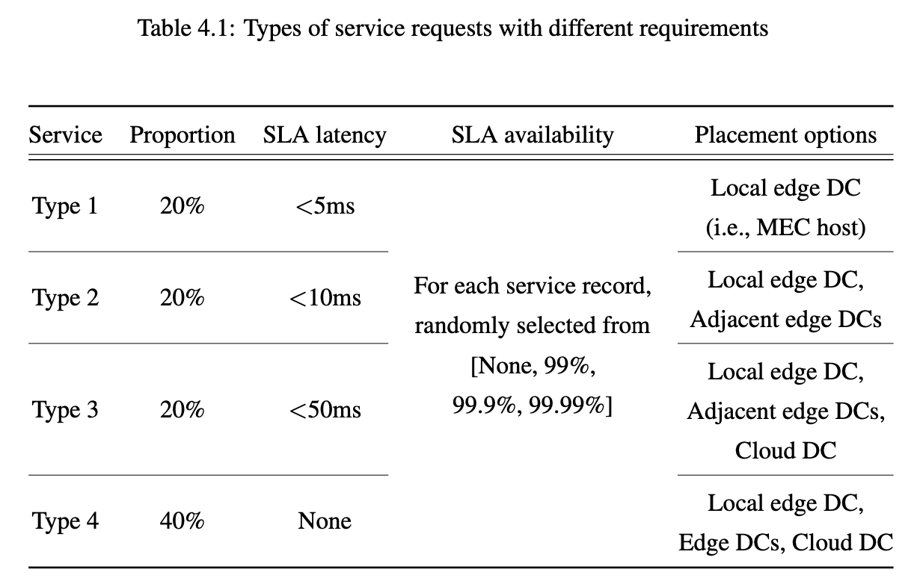
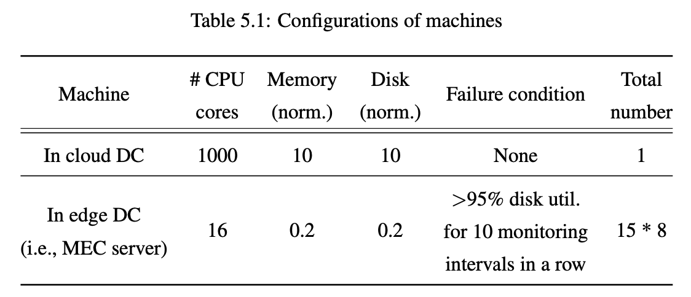
Evaluation (1/6)
Experiment Setup
  Simulator runs in a commodity server
    36 CPU cores from two Intel Xeon Gold 5220 sockets (2.2GHz), 64GB RAM
  Scenario
    1000 service requests are instantiated (deployed) in machines (Table 5.1)
    Service types are different in SLAs and placement options (Table 4.1)
    One episode lasts from arrival of the first request to finish of the last service
      DRL agents interact w/ env. every migration decision interval (10s)

Slide 27
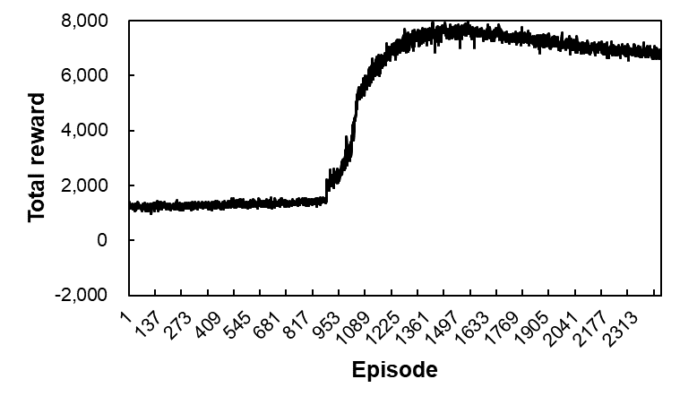
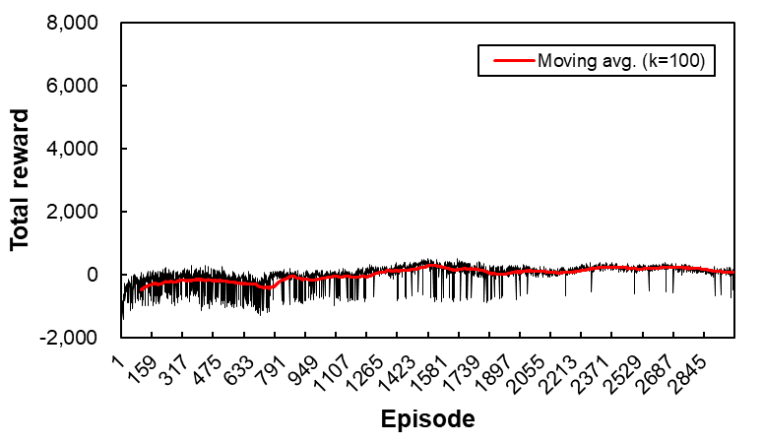
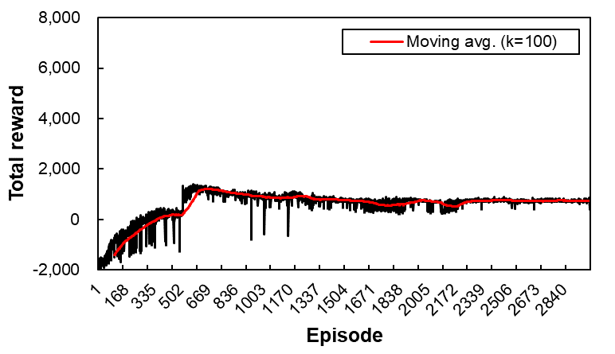


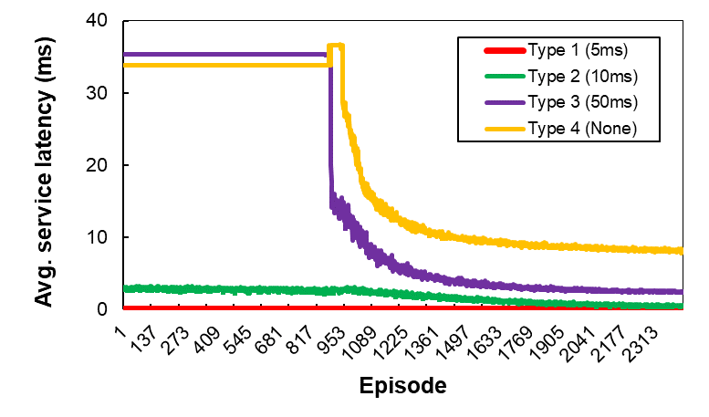
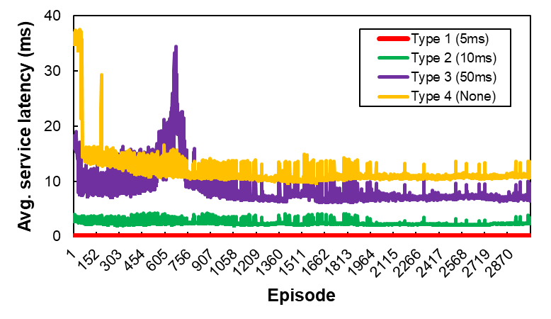
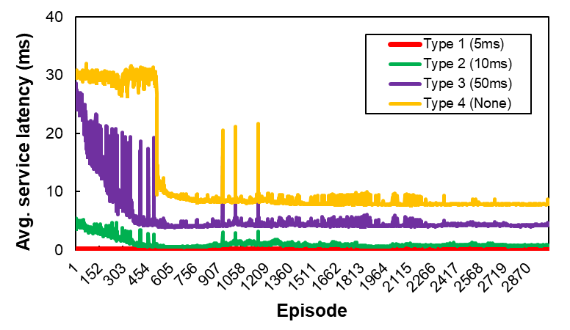
Evaluation (2/6)
Behavior of DRL-based Dynamic Service Placement Algorithms
  SA-DDPG (Single-agent Deep Deterministic Policy Gradient) [5] ➔ for comparison
    Implementation based on the described single-agent model (pp. 14)
  MA-DQN (Multi-agent DQN) / MA-TDAC (Multi-agent Temporal Difference Actor-Critic) ➔ proposed
<SA-DDPG>
<MA-DQN>
<MA-TDAC>

Slide 28






Evaluation (3/6)
Behavior of DRL-based Dynamic Service Placement Algorithms
  SA-DDPG: no considerations on service availability and migration downtime
  Proposed: MA-DQN/MA-TDAC reduce # of migrations, MA-TDAC improve service availability
<SA-DDPG>
<MA-DQN>
<MA-TDAC>

Slide 29


Evaluation (4/6)
Performance of DRL-based Dynamic Service Placement Algorithms
  CloudFirst (static service deployment w/o migration)
    Deploy a service in cloud DC first unless SLA latency is not violated
  Service latency is highly improved w/ dynamic service placement
    MA-TDAC reduces latency of service type 2, 3 and 4 by 80%, 88% and 77% respectively (vs. CloudFirst)
  SA-DDPG outperforms in service deployment delay
    Deployment of service request at arrival is delayed depending on the degree of saturation in edge resources

Slide 30



Evaluation (5/6)
Performance of DRL-based Dynamic Service Placement Algorithms
  MA-TDAC outperforms in # of service failures
    67% and 62% less than SA-DDPG and MA-DQN
  MA-DQN outperforms in # of migrations
    72% and 42% less than SA-DDPG for type 1 and 2 respectively
  MA-TDAC outperforms in learning time per episode
    42% less than SA-DDPG
    Possibility to parallel learning of each agent

Slide 31

Evaluation (6/6)
Cross Validation
  Split service requests into three dataset (each 1000 records)
  Train MA-TDAC w/ each dataset for 1000/4000 episodes
  Test each dataset with learned MA-TDAC models
    Trained models are generalizable to untrained datasets;
    the model trained with dataset1 is robust to dynamic service placement on
    unseen service requests in dataset2 and dataset3
    For dataset2, need to train model long enough
    For models trained with dataset1/3,
    Catastrophic Forgetting [12][13] happens
dataset1
dataset2
dataset3
<Improvement (%) in service latency (type 2)
vs. static placement (CloudFirst)>
<Improvement (%) in # of service failures
vs. static placement (CloudFirst)>

Slide 32
Conclusion
Contributions
  The problem of dynamic service placement in edge computing is formulated as the corresponding DRL model of environment, agent, state, action and reward
  Multi-agent DRL-based dynamic service placement algorithms are proposed to generate live migration policy that optimizes average service latency and service availability
  Edge computing simulator is implemented where event-driven simulation is supported and components are extensible to develop different DRL algorithms
  Performance benefits from dynamic service placement are evaluated in comparison with pure service deployment and existing approach (simulation)
    Average service latency and service availability are improved by 9% and 67% with 72% smaller number of migrations in processing 1000 service requests in 120 servers across 16 DCs
    The proposed DRL models are generalizable to different edge computing environments
Future Work
  Improvement in the proposed DRL models
  Verification of the proposed methods in a real testbed

Slide 33
References
[1] Siddiqi, Murtaza Ahmed, Heejung Yu, and Jingon Joung. "5G ultra-reliable low-latency communication implementation challenges and operational issues with IoT devices." Electronics 8.9 (2019): 981.
[2] Zhang, Cheng, and Zixuan Zheng. "Task migration for mobile edge computing using deep reinforcement learning." Future Generation Computer Systems 96 (2019): 111-118.
[3] Wang, Hongman, et al. "Service migration in mobile edge computing: A deep reinforcement learning approach." International Journal of Communication Systems (2020): e4413.
[4] Zeng, Jing, et al. "Adaptive DRL-based Virtual Machine Consolidation in Energy-Efficient Cloud Data Center." IEEE Transactions on Parallel and Distributed Systems (2022).
[5] Dalgkitsis, Anestis, et al. "Dynamic Resource Aware VNF Placement with Deep Reinforcement Learning for 5G Networks." GLOBECOM 2020-2020 IEEE Global Communications Conference. IEEE, 2020.
[6] Dai, Yu, Qiuhong Zhang, and Lei Yang. "Virtual Machine Migration Strategy Based on Multi-Agent Deep Reinforcement Learning." Applied Sciences 11.17 (2021): 7993.
[7] Wang, Guosai, Lifei Zhang, and Wei Xu. "What can we learn from four years of data center hardware failures?." 2017 47th Annual IEEE/IFIP International Conference on Dependable Systems and Networks (DSN). IEEE, 2017.
[8] Biswas, Md Israfil, et al. "A practical evaluation in openstack live migration of vms using 10gb/s interfaces." 2016 IEEE symposium on service-oriented system engineering (SOSE). IEEE, 2016.
[9] Jo, Changyeon, Youngsu Cho, and Bernhard Egger. "A machine learning approach to live migration modeling." Proceedings of the 2017 Symposium on Cloud Computing. 2017.
[10] https://github.com/alibaba/clusterdata/tree/master
[11] Alliance, N. G. M. N. "Verticals URLLC use cases and requirements." NGMN Alliance (2019).
[12] https://ai.stackexchange.com/questions/20127/how-can-i-handle-overfitting-in-reinforcement-learning-problems
[13] Zhang, Chiyuan, et al. "A study on overfitting in deep reinforcement learning." arXiv preprint arXiv:1804.06893 (2018).

Slide 34

Q&A

Slide 35


Appendix
Proposed Algorithm w/ Different Reward Model
  Deployment w/ LeastLatency (EdgeFirst) + dynamic placement w/ MA-TDAC
    w_{L} of 0.1 and w_{A} of 1 ➔ more weight on service availability benefit
  Average # of failures in edge servers reduces as learning proceeds
    Indicating reduction in total # of migrations to edge DCs at the same periods
    Proposed algorithms show the behavior intended in reward model

Slide 36



Appendix

Slide 37




Appendix
Previous Work – Proactive VNF Live Migration using Machine Learning

Slide 38




Appendix
Previous Work – Service Downtime in OpenStack VM Live Migration

