Slide 1
Design and Implementation of Central Bank Digital Currency using Blockchain
Jungsu Han
Supervisor: Prof. James Won-Ki Hong
Distributed Processing & Network Management (DPNM) Lab.
Dept. of Computer Science and Engineering
POSTECH
saw1515@postech.ac.kr
http://dpnm.postech.ac.kr

Slide 2
Table of Contents
Introduction
Background
Requirements
Design
Implementation
Evaluation
Conclusion & Future Work

Slide 3
Introduction

Slide 4
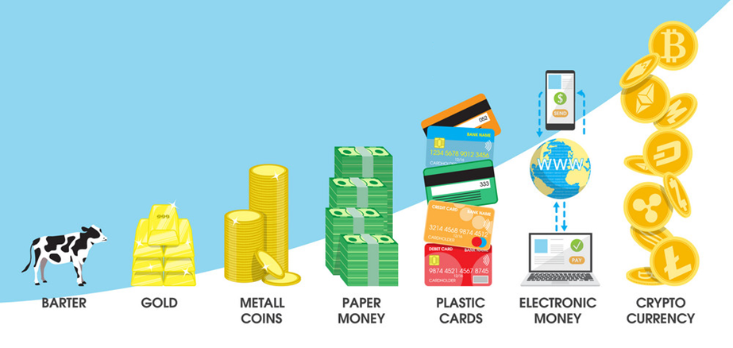
Introduction
Evolution of Money
Source : https://www.vectorstock.com/royalty-free-vector/evolution-of-money-concept-vector-18603854

Slide 5
Introduction
Problems of Fiat Cash
Operability
Expensive issuance cost
Easy to damage
Difficult to track
Regulation
Usability
Difficult to carry
Low security
Routes of infection
Hard to AML, CFT, KYC
Easily used in crimes
Notes:
1만원권 발행비용 : 200원, 한은에서는 점진적으로 신권 발행 비율을 줄이는 중

Slide 6
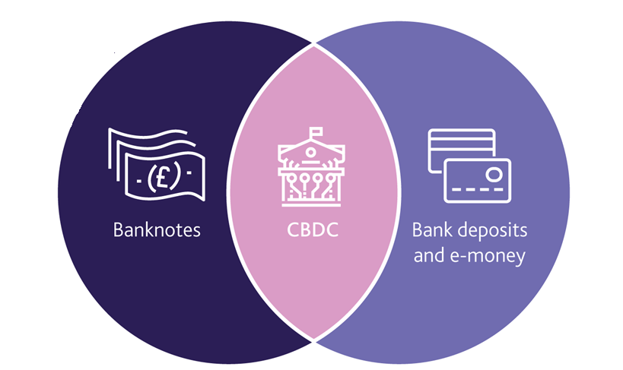
Introduction
What is CBDC?
Central Bank Digital Currency
Issued by
Central Bank
Digital
Currency
Source : https://www.bankofengland.co.uk/research/digital-currencies
Notes:
소스 추가
32 – 28 -24

Slide 7

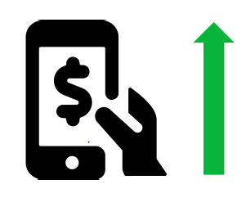
Introduction
Rise of CBDC
Inherent problems of Fiat Cash
Expensive to produce, circulate and mange
Lack of transparency
Domination of private PSPs and E-money
Popularity of credit cards (Visa, Master card …)
Wechat pay, Ali pay, Kakao pay, Naver pay …
Launching of Stablecoins
Facebook’s Libra (Diem)
JPmorgan’s JPM coin
PSP : payment service provider

Slide 8
Introduction
CBDC Key Drivers
Challenge
Competition
Chance
“Financial Innovation”
“Currency Supremacy”
“Improvement in Financial System”
Discussion about adoption of CBDC in major countries
CBDC adoption in emerging countries for financial inclusion
Bahamas, Cambodia, OECS
Cross-border payment project
Hong Kong, Thailand, Singapore
Fintech, Crypto Assets
Private Stablecoins
Legal tender of Bitcoin
Notes:
소스 추가

Slide 9
Background

Slide 10
Background
Global CBDC Trend
Country
Review
Research
PoC/Pilot
Commercialization
Bahamas
OECS
China
Singapore
Hong kong
EU
Korea
USA
Notes:
간격 수정
한국 추가 – 리서치 단계 (EU와 유사)
카카오하고 확인

Slide 11
Background
Wholesale CBDC vs Retail CBDC
Wholesale CBDC
Settlement of interbank transfers and related wholesale transaction
Experiments on the application of distributed ledger technology to payments between financial institutions.
Retail CBDC
Digital extension of cash by all people and companies
Reviewed for the purpose of maintaining the stability of the payment and settlement system in countries where demand for cash decreases rapidly

Slide 12
Background
Blockchain-based vs. Non-Blockchain-based CBDC
Blockchain-based CBDC
Excellent resilience
Reduce operational risk
Reduce cost
Non-Blockchain-based CBDC
High performance
Full control of infrastructure
Easy to monitor and modify

Slide 13
Background
Blockchain for CBDC
R3 Corda [1], Hyperledger Fabric [2]
Scalable and interoperable Blockchain [3,4]
Multiple Blockchain architecture [5]
[1] Calle, G., & Eidan, D., “Central Bank Digital Currency: an innovation in payments,” R3 White Paper, 2020.
[2] Maharjan, S., Ko, K., Kang, C., Woo, J., & Hong, J. W., "A Study of CBDC Model Applicable for the Current Banking Environment", KNOM Conference 2020, pp. 56-60, 2020.
[3] Croman, K., Decker, C., Eyal, I., Gencer, A. E., Juels, A., Kosba, A., ... & Wattenhofer, R. On scaling decentralized blockchains. In International conference on financial cryptography and data security, pp. 106-125, 2016.
[4] Allen, S., Cˇ apkun, S., Eyal, I., Fanti, G., Ford, B. A., Grimmelmann, J., ... & Zhang, F. Design Choices for Central Bank Digital Currency:Policy and Technical Considerations (No. w27634). National Bureau of Economic Research, 2020.
[5] Kan, L., Wei, Y., Muhammad, A. H., Siyuan, W., Linchao, G., & Kai, H. A multiple blockchains architecture on inter-blockchain communication. In 2018 IEEE International Conference on Software Quality, Reliability and Security Companion (QRS-C), IEEE, pp. 139-145, 2018.

Slide 14
Requirement

Slide 15
Requirements
System Requirements
Compatibility
- The design of CBDC typically involves the two-tier banking system
Interoperability
- CBDC should enable cross-border and cross-network transactions
Privacy
- Privacy should be guaranteed in a CBDC transaction, like Cash
Notes:
분리

Slide 16
Design

Slide 17



Design
Compatibility
Two-Tiered CBDC system
Central Bank
Central node
Commercial Bank A
Commercial Bank B
Commercial Bank C
…
Node A
Node B
Node C
Customer
Customer
Customer
Merchant
Notes:
개인/상점 고객은 간접적으로 CBDC에 참여함

Slide 18




Design
Compatibility
End User
Commercial Bank
Central Bank
User Interface
User Interface
User Interface
Digital wallet
CBDC circulation management
CBDC issuance
Record of CBDC transaction
Record of customer CBDC transaction
Commercial bank assignment
CBDC payment/transfer/exchange
Customer management
Commercial bank management
Blockchain interface
DB interface
Blockchain interface
DB interface
Blockchain interface
DB interface
Commercial Bank DB
Central Bank DB
Blockchain
Smart contract
Transaction data
Notes:
개인고객은 시중은행이 관리함

Slide 19
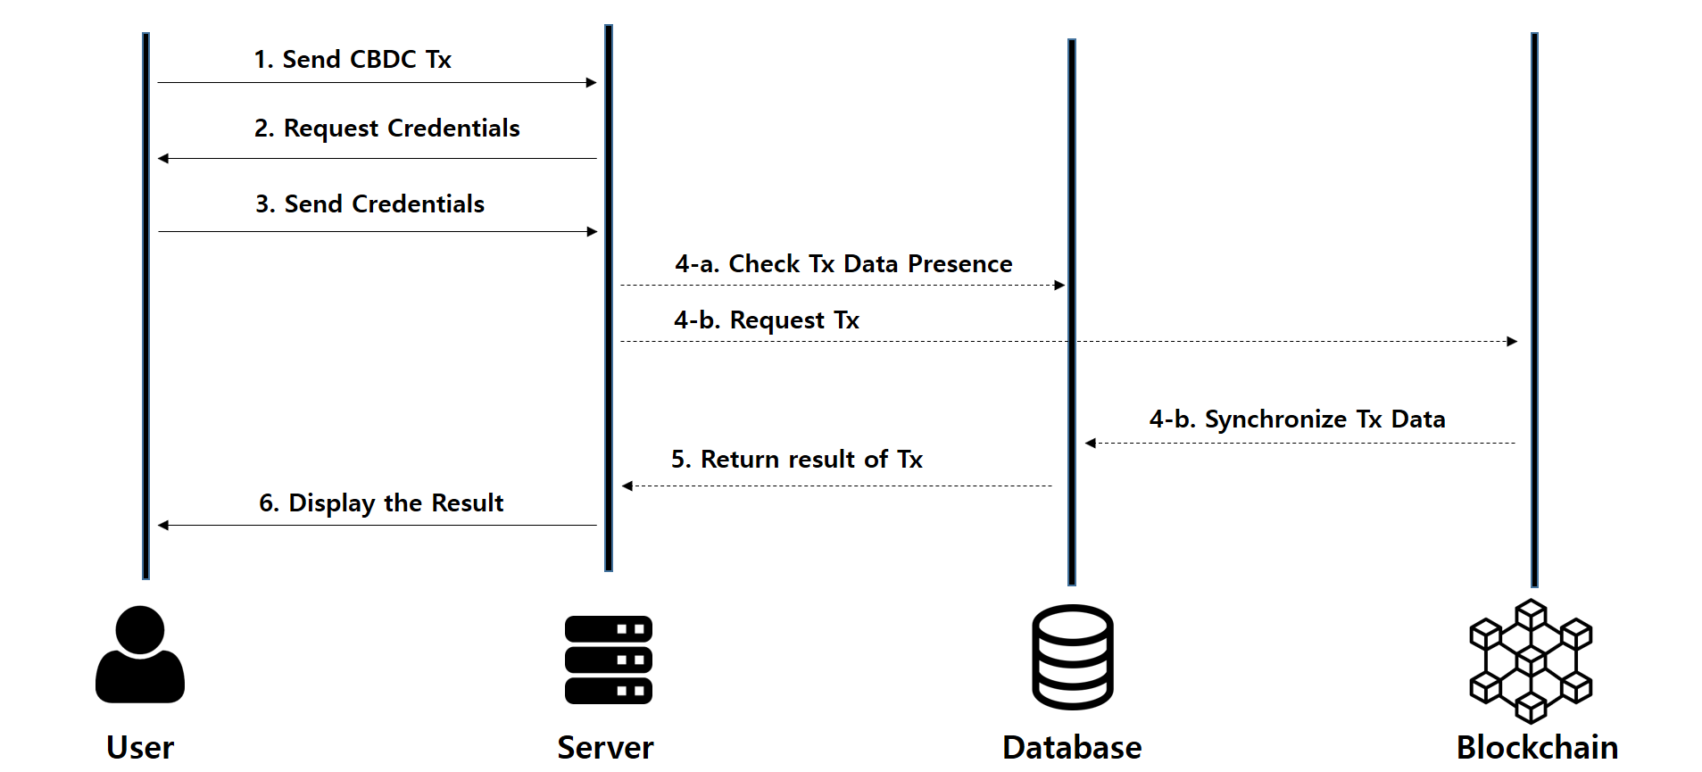
Design
Compatibility
Sequence Diagram of Retail CBDC Transaction
Notes:
블록체인의 정보를 사용하는 과정. 병목현상을 줄이도록 설계

Slide 20

Design
Interoperability
Cross-border payment
Chain A
Chain B
Central Bank
Central Bank
Commercial Bank
Commercial Bank
IBC
IBC
Customers
Relayer
Customers
IBC : Inter-Blockchain Communication
Notes:
블록체인 기반 CBDC가 확대되면 국가별로 사용하는 블록체인 프로토콜이 상이할 것으로 생각됨
이종 블록체인간은 트랜잭션이나 토큰을 교환할 수 있는 것이 중요한 요구사항 중 하나임

Slide 21
Design
Interoperability
Value Transfer (Native Protocol)
Cosmos enables blockchains to transfer value with each other through IBC and Peg-Zones
Hub: Multi-asset distributed ledger
Zones: Independent blockchain communicating Hub with IBC messages
Hub can be Central bank or SWIFT
Zone can be Commercial Bank or each country
Notes:
첫번째 방법은 Native protoco을 쓰는 것임.
이것은 두 국가가 동일한 프로토콜을 사용하면 효과적으로 적용가능함
관련 프로젝트 중 코스모스가 주목 받고 있음
코스모스 블록체인 내에 자체적인 비즈니스 로직에 맞는 CBDC 시스템을 개발하고 연동하는 것이 가능함

Slide 22

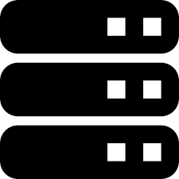
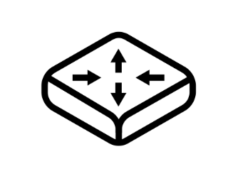
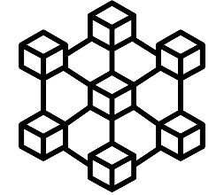

Design
Interoperability
1. Send CBDC Tx
2. Request Credentials
3. Send Credentials
4. Request Tx
5. Select Blockchain
6. Synchronize Tx Data
7. Return result of Tx
8. Display the Result
User
Server
Cosmos Hub
Blockchain A
Blockchain B
Notes:
동일한 블록체인, 예를 들어 코스모스를 사용한다고 가정 시 동작 과정

Slide 23
Design
Interoperability
Value Transfer (Bridge Contract)
Chain A
Chain B
3
Bridge A
Bridge B
P2P
Event
4
Transaction
2
Bridge Contract
Bridge Contract
Transaction
Balance Update
1
5
Alice
Bob
Notes:
하지만 표준 프로토콜이 정립되지 않는 이상 대부분의 국가에서는 이종 블록체인을 사용할 것으로 예상
현재 이종 블록체인간에 주로 사용하는 브릿지 방식을 도입
Transaction 1: Value Transfer Request를 하며 CBDC를 컨트랙트에 보관함
Event : chain A에서 chain B로 전송하겠다 이벤트를 생성함 (트랜잭션은 단일 노드에서의 state를 변경시키는 수단이므로, Event는 다른 노드의 것을 변경시키길 요청하는 것이니까)
P2P : 노드 간 통신
Transaction 2: Chain B에 있는 CBDC를 Bob에게 전송하기를 요청

Slide 24
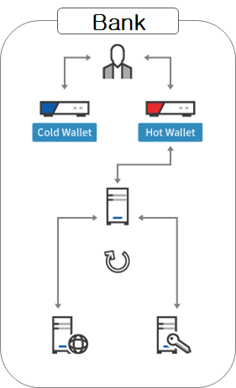


Design
Privacy
Off-chain Privacy
On-chain Privacy
Zero-knowledge
Authentication
Admin
CBDC
Network
Communication
Stealth Address
TX server
Web server
Key server
Notes:
CBDC 저변확대를 위해 프라이버시에 대한 연구가 필요함
프라이버시는 크게 두가지로 나뉨

Slide 25
Design
On-chain Privacy
Mixing
Mix different streams of potentially identifiable cryptocurrency
Ring signature
Performed by any member of a set of users that has keys
Message signed with a ring signature is endorsed by someone in a particular set of people
Encrypted Transaction
Encrypt TX data with PKI and Store them in block

Slide 26
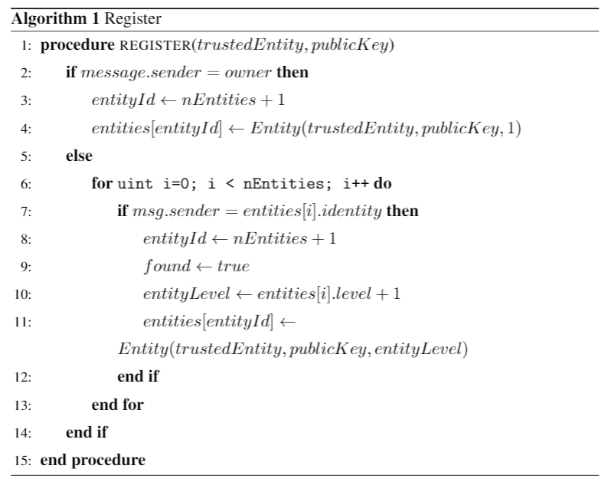
Design
On-chain Privacy
Notes:
PKI 시스템을 구현하기 위한 스마트 컨트랙트 알고리즘

Slide 27
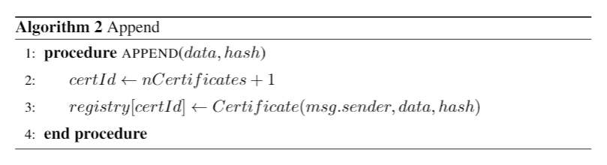
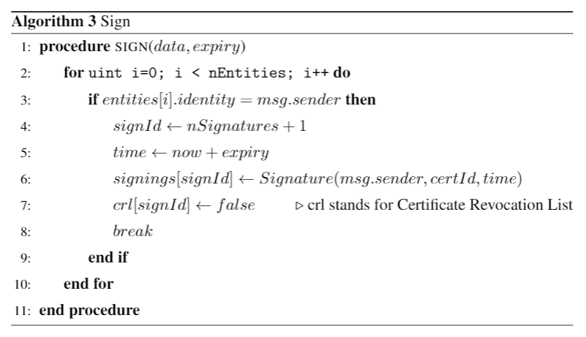
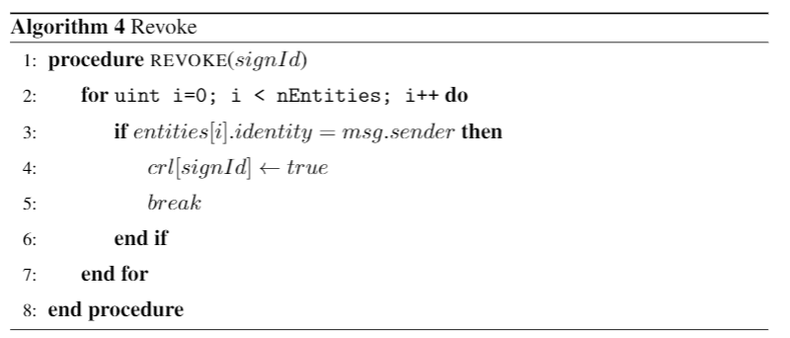
Design
On-chain Privacy

Slide 28
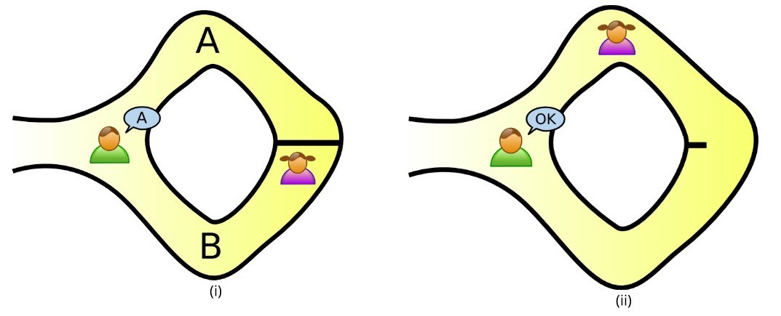
Design
Off-chain Privacy
Authentication with Zero-knowledge proof

Slide 29
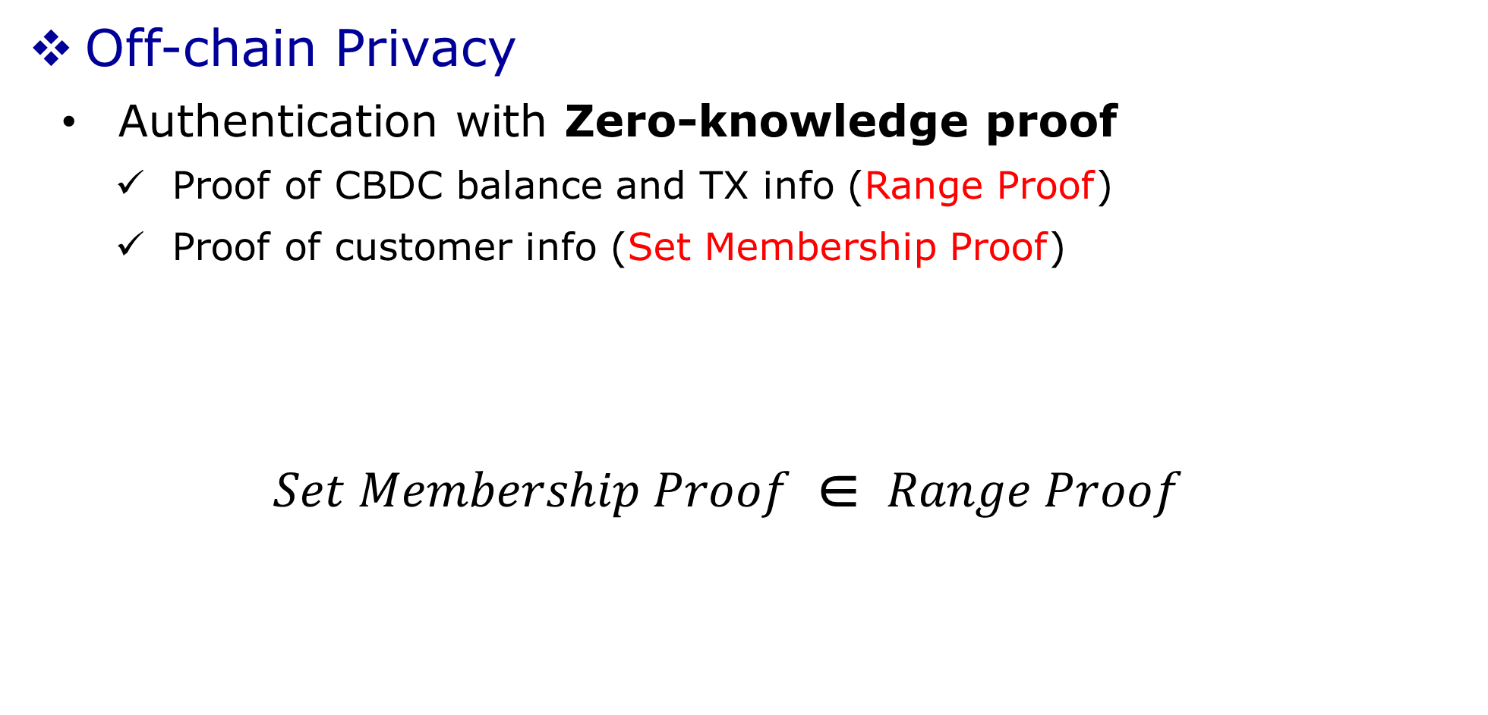
Design
Off-chain Privacy
Authentication with Zero-knowledge proof
Proof of CBDC balance and TX info (Range Proof)
Proof of customer info (Set Membership Proof)
$$Set Membership Proof \text{∈} Range Proof$$

Slide 30


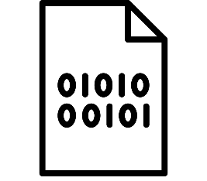


Design
Privacy System Overview
Customer
(Prover)
Zero Knowledge Proof System
Reject
Set Membership Proof
Proof
3
False
2
4
Record
verification
True
Range Proof
Bank
(Verifier)
1
Hash
Encryption
Signing
Transaction

Slide 31
Implementation

Slide 32
Implementation
Overview
Cos-CBDC written in React.js
Used Cosmos-SDK for CBDC Ledger (written in Go)
Operate collaboratively on a web, mobile and server
Zero-knowledge Range proof for Privacy

Slide 33
Implementation
Functions
Central Bank
Issuance
Redeem
Assign
Cross border payment (Dashboard for CBDC Ledger)
Commercial Bank & End User

Slide 34
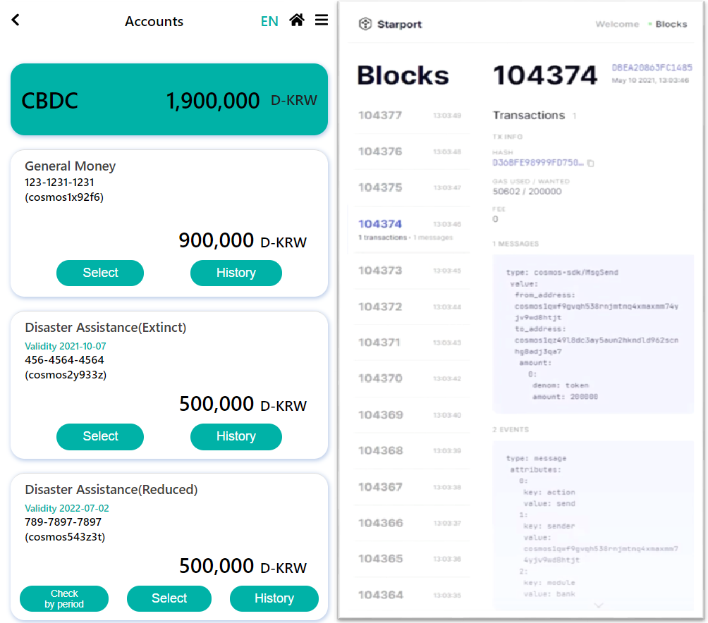
Implementation
Functions
User Interface#1
Exchange
Payment
Transfer
Demo Youtube (Korean ver.) : https://www.youtube.com/watch?v=hSa5LtzT070

Slide 35
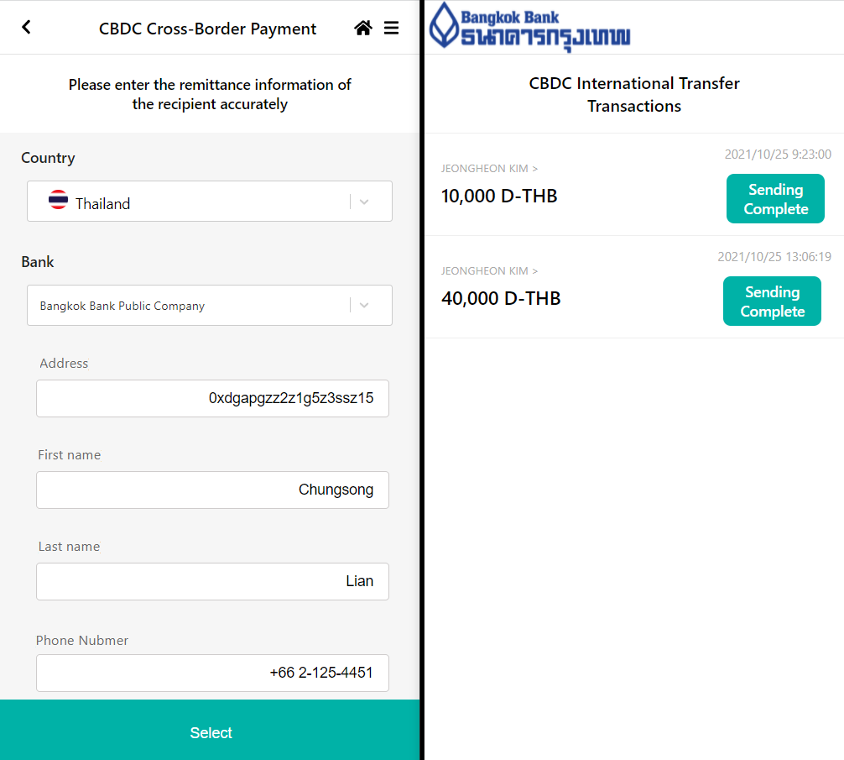
Implementation
Functions
User Interface#2
Cross-Border Payment
CBDC Dashboard
Demo Youtube (Korean ver.) : https://www.youtube.com/watch?v=hSa5LtzT070

Slide 36
Evaluation

Slide 37
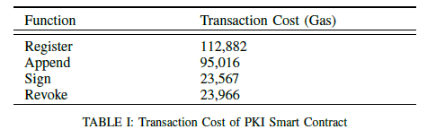
Evaluation
On-chain Privacy Overhead
PKI with Smart Contract
Register : Add trusted entity
Append : Publish Certificate
Sign : Sign certificate and set expiry
Revoke : Revoke signature
Notes:
ByteCode size 26,052

Slide 38
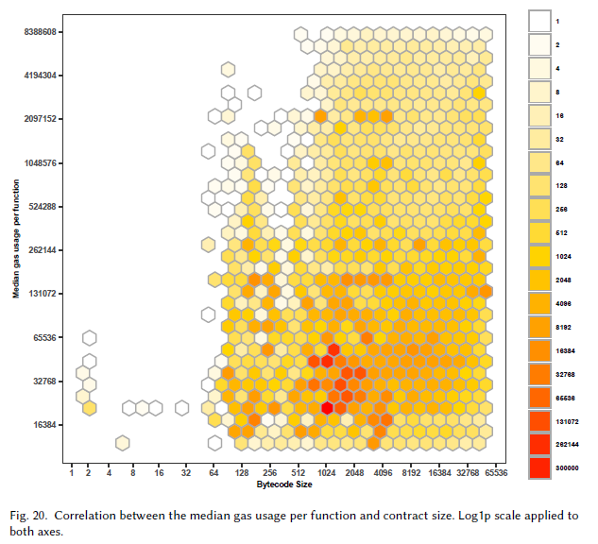
Evaluation
On-chain Privacy Overhead
PKI with Smart Contract
Our PKI Contract
- PKI Contract Bytecode : 26,052
- Median Gas Usage : ~60,000
Source : Zarir, A. A., Oliva, G. A., Jiang, Z. M., & Hassan, A. E. (2021). Developing Cost-Effective Blockchain-Powered Applications: A Case Study of the Gas Usage of Smart Contract Transactions in the Ethereum Blockchain Platform. ACM Transactions on Software Engineering and Methodology (TOSEM), 30(3), 1-38.
Fig. Correlation between the median gas usage per function and contract size.

Slide 39
Evaluation
Off-chain Privacy Overhead
Sequence flow of Zero-Knowledge Proof (ZK-SNARK)
Setup
Prove
Verify
circuit.circom
verification_key.json
circuit.json
proving_key.json
Proof.json
OK
input.json
witness.json
Public.json
zk-SNARK
Notes:
회로 생성 및 Trusted Setup
Trusted Setup은 Prover 가 치팅을 하거나 Fake proof 생성을 막고, verifie가 무엇이 proven 되는 지를 알고 있어야 하기 때문에

Slide 40
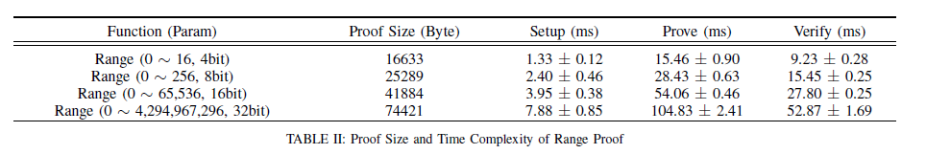
Evaluation
Off-chain Privacy Overhead
Zero-Knowledge Range Proof Overhead
Setup : Set public randomness for trusted setup
Prove : Generate Proof
Verify : Verify Proof

Slide 41
Conclusion & Future work

Slide 42
Conclusion & Future Work
Conclusion
We have designed and implemented a blockchain-based CBDC system
Our CDBC system is designed considering compatibility, interoperability and privacy

Slide 43
Conclusion & Future Work
Future Work
Cross-border CBDC payments using IBC between different country blockchains
More research on preserving privacy is needed

Slide 44

Thank you!
Notes:
Summary 추가

Slide 45
References
[1] Auer, R. A., Cornelli, G., & Frost, J., “Rise of the central bank digital currencies: drivers, approaches and technologies,” CESifo Working Paper, no. 8655, 2020.
[2] Boar, C., Holden, H., & Wadsworth, A., “Impending arrival–a sequel to the survey on central bank digital currency,” BIS paper, no. 107, p. 19, 2020.
[3] Mita, M., Ito, K., Ohsawa, S., & Tanaka, H., “What is stablecoin?: A survey on price stabilization mechanisms for decentralized payment systems,” 2019 8th International Congress on Advanced Applied Informatics (IIAI-AAI), pp. 60-66, 2019.
[4] Center for Cryptocurrency & Blockchain Research [POSTECH CCBR]. Blockchain Trend. YouTube. https://www.youtube.com/channel/UCCKFHV5J8G1iFXar6kYAi6A
[5] Upbit [UDC]. (2021, 9). CBDC Global Trend & Future [Video]. YouTube. https://www.youtube.com/watch?v=eIoD1i1aHmY
[6] Nakamoto, S. Bitcoin: A peer-to-peer electronic cash system. Manubot, 2019
[7] JASPER: James Chapman, Rodney Garratt, Scott Hendry, Andrew McCormack, and Wade McMahon. Project jasper: Are distributed wholesale payment systems feasible yet. Financial System, 59, 2017
[8] UBIN : Darshini Dalal, Stanley Yong, and Antony Lewis. The future is here–project ubin: Sgd on distributed ledger. Monetary Authority of Singapore & Deloitte, 2017.
[9] Inthanon :Chananun Supadulya, Kasidit Tansanguan, and Vijak Sethaput. Project inthanon and the project dlt scripless bond. 2019
[10] Peters, M. A., Green, B., & Yang, H. (2020). Cryptocurrencies, China's sovereign digital currency (DCEP) and the US dollar system.
[11] Sanddollar, “Digital Bahamian Dollar Sand Dollar” [Online]. Available: https://www.sanddollar.bs/
[12] ECCB, “What You Should Know” [Online]. Available: https://www.eccb-centralbank.org/p/what-you-should-know-1
[13] Bakong : The next-generation mobile payments and banking. Available at https: //bakong.nbc.org.kh/.
[14] Boar, C., Holden, H., & Wadsworth, A. (2020). Impending arrival–a sequel to the survey on central bank digital currency. BIS paper, (107).
[15] Facebook, “Diem” [Online]. Available: https://www.diem.com/
[16] Morgan, J. P. (2016). Quorum whitepaper. New York: JP Morgan Chase.
[17] Han, J et al., Design of Blockchain-based CBDC Architecture and Transaction Key Management System, KNOM Conference 2021, pp. 65-68, 2021.
[18] Calle, G., & Eidan, D., “Central Bank Digital Currency: an innovation in payments,” R3 White Paper, 2020.
[19] Maharjan, S., Ko, K., Kang, C., Woo, J., & Hong, J. W., "A Study of CBDC Model Applicable for the Current Banking Environment", KNOM Conference 2020, pp. 56-60, 2020.
[20] Qasse, I. A., Abu Talib, M., & Nasir, Q. “Inter blockchain communication: A survey,” ArabWIC 6th Annual Interna-tional Conference Research Track, pp. 1-6, 2019.
[21] Szabo, N. (1997). Formalizing and securing relationships on public networks. First monday.

