Slide 1
A Framework for Development, Operations, and Management of SDN-based Virtual Networks
Yoonseon Han
Supervisor: Prof. James Won-Ki Hong
Distributed Processing and Network Management Lab.
Division of IT Convergence Engineering
Pohang University of Science and Technology
seon054@postech.ac.kr
2017. 06. 29
Notes:
제 박사 졸업 심사 주제는 “A Framework for Development, Operations, and Management of SDN based Virtual Network Services” 입니다.
SDN based Virtual Networks

Slide 2
Outline
Introduction
Related Work
Requirements
Architecture Design
Implementation
Evaluation
Conclusion

Slide 3
Introduction
Research Motivation
Background
Problem Statement
Research Goal

Slide 4
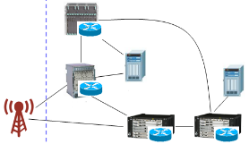


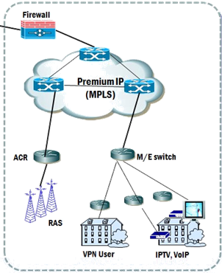


Research Motivation
Telco Networks
SGSN
EPC Core
Foreign Carriers
BSS
OSS
NMS
EMS
Web
PCRF
NAT
DNS
DHCP
DPI
Cache
HSS
Global Hub
Server Farm
MME
GSR
eNodeB
S-GW
P-GW
Data Center
1
1
Center
Router
IX
Other Carriers
Core Router
Core
Router
Core
Router
Core
Router
GSR
Notes:
현재 대부분의 국내외 캐리어 네트워크의 구조를 살펴보면 크게 2가지 분류의 네트워크로 구성되어 있는 것을 알 수 있습니다.
첫번 네트워크는 QoS가 보장 되지 않고 Best Effort 형태로 서비스 되는 일반 네트워크 망입니다.
이 네트워크는 일반 인터넷 연결 서비스들을 대상으로 하며, 코어 네트워크에서 각종 데이터 센터, 타 캐리어 네트워크, 그리고 타사 네트워크들과 연결되어 연경설을 제공하는 것을 목표로 하고 있습니다.
따라서 VoIP, IPTV, VPN과 같은 QoS가 중요한 서비스들을 수용하는 데는 부적절한 형태입니다.
이를 해결하기 위해 국내외 대부분의 네트워크 사업자들은 그들의 time-critical sensitive한 서비스들 (IPTV, VoIP, VPN 등) 제공하기 위해 traffic이 많지 않고 delay가 적은 “프리미엄망”을 별도로 운용하고 있습니다. 트래픽이 많아지면 이 프리미움망의 용량을 계속 늘려가며 QoS를 제공하고 있습니다.
2개의 독립적인 네트워크를 수용하기 위해서, 네트워크 사업자들은 높은 비용을 들여 네트워크를 설치 하고 운용/유지해야 하는 문제가 있습니다.
저희 연구팀에서는 이러한 고비용 문제를 해결하기 위한 방법으로 네트워크 가상화 기술을 유력하게 생각하고 있습니다.

Slide 5
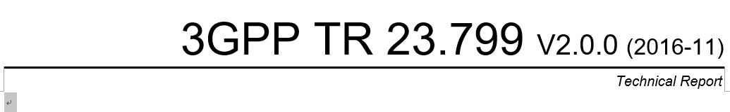
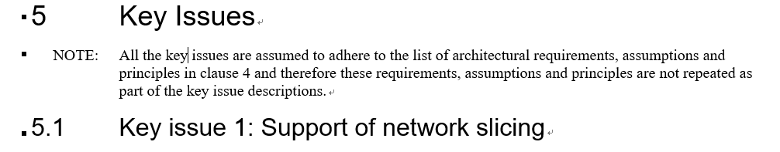
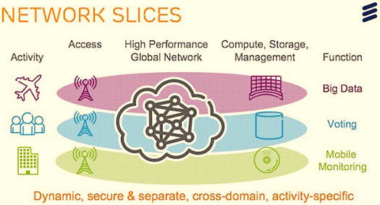
Research Motivation
IoT and 5G mobile network
Hard to support differential Quality of Service (QoS)
Scalability - Hard to address rapidly increasing number of network devices
Flexibility – Hard to change the structure of physical network
High cost – High CAPEX/OPEX
3GPP introduce a concept of network slice to meet various service requirements in a physical network.
But, there is no realization technology.
The number of IoT devices will be rapidly increasing.
Current network hard to address all of them (Address, routing table, etc)
3GPP’s 5G Network Slice
The estimation of IoT device growth
(Source: 3GPP 2016)
(Source: Gartner 2015)
Notes:
현재 학계, 산업계, 정부 전반에 걸쳐서 미래 네트워크에 대해서 뜨겁게 논의 중에 있습니다.
대표적으로 대두되고 있는 미래 네트워크 기술로써 5G 네트워크와 IoT가 있습니다.
이외에도 다양한 미래 네트워크 기술들이 논의 중에 있습니다.
이러한 미래 네트워크 기술들은 매우 많은 공통점을 가지고 있습니다만, 본 과제에서 주목한 것은 두가지 공통점입니다.
첫번째는 서비스 별 차별화된 최적의 네트워크 자원 제공입니다.
5G 네트워크 표준화 기구인 3GPP에서는, 이를 네트워크 슬라이싱이라는 개념으로 설명하고 있지만, 실제 구체적인 구현기술은 없는 상황입니다.
두번째는 매우 많은 장치의 연결입니다.
2015년 가트너사에서 조사한 결과에 따르면, IoT 장비의 갯수는 기하급수적으로 증가하여 5억개의 장치가 2020년에는 연결될 것으로 예측하고 있습니다.
더불어 이러한 장치의 증가 추이는 기술의 발전에 따라 더욱더 가속화 될 것으로 예상됩니다.
이러한 미래 네트워크의 요구사항은 현재의 IP기반의 네트워크 기술로는 대응하기에는 많은 한계점을 지니고 있습니다.
본 연구에서는 이러한 문제를 해결하기 위한 방법의 일환으로 네트워크 가상화에 초점을 맞추었습니다.

Slide 6
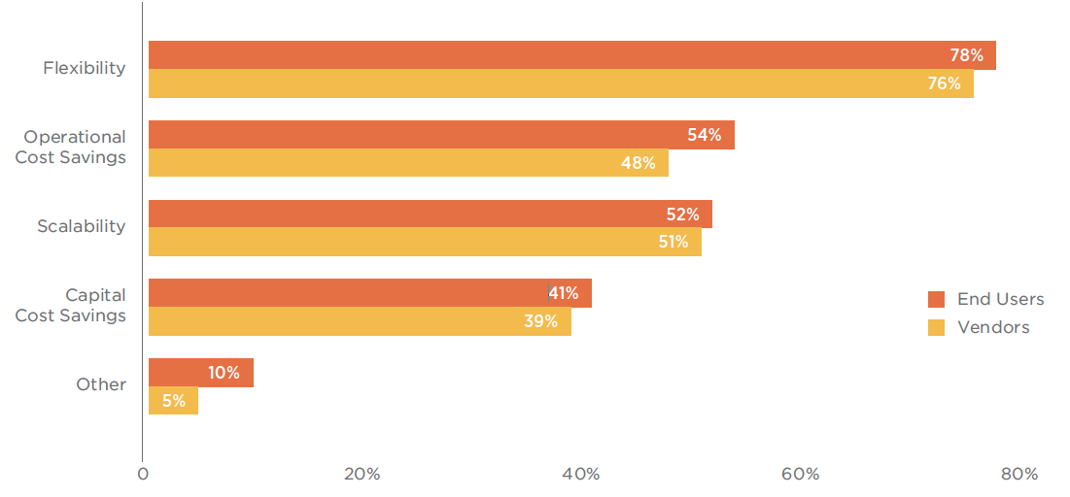
Background
Network Virtualization (NV)
Create logical virtual networks (VNs) that run on top of a physical network
Separate network functionality from physical equipment
Benefits of NV
Multi-tenancy
Flexibility
Scalability
Agility
CAPEX/OPEX saving
NV Use Cases
Data-center networks
Infrastructure as a Services (IaaS)
Centralized management of distributed networks
Data-center re-building
Carrier-grade networks
The benefits of network virtualization
Source : 2016 Market Report, [SDxCentral 2016]
Network Virtualization Experience
Source : 2016 Market Report, [SDxCentral 2016]

Slide 7
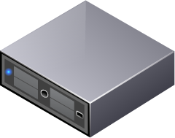

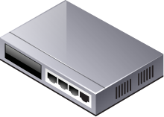
Background
Software Defined Networking (SDN)
Separates the control plane from the data plane
Centralized management
Rich programmability
OpenFlow (OF)
The de facto standard protocol to communicate between control and data plane
Providing remote administration of forwarding tables of switches
Current SDN technologies are heavily depending on OF
Benefits of SDN
Programmability
Agility
Flexibility
CAPEX/OPEX saving
Vendor neutrality
Source: SDN Market Size Report, [SDxCentral 2015]
Flow Entry | Match Field | Counter | Action
1 | Dst IP: 10.0.1.2 | 22 | Port 3
2 | Dst TCP/UDP Port: 80 | 14 | Drop
... | ... | ... | ...
Pre-defined functions only
Flow Table
Control Plane
Mgmt.
Plane
Controller
Data Plane
OpenFlow
Traditional Network
SDN

Slide 8
Problem Statement
Problem Statement
How to create and manage VNs?
How to apply different QoS per VNs?
How to provide high availability and scalability?
How to isolate control and data plane per VN?
How to support heterogeneous data-plane implementation of devices?
How to develop, operate, and manage an environment to develop and run services for VNs?
Notes:
Fundamentally. How to create virtual networks?

Slide 9


Research Goal
Develop a Network Virtualization Framework
Multi-tenancy
Isolated data and control plane per VN
Distributed architecture
Heterogeneous network support
On-platform apps
Service APIs for VNs
Virtual Edge Link
Virtual Link
Virtual Path
Virtual Host
Virtual Host
Virtual Device
Virtual Network #1
Virtual Network #2
…
Virtualize
Apps for VN#1
Apps for VN #2
…
Apps for VN#1
Apps for VN#1
Apps for VN#1
Apps for VN#1
Network Virtualization Framework
De-virtualize
Host
Host
Physical Device
Physical Network Infrastructure

Slide 10
Related Work
NV Approaches
Limitations
SDN NV Solution Comparison

Slide 11

NV Approaches
Traditional Approaches
L2 or L3 link virtualization (Only connectivity)
Not fully decoupled form the physical network (topology, address, control function)
E.g.) VLAN, VPN, VRF
Overlay Network-based Approaches
Create and manage VNs using Virtual switches and tunnels
Most of commercial data center solutions (VMWare NSX, Microsoft Hyper-V, Cisco ACI)
Hypervisor-based solution, easy to deploy
Direct Programming Approaches
Directly program physical switches (network slices) to create and manage VNs
OpenVirtex, FlowVisor, FlowN, VerTIGO
Network-based solution, powerful QoS management, transparency
Tenant
Controller #1
Tenant
Controller #2
Tenant ID | Match Field | Action
1 | Dst IP: 10.0.1.2 | Port 3
2 | Dst IP: 20.0.1.1 | Drop
... | ... | ...
VN manager
L3 Tunnel #1
Network Hypervisor
vSwitch
vSwitch
OpenFlow
VM1
VM2
L3 Tunnel #2
VM3
VM4
VM1
VM2
VM1
VM2
Hypervisor #1
Hypervisor #2
Hypervisor #1
Hypervisor #1
Overlay network-based approaches
Direct programming approaches
Notes:
Traditional approaches의 criteria? 애니매이션 넣을것
네트워크 가상화 기술 실현의 방식은 크게 3가지로 나눌 수 있습니다.
첫번째는 전통적인 접근법으로써 VLAN과 VPN기술 들입니다.
이렇나 전통적인 접근법은 L2 또는 L3 레이어에서 가상 링크를 제공합으로써, 가상 네트워크를 구성하는 장치들의 연결성을 보장하는 것에 초점이 맞춰져 있습니다.
SDN에 기반한 네트워크 가상화 기술은 다시 오버레이 방식과 네트워크 슬라이싱 방식으로 나눌 수 있습니다.
오버레이 방식의 네트워크 가상화 방식은 데이터 센터 네트워크에서 주로 사용하는 방식으로, 특정 사용자 컴퓨팅 자원을 연결하는 것에 초점을 맞춰져 있습니다.
대부분의 구현은 가상 머신을 호스팅하는 하이퍼바이저에 가상 네트워크 스위치를 생성하고, 이들을 VXLAN이나 NVGRE와 같은 터널을 구축 하므로써 구현합니다.
단순히 가상 스위치를 통해 연결성을 제공하므로, 실제 네트워크에 대한 구조 변경없이 컴퓨팅 노드만을 가지고 구현과 배포가 용이하다는 장점을 가지고 있습니다.
마지막으로, 본 과제에서 취하고 있는 접근법으로 SDN의 특징인 programmability를 활용하여, 각 가상 네트워크에 해당하는네트워크 슬라이스를 직접 프로그래밍하는 방법입니다.
이 방식은 실제 네트워크 장치에 접근하여 자원들을 관리 할 수 있으므로 네트워트 성능과 관련된 강력한 QoS지원, 네트워크 관리 투명성, 및 강력한 장애 진단 및 복구 기능을 가질 수 있습니다.

Slide 12
Limitations
The limitations of current NV solutions
Traditional approaches
Mainly provide connectivity between nodes
Isolation of physical network resources only
Impossible to support topology and control function virtualization
Overlay network-based approaches
Limited capability of VN programmability
Cannot support end-to-end QoS
Developed as a data-center (cloud) solution
Direct programming approaches
Most solutions are based on Proxy architecture
Not fully isolated data and control plane per VN
No distributed system (Single point of failure)
No service and API for VN applications
Only support Openflow protocol

Slide 13
SDN NV Solution Comparison
Functionality | FlowVisor (Stanford, 2009) | FlowN (Princeton, 2012) | VerTIGO (CREATE-NET, 2012) | OVX (ON.Lab, 2014) | Proposed Solution (ONVisor)
Address Virtualization | X | O (VLAN Tagging) | X | O (Addr. Rewriting) | O (Tagging and Addr. Rewriting)
Topology Virtualization | X | O | O | O | O
Control Plane Isolation | X | O (Threads) | X | X | O
Data Plane Isolation | O (Flow Table) | X | X | O (Flow Table) | O (Flow Table)
Multi data-path support | X | X | X | X | O
Distributed Architecture | X | △ | X | X | O
Open Source | O | X | X | O | O

Slide 14
Requirements
Use-case analysis
Requirements

Slide 15
Use-case Analysis
Cloud Provider
Infrastructure Provider
5G Mobile Network Provider
Fog and Edge Computing
Source – Alexander Spotnitz, PubNub
Open Cloud Source – Cisco
5G and IoT network
Source – Ericsson
SD-WAN
Source – Juniper Networks

Slide 16
Requirements
Multi-tenancy
Creates multiple VNs on top of the shared physical resources
Scalability
A large number of connected physical devices
Creating and managing a large number of VNs
Flexibility
On-demand VN provision
Allow to change the structure and/or size of the provisioned VN
Scalable VNs
Virtual Host
Virtual Host
Virtual Device
Virtual Network #1
Virtual Network #2
…
Realized (mapped)
A large number of physical devices
Host
Host
Physical Device
Physical Network Infrastructure

Slide 17
Requirements
Control Plane Isolation
Changes of a VN not affect to other VNs’ operation
Dedicated service interfaces per VN
Data Plane Isolation
No end-to-end traffic interference by other VNs
Support for heterogeneous networks
SDN protocols are not fully standardized
Data-path implementations are different
On-platform Application Model
Run VN applications inside NV platform

Slide 18
Architecture Design
Overall Architecture
VN Representation Model
VN Administration and Core Services
Translators
Distributed Virtualization Operations
Application Model

Slide 19
Overall Architecture
Off-Platform apps
External SDN controller
Off-platform Apps
Northbound Interface (GUI, CLI, REST, Netconf, Openflow, …)
Application Layer
OFAgent
OpenStack Integration
…
On-platform Apps
On-platform Apps for VNs
Virtual Abstraction Layer
Virtual Device
Virtual Host
Virtual Link
..
Virtual Topology
Dedicated interfaces to control VNs
Translation Layer
Topology Mapping
Address Mapping
Control Mapping
...
ACL
Translates virtual things into physical things
Abstraction Layer
Device
Host
Link
...
Virtual Admin
Abstracted interfaces to control the physical network
Protocol Adaptation Layer
Openflow
OVSDB
Yang/ Netconf
…
LISP
Encode/decode protocol messages
Southbound Interface
Physical Devices

Slide 20
Features
Off-Platform apps
External SDN controller
Distributed Architecture
Northbound Interface (GUI, CLI, REST, Netconf, Openflow, …)
Application Layer
VN Application development and execution
OFAgent
OpenStack Integration
…
On-platform Apps
Virtual Abstraction Layer
Virtual Device
Virtual Host
Virtual Link
..
Virtual Topology
Dedicated VN core services
Translation Layer
Topology Mapping
Address Mapping
Control Mapping
...
ACL
Pluggable translators
Abstraction Layer
Device
Host
Link
...
Virtual Admin
Protocol Adaptation Layer
Multi-protocol support design
Openflow
OVSDB
Yang/ Netconf
…
LISP
Southbound Interface
Physical Devices

Slide 21
VN Representation Model
Virtual Network Objects
Tenant
Virtual Network
Virtual Device
Virtual Port
Virtual Host
Virtual Link
Virtual Path
Virtual Topology
Virtual Edge Link
Virtual Link
Virtual Path
Virtual Host
Virtual Host
Virtual Device
Virtual Network #1
Virtual Network #2
…
Realized (mapped)
Host
Host
Physical Device
Physical Network Infrastructure

Slide 22
VN Administration and Core Services
VN Administration Service
To create and manage the VN structure
Register/unregister tenants
Create/remove networks
Create/remove/modify virtual objects
Query tenants/networks/virtual objects
VN Core Services
A core service is a unit of functionality
E.g.) Device service, Packet service, Topology service, …
Responsible to isolate control plane for each VNs
Allocate a dedicated service instance per VN
Own independent threads and memory space
Dynamic instantiation of service implementation

Slide 23
Translators
Pluggable and Extensible Translators
Convert virtual object into physical object
Provides topology, address, and control functions virtualization
Various algorithms can be applied
Topology Virtualization
Allow to decouple VN topology from the physical networks
End-to-end path only
Substrate networks
Identical (clone) networks
Virtual Link
Virtual Host
Virtual Host
Virtual Host
Virtual Host
Virtual Host
Virtual Host
Realized (mapped)
Realized (mapped)
Realized (mapped)
Host
Host
Host
Host
Host
Host
End-to-end path topology
Substrate topology
Identical topology

Slide 24

Translators
Address Virtualization
Allow to use own network address space
Encapsulation, Address rewriting
Control function Virtualization
Allow to network operations on virtual topology and address
All operations should be translated into physical operations
10.10.10.1
10.10.10.3
Tenant 100
10.10.10.2
32 bit
Network Hypervisor
Tenant ID
NW IDX
TID =100
10.10.10.1
Physical address
1.0.0.1
10.10.10.3
TID =100
10.10.10.1
1.
0.0.1
S
10.10.10.1
S
2.0.0.1
1.0.0.1
10.10.10.3
S
10.10.10.1
Address Mapping
D
10.10.10.3
D
S
2.0.0.1
D
2001::2
Virtual Address
10.1.1.1
D
10.10.10.1
1.0.0.1
2.0.0.1
10.10.10.3
10.10.10.2
Address Virtualization using IP address rewriting
Address Virtualization using Encapsulation

Slide 25
Distributed Virtualization Operations
Distributed operations and stores
Synchronize VN information among the multiple instances
High availability
Load balancing
Apply sync. mechanism according to the data type
Instance 1
Instance 2
VN1
VN1
VN1
VN1
VN1
Synchronized via events
VN1
Store
Store
Physical Network Infrastructure

Slide 26
Application Model
On-Platform Apps
Consume VN core services
Almost similar to develop apps for SDN controllers
Benefits
Low latency
A rich set of services
Tenant-awareness
Off-platform Apps
Using northbound interfaces
CLI
REST
Protocols (e.g. Openflow, NetConf)
Off-Platform Apps
External Controllers
OpenFlow
GUI
Rest API
On-Platform Apps
Command Line
OFAgent
VN core services
ONOS networking core service
ONOS applications platform
OSGi / Apache Karaf
Notes:
색깔을 통일 시킬 것.

Slide 27
ONVisor Implementation
Virtual Network Subsystem
Virtual Network Abstraction Model
Virtual Network Event Delivery
Virtual Network Administration Service
Virtual Network Core Service
Distributed Stores
Applications

Slide 28
Virtual Network Subsystem
ONVisor (Open Network Hypervisor)
Implemented as an ONOS subsystem
Extended subsystem structure
Virtual Managers
Virtual providers
App
Component
query &
command
Listener
command
add & remove
notify
AdminService
Service
Virtual
Manager
Component
Virtual
Manager
Component
ProviderService
ProviderRegistry
App
Component
sensing
command
register & unregister
Listener
Virtual Provider
query &
command
add & remove
Virtual
Provider
Component
command
notify
Virtual
Provider
Component
AdminService
Service
Listener
Manager
Component
Devirtualize
Virtualize
AdminService
Service
Manager
Component
ProviderService
ProviderRegistry
command
register & unregister
ProviderService
ProviderRegistry
sensing
sensing
command
register & unregister
Provider
Provider
Component
Provider
Provider
Component
Provider
Component
Provider
Component
Protocols
Protocols
Original ONOS subsystem
ONVisor subsystem

Slide 29
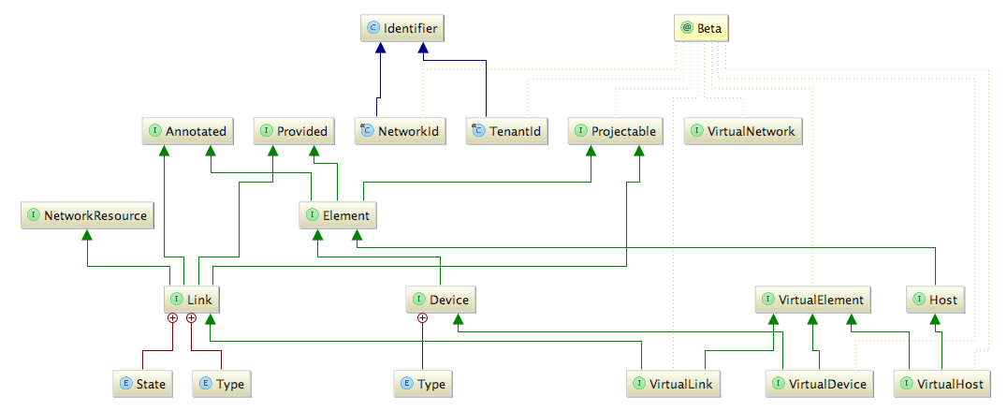
VN Model Implementation
VN Abstraction Model
ONOS provides a rich set of network abstractions
But, designed for a single physical network
Extending existing abstraction model
Allow the instantiation of multiple services
Introduce new attributed for VNs

Slide 30
Virtual Network Event Delivery
Event delivery service
Used to notify changes of VN objects
From a Store to subscribing Event Listeners
Shared event delivery mechanism using event encapsulation
Application #1
Event Listener Interface
post events
Service Interface
post events
Event Listener Interface
Generate
events
Notify events
Store
Store Delegate
Event Delivery
Service
Service #1
Service #2
Encapsulate and decapsulate events
for virtual network service

Slide 31
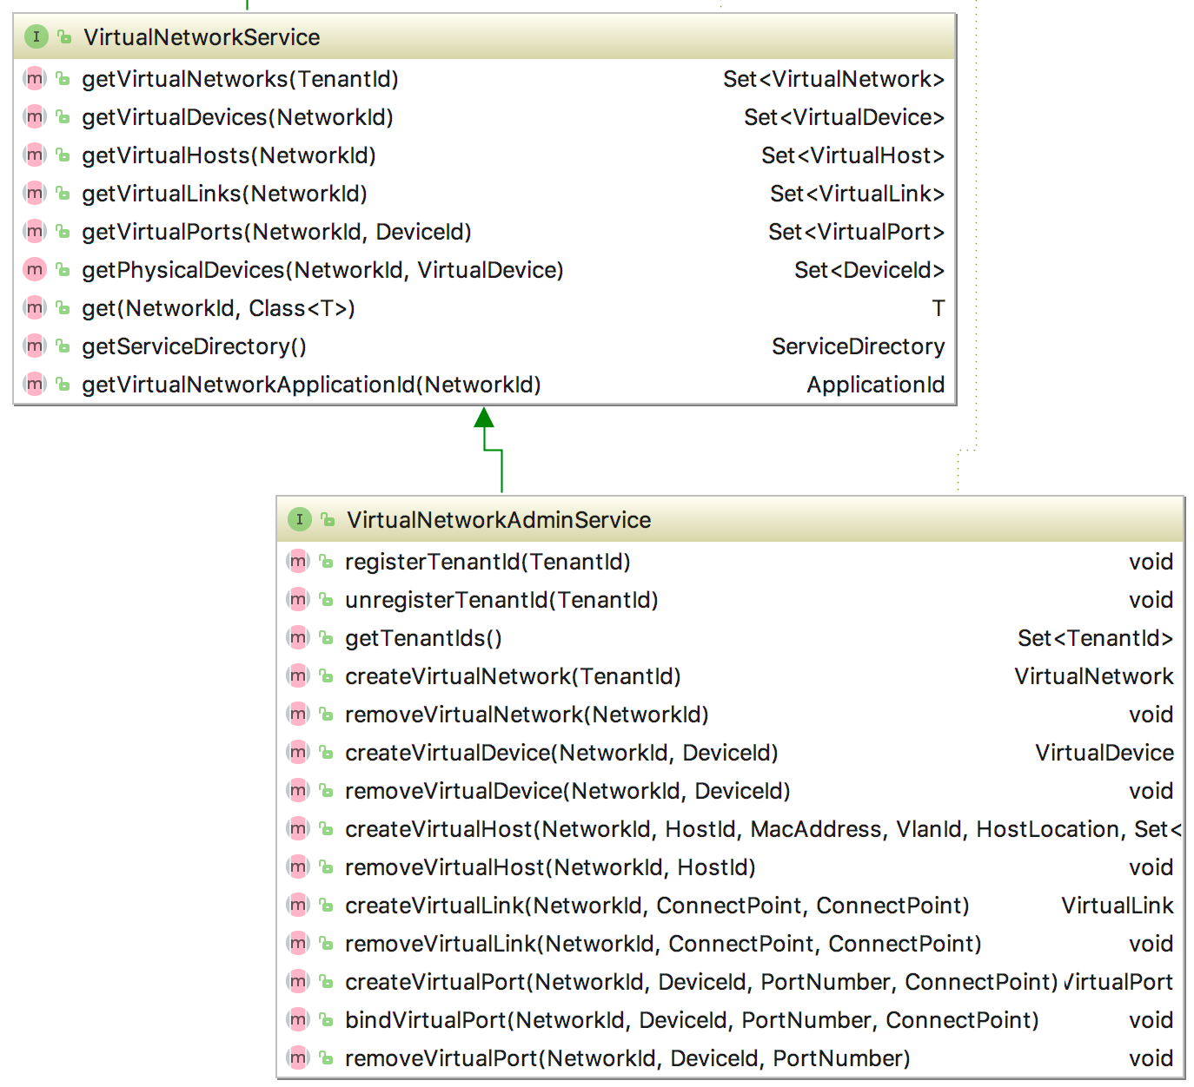
Virtual Network Administration Service
Virtual Network Service
Query service to obtain virtual objects
Virtual Network Admin Service
Allow to create/remove/modify virtual objects
VirtualNetwork
VirtualDevice
VirtualLink
VirtualHost
TenantId
VirtualPort
application
create/edit/remove
virtual network
query & program virtual network
VirtualNetworkListener
add & remove
notify
VirtualNetworkAdminService
VirtualNetworkService
VirtualNetworkManager
Component
DistributedVirtualNetworkStore
Component
VirtualNetworkStoreDelegate
VirtualNetworkStore
VirtualNetworkProviderService
VirtualNetworkProviderRegistry
sync & persist
program commands
sensing
register & unregister
VirtualNetworkProvider
VirtualNetworkProvider
Component
IntentBasedVirtualNetworkProvider
Component

Slide 32
Virtual Network Core Services
VN Core services
A dedicated and independent service processing per VN
managed by Virtual Network Service
External Apps
External Apps
External controllers
App interfaces
REST API
GUI
CLI
On-Platform Apps
OFAgent
OpenStack Integration
VN Embedding
. . .
VN core
Service module
Device
Path
Link
Host
Flow/ Rule
Packet
…
Application
UI Extension
Security
Device Cfg.
Discovery
Network Virt.
Tenant
. . .
ONOS core
Service module
Config
Storage
Region
Driver
Path
Tunnel
Intent
Statistics
Core
Cluster
Leadership
Mastership
Topology
Network Cfg.
Flow Objective
Group
Event
Messaging
Graph
Device
Link
Host
Flow Rule
Packet
South Bound Interface module
OSGi / Apache Karaf
OpenFlow
NetConf
OVSDB
. . .

Slide 33
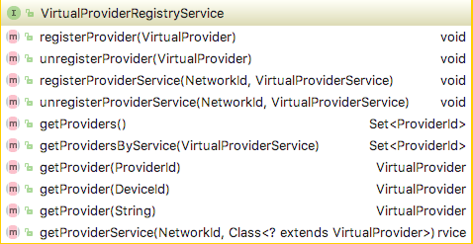
Scheme-based Flexible Virtual Providers
Virtual Providers (Translators)
Implement logics to translate virtual objects
Virtual Provider Services
A callback service to get notified requests/changes
Virtual Provider Registry Service
A match making service to connect Virtual Providers and Provider Services
<Interface>
Virtual Provider Registry Service
register
getProvider
<Interface>
Virtual Provider
<Interface>
Virtual Provider Service
Virtual Packet Provider Service
Virtual Flow Rule Provider Service
Packet Provider Service
…
Virtual Flow Rule Provider Service
Default Packet Provider
…
Default Flow Rule Provider
Packet Provider Service
Virtual Flow Rule Provider Service

Slide 34
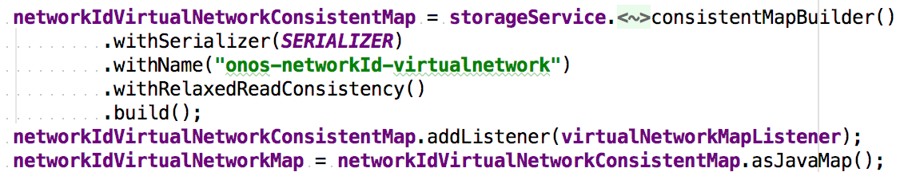
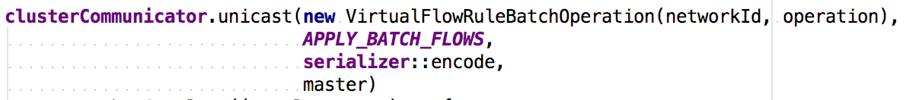
Distributed Stores
Mastership service
Responsible for determining mastership of a element
Distributed Stores for VNs
Structural Information (-> Consistent Map)
Topology, Address mapping
Operational Information (-> Cluster Communication)
Packet, Flow rule, Flow objectives, Meter, Group, …
Kyro serializer, CopyCat (RAFT consensus), Netty
A part of Virtual Network Store (ConsistentMap)
A part of Virtual Flow Rule Store (Cluster Communication)

Slide 35
Applications
Application Development Environment
Can be implemented using JAVA
Consume ONVisor Core Services by referencing
Running as a OSGi bundle
Support dynamic activation/deactivation
@Reference(cardinality = ReferenceCardinality.MANDATORY_UNARY)
protected DeviceService deviceService;
Referencing ONOS core service
@Reference(cardinality = ReferenceCardinality.MANDATORY_UNARY)
protected VirtualNetworkService vnetService;
...
DeviceService deviceService = vnetService.get(networkId, DeviceService.class);
Referencing VN core service

Slide 36
Evaluation
Demo
Stress tests using Cbench
Mininet based Tests
Distributed operation tests

Slide 37
Demo
Demo
Reactive forwarding app for VNs
A tenant specific application
A minor copy of ONOS reactive forwarding app (org.onosproject.fwd)
https://www.youtube.com/watch?v=D9yRPvnfyBo&t=140s
A cord fragment of Reactive Forwarding App

Slide 38
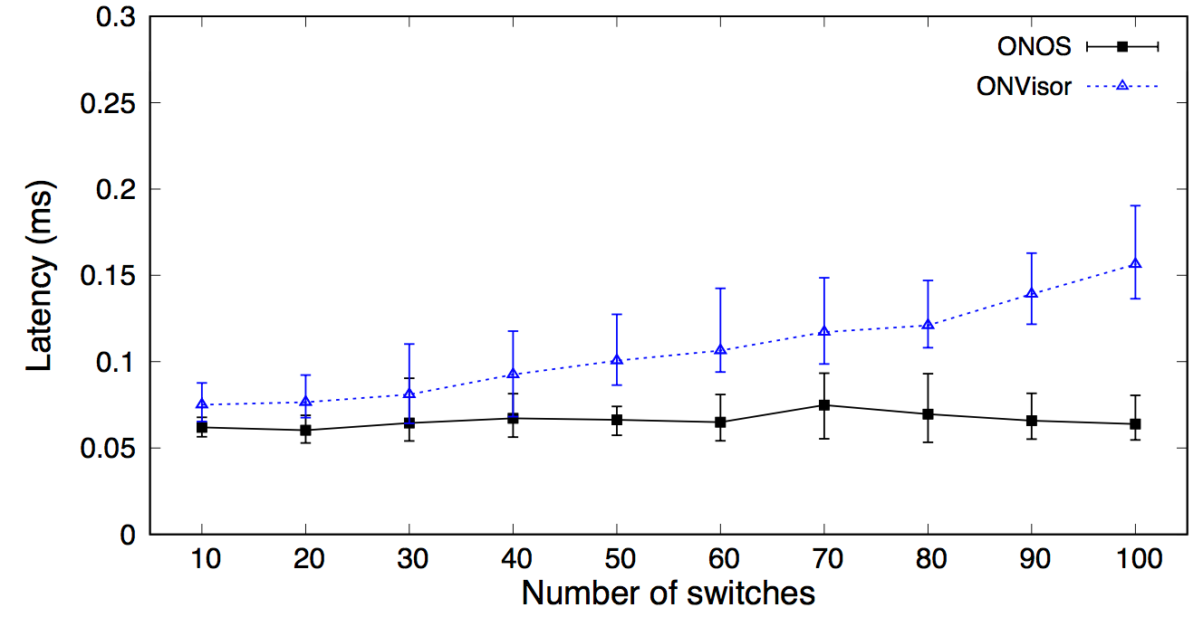
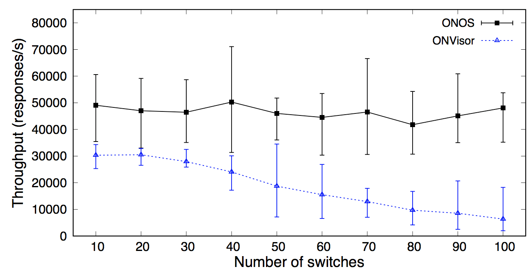
Stress tests using Cbench
Cbench tool
A benchmark tool for assessing Openflow controllers
Generating a massive amount of PKT_IN events
Scenario
Physical clone network
Increase the number of physical and virtual switches
Result
0.04ms additional delay, 48% regression on average
Response Latency
Response Throughput

Slide 39


Mininet Based Tests
Environment
A commodity laptop
2.7GHz quad-core Intel Core i7 (turbo boost up to 3.5GHz)
16GB 1600MHz memory
512GB PCI-e based flash storage
Virtual Machine
1 core CPU, 1GB ram, 15 GB disk space
Ubuntu
ONVisor
ONVisor
Sync
SDN Network

Slide 40
Mininet Based Tests
VN topologies
S1: Physical network clone
S2: One big switch
Scenario
Increase the number of physical and VN devices
Measure network performance
Virtual Network #1
Virtual Network #1
…
Host
Host
Host
Host
Realized (mapped)
Realized (mapped)
…
…
Host
decapsulation
encapsulation
decapsulation
Host
Host
Host
encapsulation
encapsulation
decapsulation
Physical Network Infrastructure
Physical Network Infrastructure
Physical Network Clone
One Big Switch

Slide 41
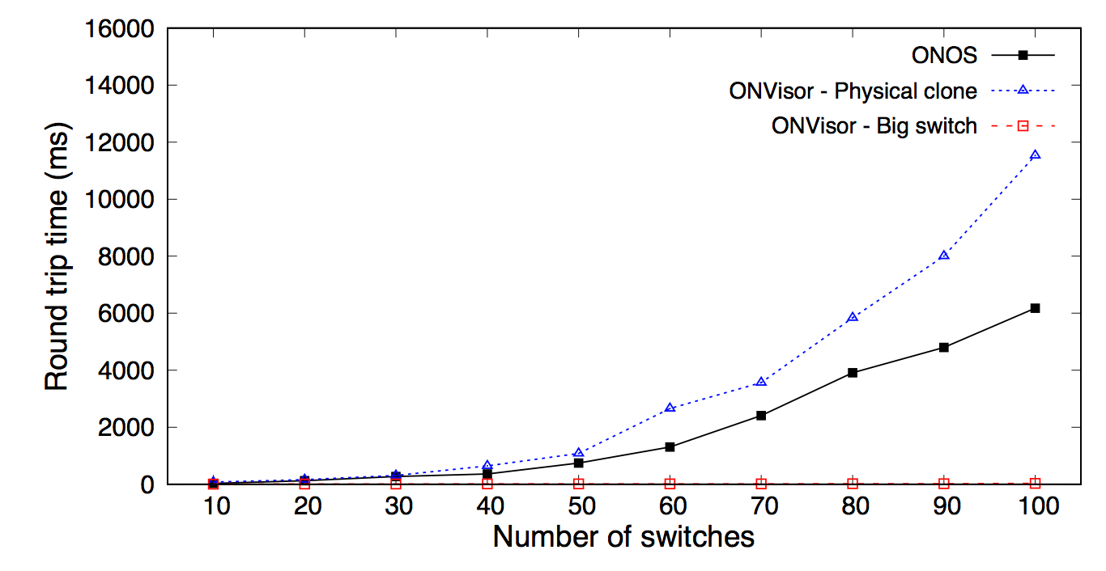
Mininet Based Tests
First Packet Latency
Measure Round Trip Time (RTT) of first packet
First packet generate PKT_IN
PKT_IN triggers the installation of flow rules

Slide 42
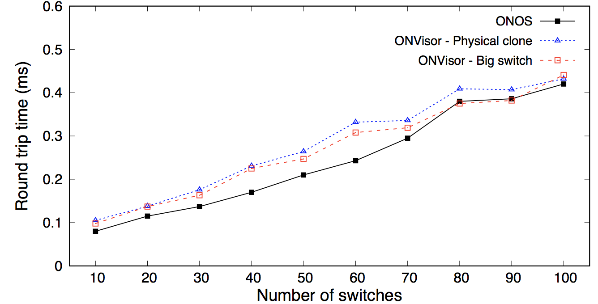
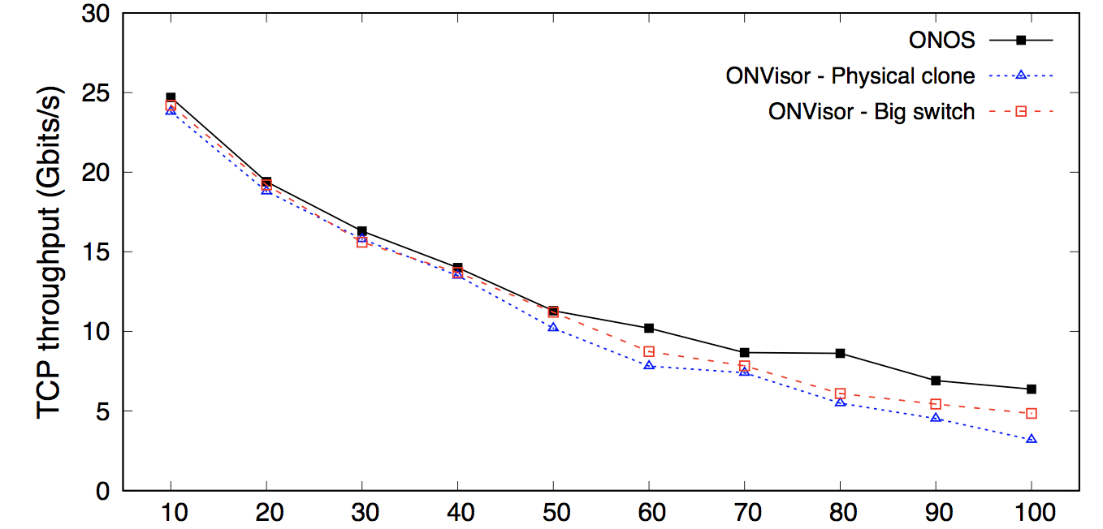
Mininet Based Tests
Data Plane Performance
Measure RTT and Throughput
Similar performance to non-virtualized network
Physical clone – 0.04 delay and 1.59 Gb/s regression
Big switch - 0.02ms delay and 0.95 Gb/s regression
Throughput
RTT

Slide 43
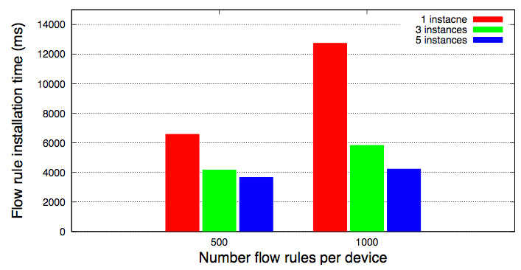
Distributed Operation Tests
Environment
5 virtual machines using Virtual Box
Single core CPU, 1GB memory, 15GB disk space
Scenario
Measure installation time of a massive flow rules
10 switches, install 500 and 1000 flow rules per devices
Total 5000 and 10000 rules
Compare the time according to the number of ONVisor instances

Slide 44
Conclusion
Summary and Contributions
Future work

Slide 45
Summary and Contributions
Summary
A network virtualization framework is presented
Provide SDN based programmable VNs
The evaluation results showed a small performance degradation
Available on
https://github.com/opennetworkinglab/onos
Contributions
Fully isolated control and data plane per VNs
Distributed virtualization operations
Extensible translators
On-platform application model and services
Support heterogeneous data-plane implementations

Slide 46
Future work
Automated and Optimal Virtual Network Embedding
Simple embedding algorithms are implemented
To reflect the demand and network traffic on the fly
Finding a optimal embedding place to reduce resources
Virtual Network Snapshotting and Migration
Snapshot is a copy of the status of the current VNs
Fast restoration, pausing, migration can be supported
Virtual Network Resilience
Failures from the physical network can propagate to VNs
Minimize the loss of VNs

Slide 47


Slide 48
Appendix

Slide 49
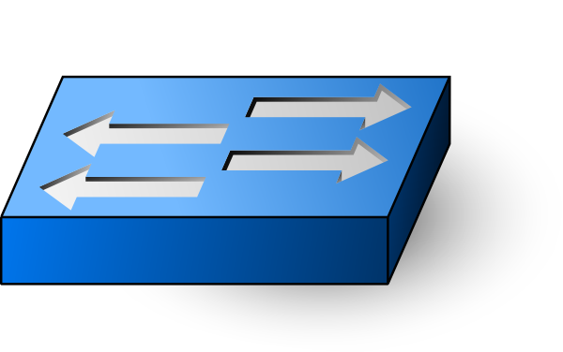
ONOS SDN controller
ONOS: Open Networking Operating System
Developed by ON.Lab, USA
High Availability (HA)
Load Balancing (LB)
Applications
Apps
North-bound Core API
Distributed Core
(state management, notifications, high-availability & scale-out)
South-bound Core API
Providers
Providers
Providers
Providers
Protocols
Protocols
Protocols
Protocols

Slide 50
Use-case Analysis
Common requirements : Multi-tenancy, low CAPEX and OPEX
Cloud Provider
Scenario : On-demand VN provisioning, virtual resource migration
Requirements : Flexibility, Control plane isolation, data plane isolation
Infrastructure Provider
Scenario : End-to-end QoS control, Network resource utilization
Requirements : Flexibility, Scalability, Control plane isolation, VN federation
5G Mobile Network Provider
Scenario : Service slicing
Requirements : Control plane isolation, data plane isolation

Slide 51
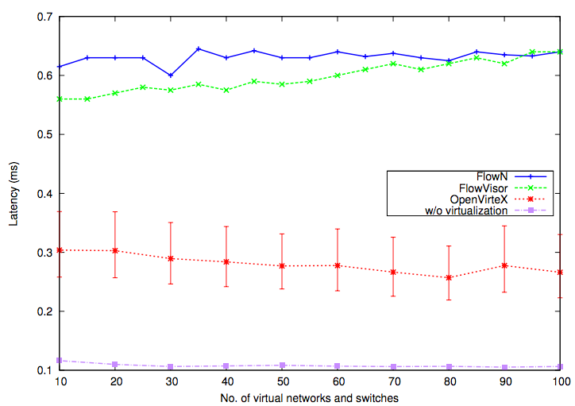
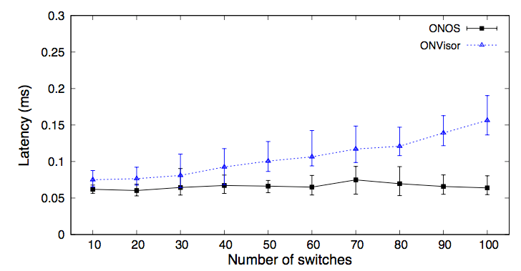
OpenVirteX performance
Test environment
A commodity laptop
2.3GHz quad-core Intel Core i7 (turbo boost up to 3.5GHz)
16GB 1600MHz memory
512GB PCI-e based flash storage
ONVisor latency
Al-Shabibi, M. De Leenheer, M. Gerola, A. Koshibe, G. Parulkar, E. Sal- vadori, and B. Snow, “Openvirtex: Make your virtual sdns programmable,” in Proceedings of the Third Workshop on Hot Topics in Software Defined Networking, ser. HotSDN ’14. New York, NY, USA: ACM, 2014, pp. 25–30
OpenVirteX latency

Slide 52
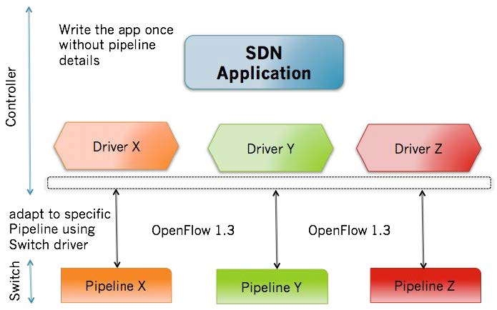
Virtual Flow Objective Service
Flow Objective Service
Service for device data plane
Independent of specific device table pipeline Impl.
Default Virtual Device Pipeliner
Normalize the operations for standard format
Single table pipeliner
Flow Objectives
29

Slide 53
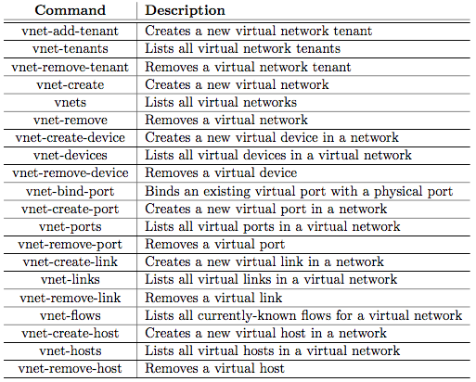
CLI

Slide 54
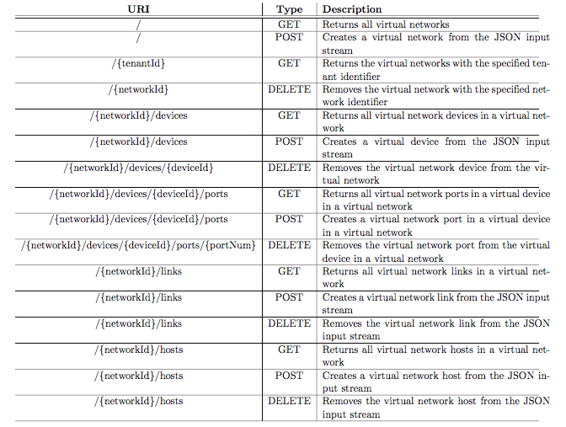
REST APIs

Slide 55
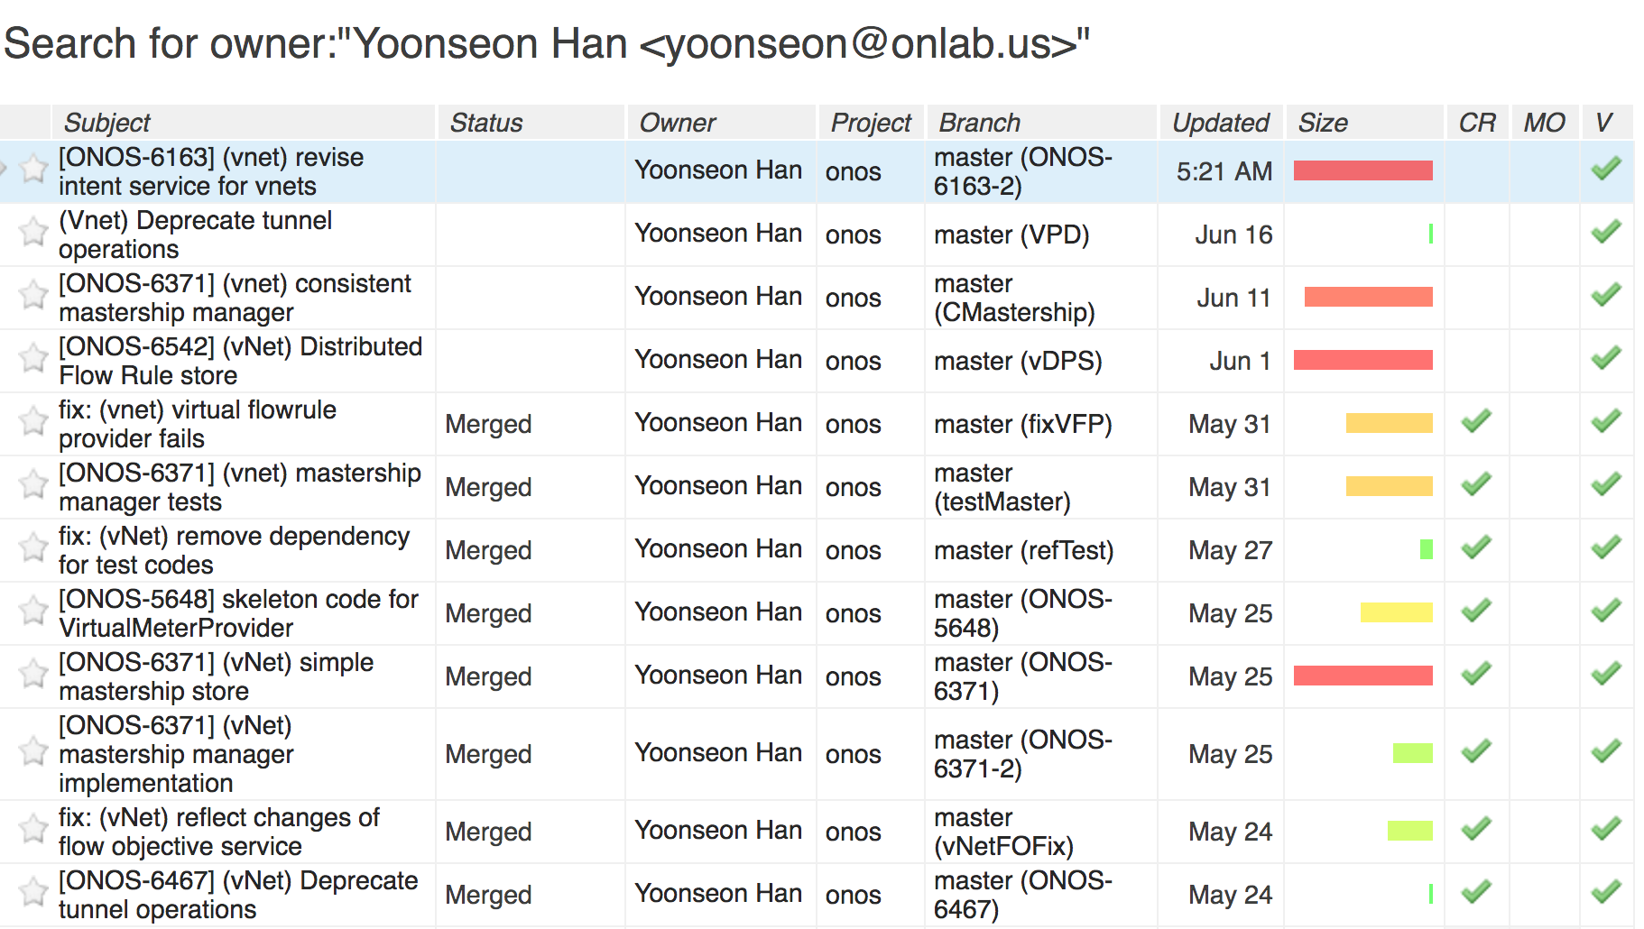
Open Source Contribution
Open Source Repository
As a sub-project of ONOS SDN controller
https://github.com/opennetworkinglab/onos

