Slide 1
A Management Architecture for
Client-defined Cloud Storage Services
Jae Yoon Chung
Supervisor: Prof. James Won-Ki Hong
Distributed Processing and Network Management Lab.
Dept. of Computer Science and Engineering
Pohang University of Science and Technology
dejavu94@postech.ac.kr
2014. 12. 15
Notes:
제 박사 졸업 심사 주제는

Slide 2
Outline
Introduction
Related Work
CLIent-defined storage Management Architecture (CLIMA)
Client-defined privacY-protected
Reliable cloUd Storages (CYRUS) Design
CYRUS Implementation
Evaluation
Conclusion

Slide 3
Introduction
Top 10 Strategic Technology Trends
2012 | 2013 | 2014 | 2015
Big data | Strategic big data | Smart machines | Smart machines
Extreme low-energy servers | Integrated ecosystems | Web-scale IT | Web-scale IT
Next generation analytics | Actionable analytics | 3D printing | 3D printing
App stores and marketplaces | Enterprise app stores | Software-defined anything | Software-defined applications/infrastructure
IoT | IoT | IoT | IoT
In-memory computing | In-memory computing | Cloud/client architecture | Cloud/client computing
Mobile-centric applications/interfaces | Mobile applications/HTML5 | Mobile apps and applications | Risk-based security/self-protection
Cloud computing | Hybrid IT/cloud computing | Hybrid cloud & IT as a service broker | Advanced pervasive/invisible analytics
Media tablets and beyond | Mobile device battles | Mobile device diversity/management | Computing everywhere
Contextual/social user experience | Personal cloud | Era of the personal cloud | Content-rich systems
Gartner, Top 10 Strategic Technology Trends for 2015, Analysts Examine Top Industry Trends at Gartner Symposium/ITxpo, Orlando, Oct. 5-9, 2014.
Notes:
가트너에서 발표한
네트워크 발전에 따라 클라우드 서비스를 단말에서 사용하기에 더욱 용이해짐.
클이언트에서 늘어나는 클라우드 리소스를 효과적으로 사용할 수 있도록 해야 함

Slide 4
Reliability and Security Concerns
Dropbox service down (Jan. 12, 2014)
  Loss master-replica pairs while updating OS
Outage for Google services (Jan. 24, 2014)
  55+ minutes service down
Outage Microsoft’s cloud services (Nov. 18, 2014)
  One hour service down affecting on
  OneDrive, MS Band, Xbox Live, Apps for Windows Phone
Private photos leaked from iCloud (Aug. 31, 2014)
  Almost 500 photos of celebrities
  Jennifer Lawrence
  Kate Upton
  Kaley Cuoco
SLA guarantees 99.9% service uptime
(8.76 hours service downtime in year)

Slide 5
Problem Statement
How to manage multiple cloud services?
How to improve privacy-protection of public cloud services?
How to integrate/coordinate multiple cloud storages?
How to realize client-defined storage management architecture?

Slide 6
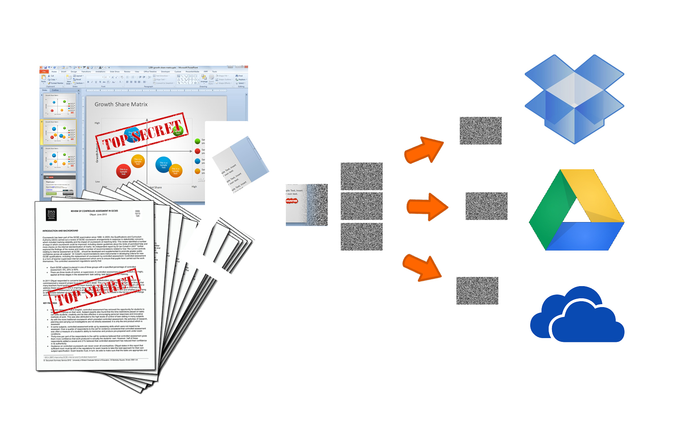
Research Motivation and Goal
Propose a management architecture for client-defined cloud storage services
Realize the proposed architecture as a client application that improves reliability, privacy-protection, and performance

Slide 7
Related Work (1/2)
Distributed storage systems
  Byzantine fault-tolerant system
  HAIL, RACS, Scalia, Ceph
Adopting techniques of storage systems to client-defined architecture
  Metadata management strategy
  Data deduplication
    ChunkStash, Content address caching with CZIP
  Data encoding for distributed storage
    (t, n) secret sharing, Erasure code

Slide 8
Related Work (2/2)
Client-based distributed storage
 | PiCsMu | InterCloud RAIDer | DepSky | Proposed Approach
(t, n) property | No | Yes | Yes | Yes
Concurrency | No | No | Yes | Yes
Data deduplication | No | Yes | No | Yes
Versioning | No | Yes | Yes | Yes
Optimal cloud selection | No | No | No | Yes
Elastic Reliability | No | No | No | Yes
Client-based Architecture | Yes | Yes | Yes | Yes

Slide 9
CLIent-defined storage
Management Architecture
                Overview
                Application Domain
                Cloud Domain
                Network Domain

Slide 10
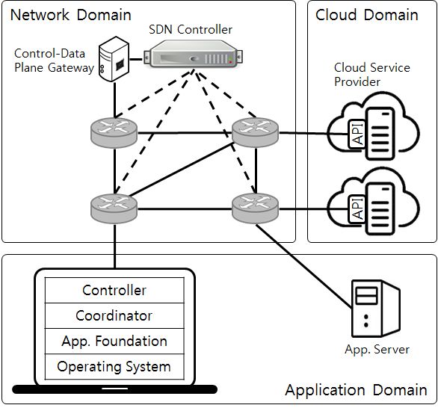
CLIent-defined storage Management Architecture
Define domains
  Different manageability
Define components
  Coordination and cloud control
Define data format
  Metadata and encoding data
Define data sync protocol
  Client-based approach
Develop optimization algorithm
  Optimal cloud selection

Slide 11
CLIMA – Application Domain
Application Domain
  Fully-manageable
  Similar with legacy Internet applications
Client
  Implementation of application functions
  Coordinator to schedule requests to multiple clouds
  Controller to access different cloud APIs
Server (optional)
  Implementation of supplementary functions
  Do not use as proxy

Slide 12
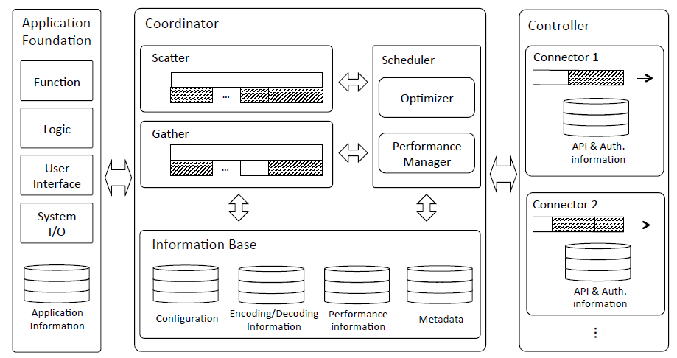
CLIMA Application

Slide 13
CLIMA – Cloud Domain
Cloud Domain
  Offer resources
  Partially-manageable
  IaaS: fully manageable
  PaaS and SaaS: limited by available APIs
Unify different clouds
  Understanding different implementations

Slide 14
CLIMA – Network Domain
Network Domain
  Link between client and clouds
  Not manageable
  No available APIs
Active probing
  Send packets through network
Passive monitoring
  Measure statistics
Limited information
  Based on inference

Slide 15
Client-defined privacY-protected
Reliable cloUd Storages Design
              Unifying Heterogeneous CSPs
              Ensure Privacy and Reliability
              Metadata and Data Sync Protocol
              CSP Selection Algorithm

Slide 16
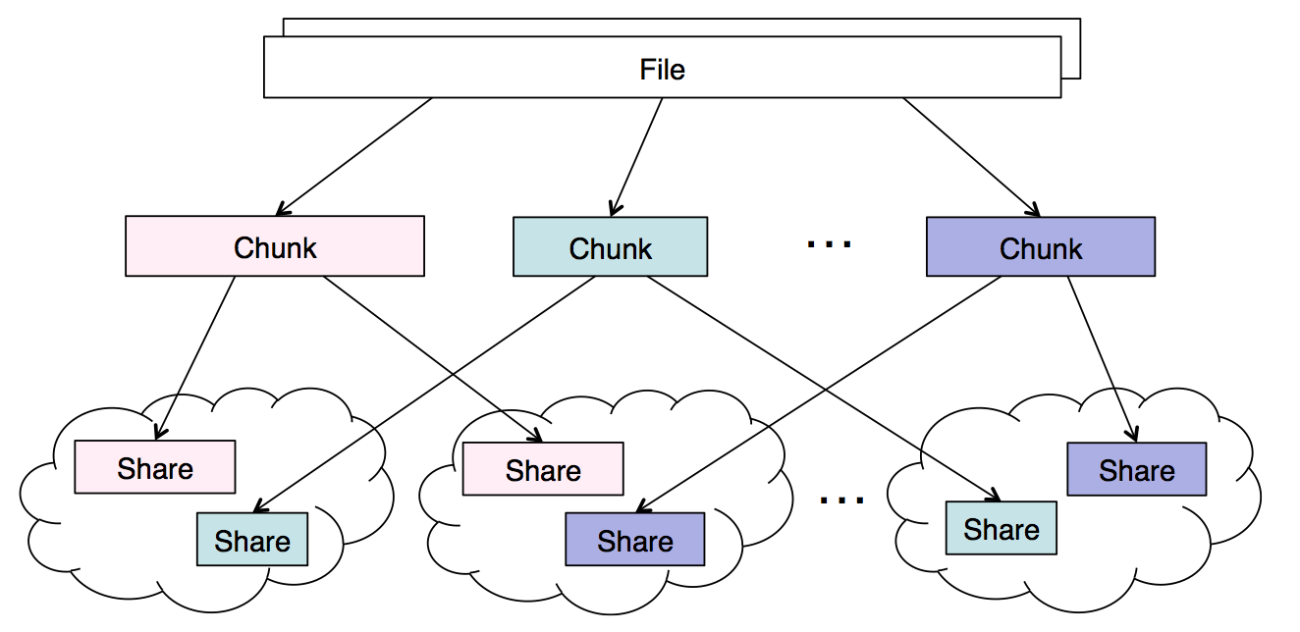
Design Considerations
Unifying heterogeneous CSPs (Cloud Service Providers)
  Without changing cloud APIs
Improve storage efficiency for version management
  Do not store duplicated data
File chunking
for data deduplication
Chunk encoding
for ensuring
privacy and reliability
Notes:
이 순서에 따라 구현

Slide 17
Data Deduplication – File into Chunks
Size-based chunking vs. content-based chunking
  Size-based chunking: unchanged data region could be detected as new chunks
  Content-based chunking: changed data region is detected as new chunks only
Size-based chunking
Content-based chunking
0101 | 0010 | 1010 | 1111 | 1010 | 1001 | 0110 | 1100 | 1011 | 1010
0101 | 0010 | 1010
0010
1111
1010 | 1001 | 0110 | 1100
1011 | 1010
0101 | 0010 | 1010 | 1111 | 1010 | 1001 | 0110 | 1100 | 1011 | 1010
0101 | 0010 | 1010
1111
1010 | 1001 | 0110 | 1100
1011 | 1010
0010

Slide 18
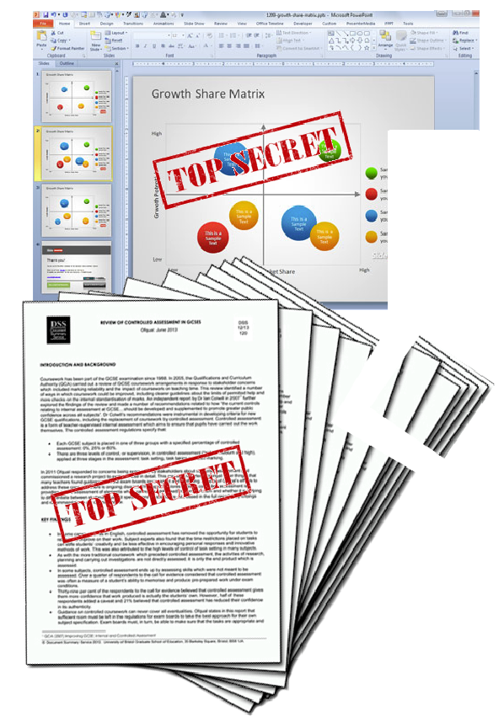
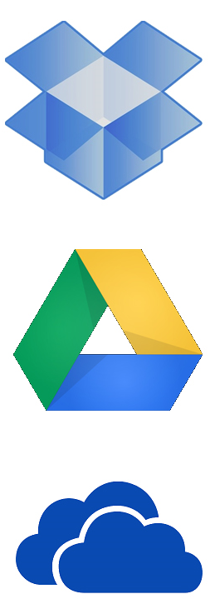
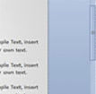


Ensure Privacy and Reliability
(t, n) threshold property
  Encode a chunk into n shares
  Need any t shares to decode data
Ensuring privacy and reliability
  At least t accounts are needed – privacy protection
  Allow failures at most n-t CSPs – reliability

Slide 19
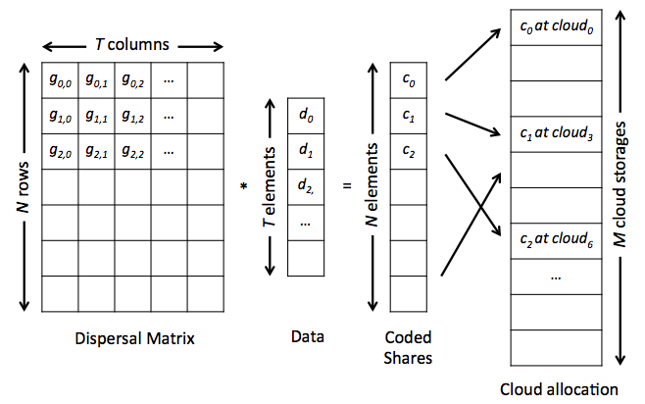
Encode chunk into shares
Reed-Solomon Code
  Generate n equations with t variables
  Hide data to the t unknown variables
  Distribute n shares (constant term) to clouds
  Need any t equations to find solution (original data)
Store n shares to clouds
Original file size = b |  | Shamir | RS Code
Storage overhead | One CSP | b | b/t
 | Total | n*b | n*(b/t)
Trans-mission overhead | Upload | n*b | n*(b/t)
 | Download | t*b | t*(b/t)=b

Slide 20
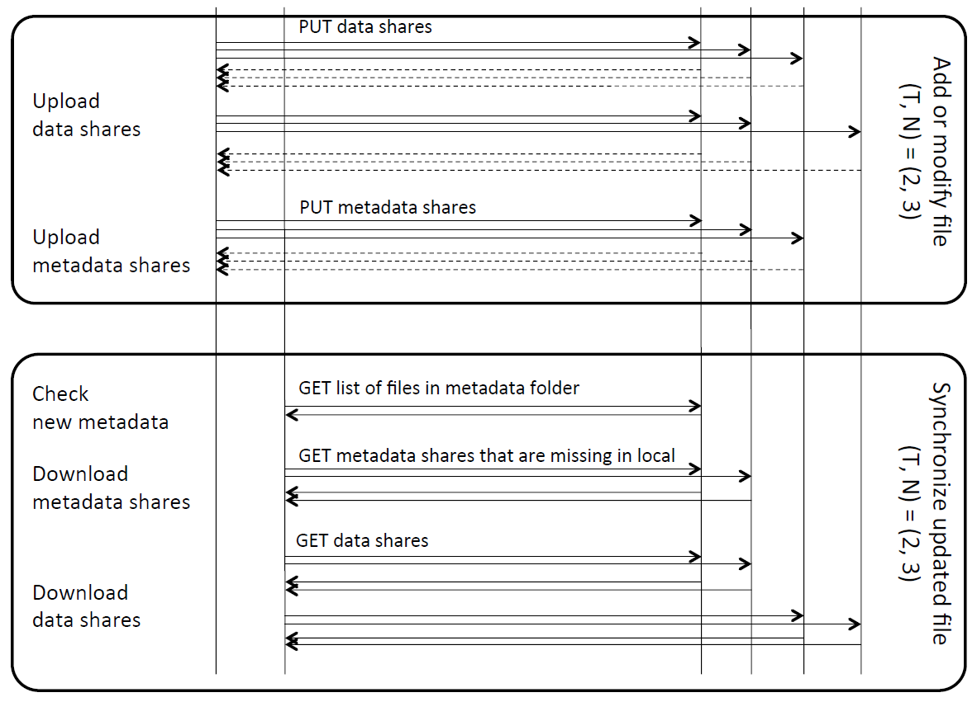
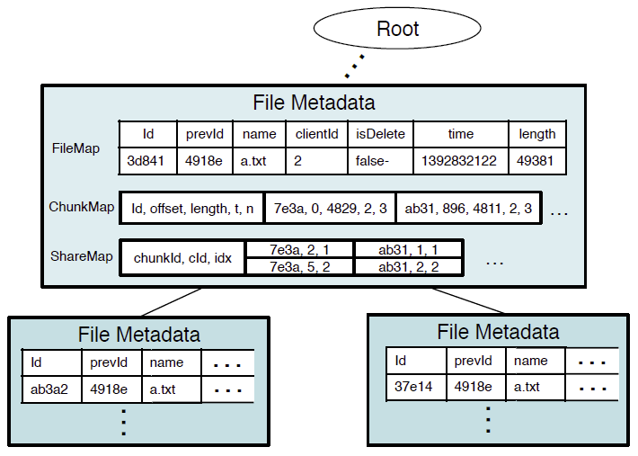
Metadata and Data Sync Protocol
Metadata stored at CSPs
  A metadata represents a file update
  Listing files in metadata folder detects new updates
Metadata format
  FileMap, ChunkMap, ShareMap

Slide 21
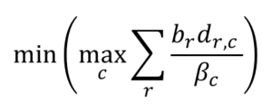
CSP Selection Algorithm
Schedule
Round-Robin
Optimal
CSP selection and performance optimization
  Minimize maximum download time of CSPs
  Indicator d_{r,c} selects t*R shares from n*R shares
    1 if chunk r is downloaded from CSP c
    0 otherwise
    Download more shares from faster CSPs
c : CSP index
r : chunk index
b_{r} : size of chunk r
d_{r,c} : indicator
β_{c} : bandwidth of CSP c

Slide 22
Client-defined privacY-protected
Reliable cloUd Storages – Implementation
                Addressing Shares
                Zfec (RS code) Modification
                DEMO

Slide 23


Addressing Shares
When uploading n shares
  Select n CSPs from C CSPs
  Avoid uploading duplicated shares
Content-based naming scheme
  Store the same shares to the same locations
Abstracting CSP-side operations
  Don’t UPDATE or DELETE files in CSP → lock-free read/write
  Require GET and PUT APIs only
SHA-1 Hash
Consistent Hash
1234abcd
Filename: xyz…
Overwrite
but the content is the same
1234abcd

Slide 24
Zfec (RS code imp.) Modification
2⁰ | 4⁰ | 3⁰ | 7⁰ | 5⁰
2 | 4 | 3 | 7 | 5
2² | 4² | 3² | 7² | 5²
2³ | 4³ | 3³ | 7³ | 5³
2⁴ | 4⁴ | 3⁴ | 7⁴ | 5⁴
2⁵ | 4⁵ | 3⁵ | 7⁵ | 5⁵
2⁶ | 4⁶ | 3⁶ | 7⁶ | 5⁶
Generating dispersal matrix
  Generate a vector with T elements from key string
  Each user uses different dispersal matrix
  The only effort for user is to remember key string

Slide 25
Evaluation
                Testbed Experiments
                Real-World Benchmarking
                Comparison with DepSky
                Deployment Trial Results

Slide 26
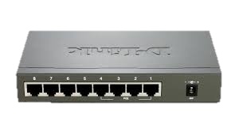
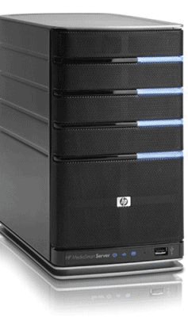
Testbed Experiments (1/3)
Testbed setup
  Traffic shaping using NetEM
  FTP servers as storages
  Upload/download 172 files (638 MB)
  in Documents directory
2 MB/s
15 MB/s

Slide 27
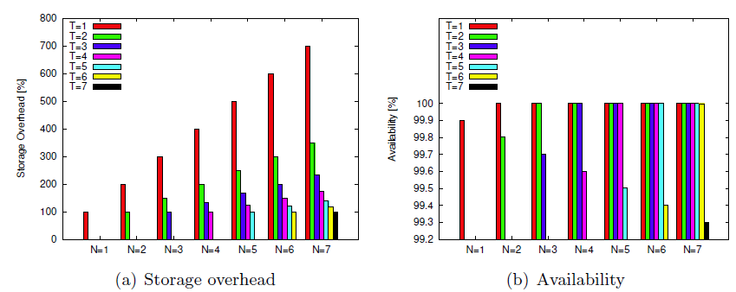
Testbed Experiments (2/3)
Storage overhead [%]
Storage reliability [%]
Storage overhead
Storage reliability
Storage overhead
  Increasing overhead when increasing n
  Decreasing overhead when t is close to n
Reliability (assuming reliability of a CSP is 99.9%)
  When t=n, reliability is lower than single CSP
  When t<n, reliability is close to 100%
    99.999999% with (2, 4) configuration
n: number of distributed shares
t : number of required shares

Slide 28
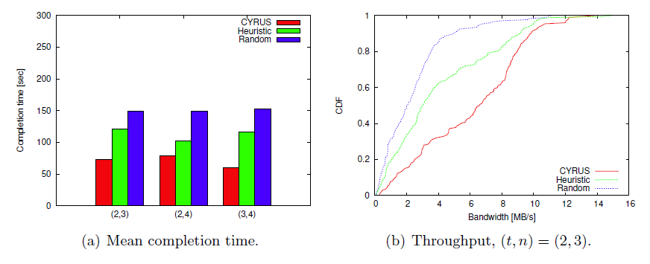
Testbed Experiments (3/3)
Download completion time while changing cloud selection algorithm
  CYRUS with optimal selection shows the best performance
Performance bottleneck is upload/download time to/from slow CSPs
  More shares are downloaded from faster CSPs
  to reduce completion time

Slide 29
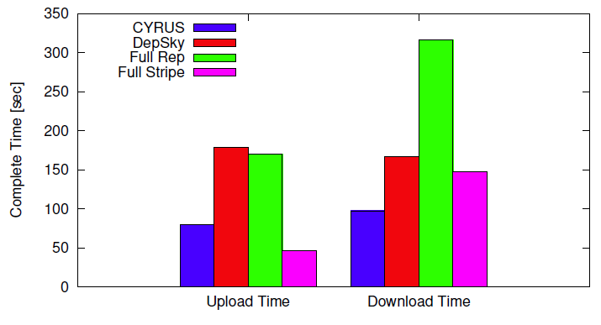
Real-World Benchmarking
Completely
parallel transmission
Completion time to upload/download a 40 MB file with
(2,3) configuration
  Google, Dropbox, Microsoft, Box.com
  Compare CYRUS with baseline approaches and DepSky

Slide 30
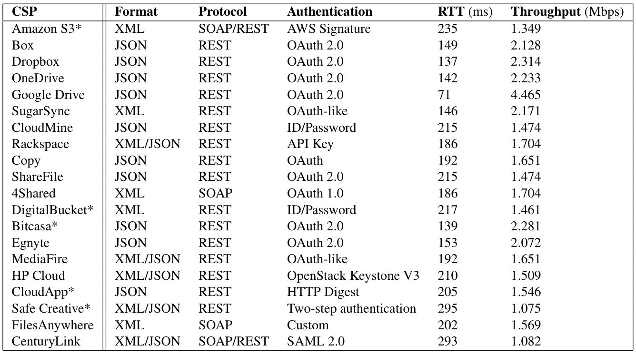
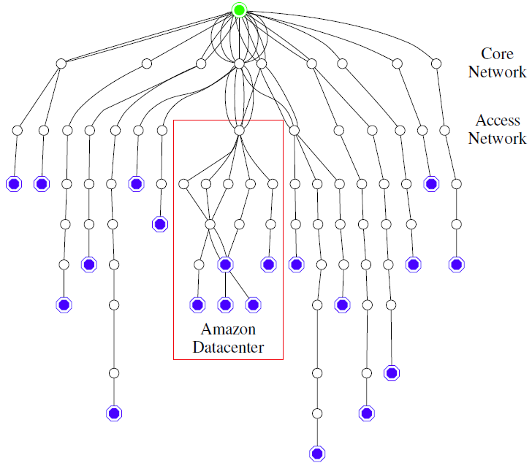
Avoiding CSP Dependency
Active probing from client using TRACEROUTE
  Measuring logical topology from client to CSPs
  Understand location and dependency of CSPs
  Detect five CSPs are deployed on Amazon
Detection time is less important
  Deployment locations of cloud services are not frequently changed

Slide 31
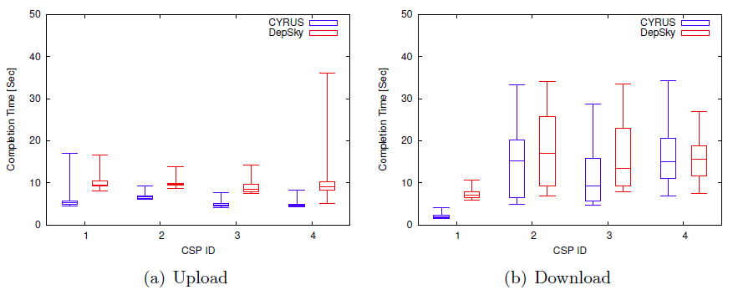
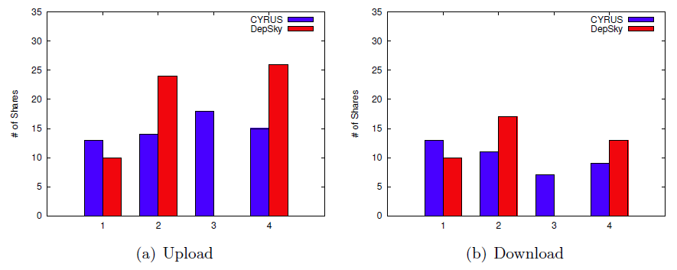
Comparison with DepSky
Locking overhead of DepSky
DepSky always selects fastest clouds

Slide 32
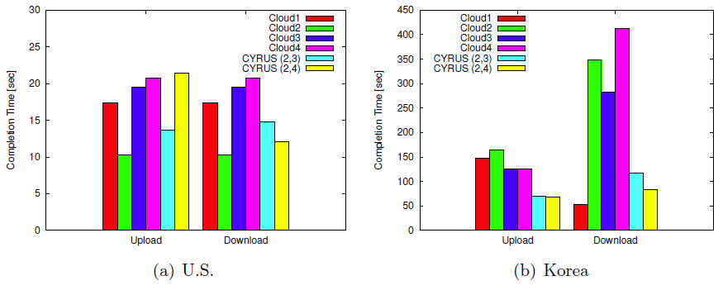
Deployment Trial Results
CSP1
CSP2
CSP3
CSP4
CYRUS (2,3)
CYRUS (2,4)
CSP1
CSP2
CSP3
CSP4
CYRUS (2,3)
CYRUS (2,4)
Recruit 20 academic users from US and Korea
  Collect event logs when CYRUS starts
Performance in United States - CSPs are fast
  Throughput is reached to client’s link capacity
Performance in Korea – CSPs are slow
  Boost up throughput by parallelizing transmissions

Slide 33
Conclusion - Contributions
Proposed CLIent-defined storage Management Architecture
  Aimed at developing entire features of storage research and commercial storage services
  Defined domains, protocols, data format, algorithm
Realized CLIMA as client app. called CYRUS
  Specified requirements and functions of storage services
  Adopted storage area research to CLIMA
  Implemented and deployed prototype in US and Korea
Evaluated performance
  Performed experiments with testbed and commercial CSPs
  99.999999% reliability with (2, 4) configuration
  Compared completion time with baseline approach and DepSky

Slide 34
Conclusion – Future Work
P2P-based metadata exchange
  Design direct metadata exchange protocol
  Develop file sharing function for multiple users
  Develop access control scheme
Extending Network Domain
  Integrate CLIMA with Software-Defined Networking research
  Develop network-side interfaces to interact
  with client applications
  Develop protocols for client applications to obtain network information and to reserve network resource

Slide 35


Slide 36
Appendix

Slide 37
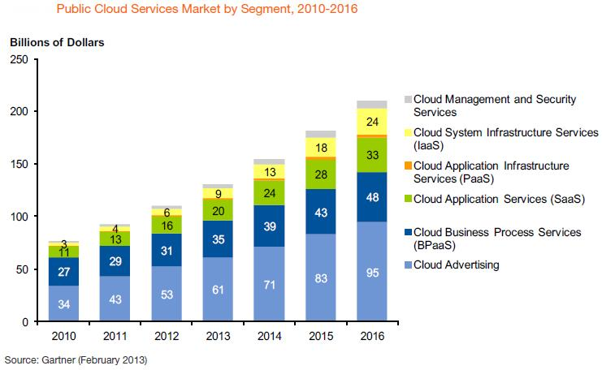
Cloud Storage Market
Cloud storage market
  244 billion dollars
  in 2017 - Gartner 2013
Trend
  Security and privacy protection
  Hybrid cloud
  Integrating cloud accounts

Slide 38
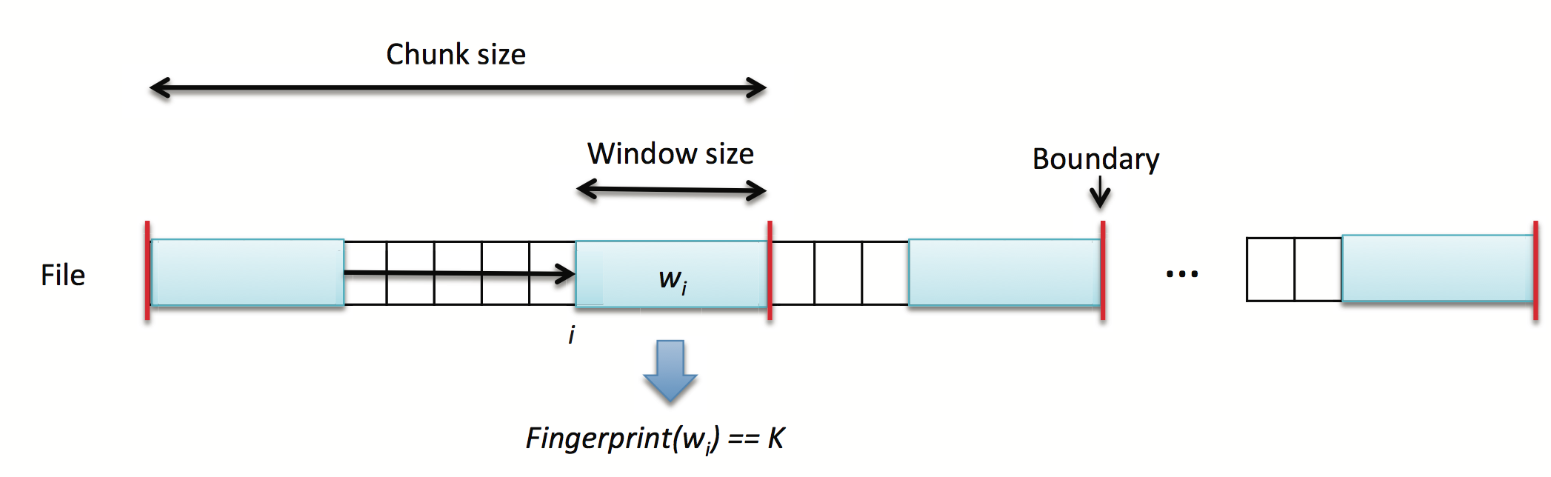
Content-based Chunking
File chunking using Rabin’s fingerprinting
  Calculate fingerprint while moving window
    If fingerprint is the same with pre-defined value, set chunk boundary

Slide 39
Example - Content-based Chunking
0101 | 0010 | 1010 | 1111 | 1010 | 1001 | 0110 | 1100 | 1011 | 1010
Hash(x): x%4
Data deduplication
  Do not store duplicated chunks
  High benefit for version control (modification history)

Slide 40
Design Considerations
Unifying heterogeneous CSPs
Ensuring privacy and reliability
Concurrent file access
Client-based architecture
CSPs selection and performance optimization

Slide 41
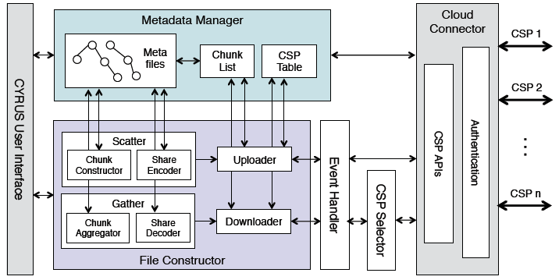
CYRUS Implementation - Client

Slide 42
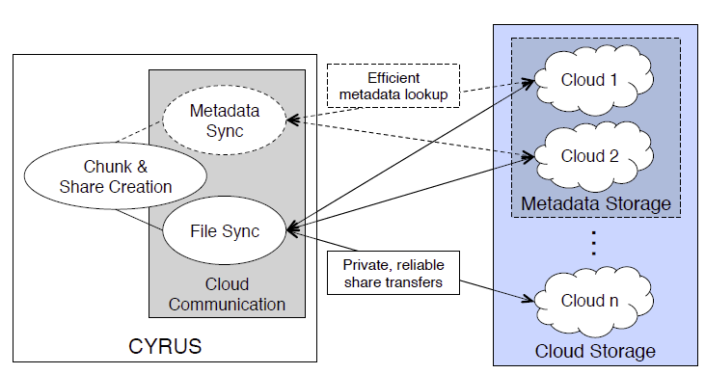
Decoupling metadata and file control

Slide 43
Decoupling Metadata
Metadata stored at CSPs
  A metadata represents a file update
  Listing files in metadata folder detects new updates
Metadata format
  FileMap, ChunkMap, ShareMap

Slide 44
Unifying Heterogeneous CSPs

Slide 45
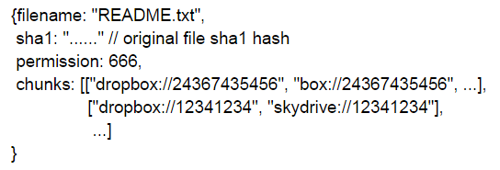
Metadata Format
Written in JSON
FileMap: file’s metadata
ChunkMap: Sequence of required chunks
ShareMap: Mapping information between shares and clouds

Slide 46
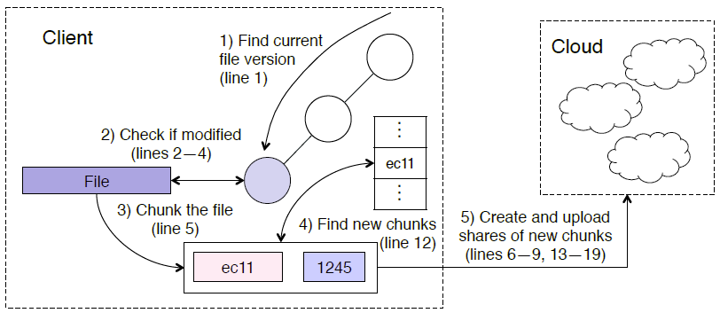
Upload

Slide 47
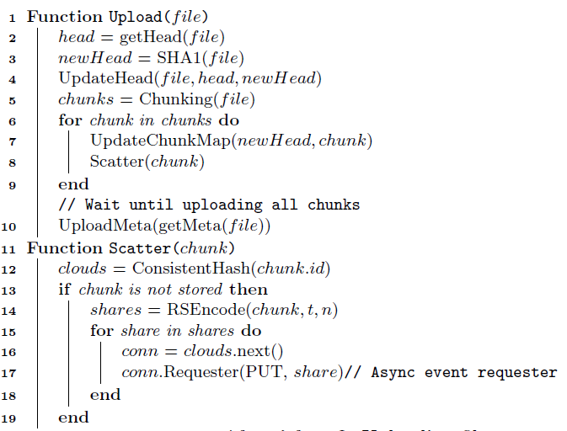
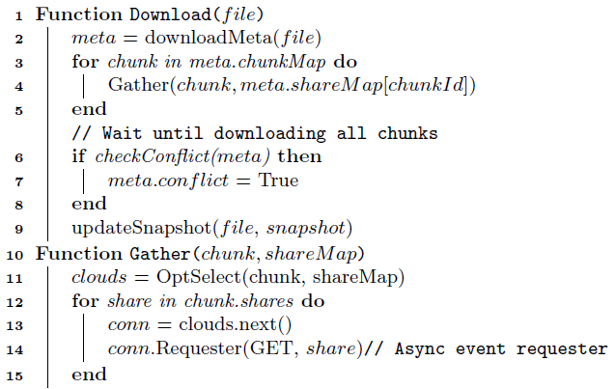
Upload/Download Procedure

Slide 48
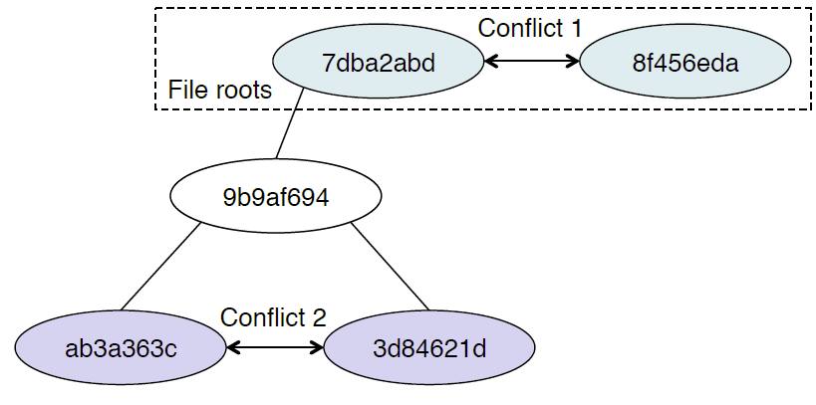
Distributed Conflict Detection

Slide 49
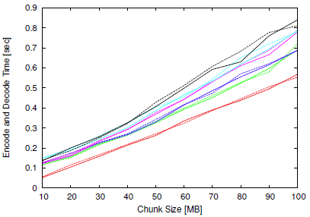
Performance of Modified Zfec
Original Zfec - solid; Modified Zfec - dashed
Different configurations
  (2, 3)
  (2, 4), (3, 4)
  (2, 5), (3, 5), (4, 5)

Slide 50
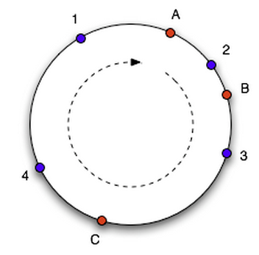
Consistent Hash

