Slide 1
Fine-grained Internet Traffic Classification based on Functional Separation
- PhD Thesis Defense -
Byungchul Park
fates@postech.ac.kr
Supervisor: Prof. James Won-Ki Hong
December 16, 2011
Distributed Processing & Network Management Lab.
Dept. of Computer Science and Engineering
POSTECH, Korea

Slide 2
Table of
Contents
01 Introduction
Traffic classification
Problems in traffic classification
Research motivation
Research approach
02 Related Work
Traffic classification approaches
Traffic classification level
03 Fine-grained Traffic Classification
Scope and objectives
Fine-grained traffic classification process
Input data collection
Functional separation
Classification filter extraction
04 Validation
Functional separation Result
Classification accuracy
Comparison with conventional DPI solutions
Comparison with clustering algorithm
05 Concluding Remarks
Summary
Contributions
Future work

Slide 3
Introduction
Internet Traffic Classification
  Classifying traffic based on features passively observed in the traffic, and according to specific classification goals
  Features could include
    Port number
    Application payload
    Temporal & statistical information
    Etc
TC
ATC
Traffic
Class 1
Class 2
App. 1
App. 2
Classification process
…
Class n
App. n
Features
Focus on traffic composition

Slide 4
Introduction
Needs for traffic classification in network management
  To understand the behavior of networks
  To understand the usage patterns by users
  To perform trend analysis for network planning
  To provide information for various applications such as usage-based accounting, intrusion detection
  To monitor SLA and QoS
Diversity of today’s Internet traffic
  New types of network applications – P2P, game, streaming
  Complicated (multi-functional) applications
  Increase of P2P traffic
  Various techniques for avoiding detection

Slide 5
Problems in Traffic Classification
Achieving high-level of accuracy and completeness
  New types of network applications
  Complex characteristics of network applications
  Mystification techniques
Analysis on traffic classification results
  Various classification methodologies
  Classification details are bounded to identifying protocols or applications in use
  Limited amount of information

Slide 6
Research Motivation
Previous studies have discussed various classification approaches
Many variants of classification approaches have been introduced continuously to improve the classification accuracy
Achieving 100 percent accuracy is extremely difficult
We need to investigate how we can provide more meaningful information with limited traffic classification results (amount of information)

Slide 7
Research Approach
Previous
Researches
Focusing on main functionality of an application
Enhancing classification methods or individual classification filters
Increasing number of applications
Achieving High Accuracy & Completeness
Detecting minor functionalities as well as main functionality
Proposed
Method
Main
Func.

Slide 8
Related Work

Slide 9
Traffic Classification Approaches
Port-based approaches [CoralReef, Caida]
  TCP port 20 and 21: FTP
  TCP port 80 or 8080: HTTP
Contents-based approaches [S. Sen, WWW ’04]
  “0x12BitTorrent protocol”: BitTorrent
  “HTTP” or “GET”: Web
Machine Learning-based approaches [A. Mcgregor, PAM ’04]
  connection-related statistical information-including connection duration, inter-packet arrival time, and packet
Surveys on traffic classification [CAIDA ’09, 68 papers]
 | Accuracy | Strength | Weakness
Port-based | Low | Low computational cost | Low accuracy
Contents-based | High | Most accurate method | High computational cost Exhaustive signature generation
ML-based | High | Can handle encrypted traffic | High computational cost

Slide 10
Traffic Classification Level
In the perspective of network layers
Network Layer
IP, ARP, RARP, etc.
Transport Layer
TCP, UDP, ICMP, etc.
Application Layer
HTTP, HTTPS, SMTP, FTP, TELNET, SSH, POP, etc.
We surveyed about 90 papers (’94~’10)
Classification levels in practice (classification output)
Traffic clustering
Bulk transfer, small transaction, etc.
Application-type breakdown
Web, game, P2P, messenger, streaming, mail, etc.
Application protocol breakdown
HTTP, HTTPS, SMTP, FTP, TELNET, SSH, POP, etc.
Application Breakdown
BitTorrent, MSN, NateOn, Filezilla FTP, etc.

Slide 11
Fine-grained Traffic Classification

Slide 12
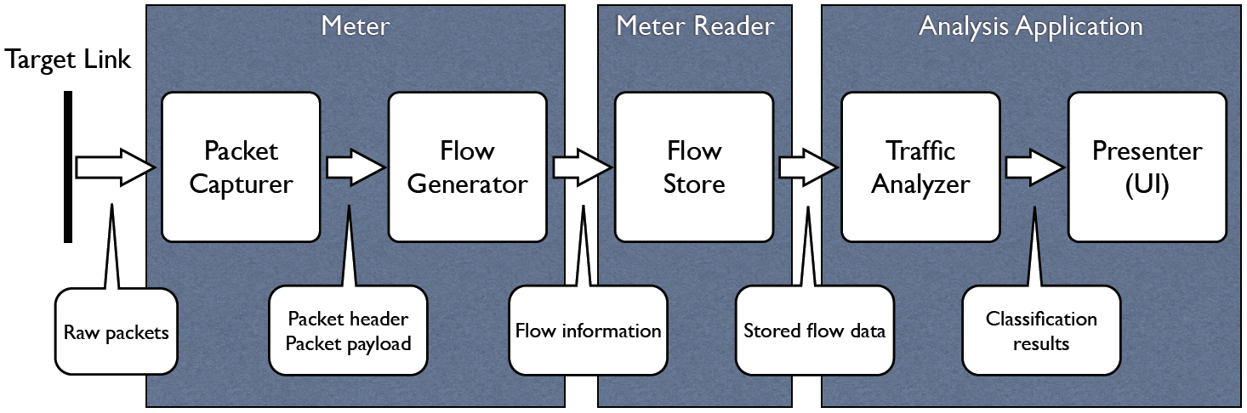
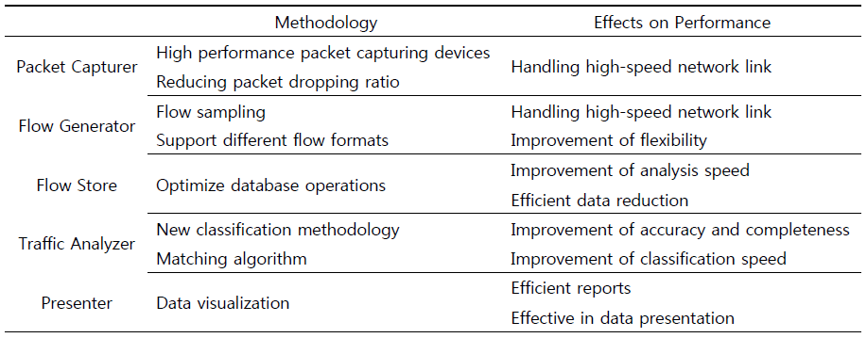
Scope and Objectives
General architecture of a typical Internet traffic classification system

Slide 13
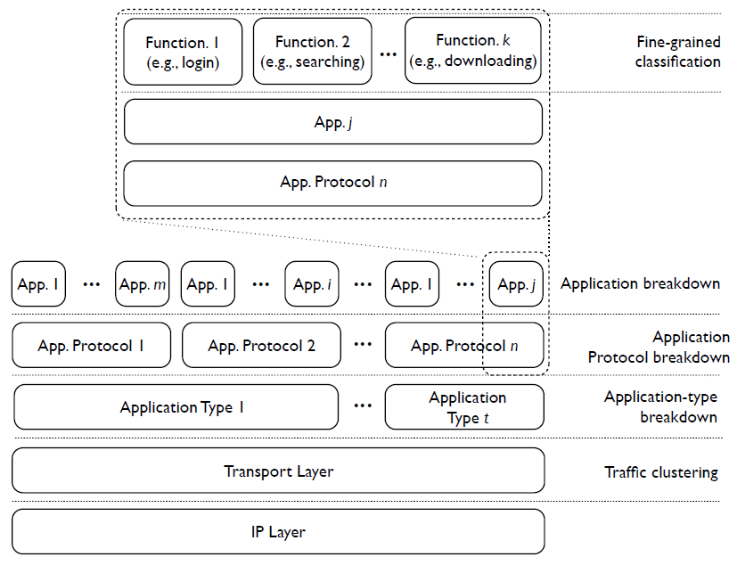
Fine-grained Traffic Classification
ALFTP
Filezilla
FTP Protocol
File Transfer Application or FTP Application
Small Transaction
Bulk Transfer

Slide 14
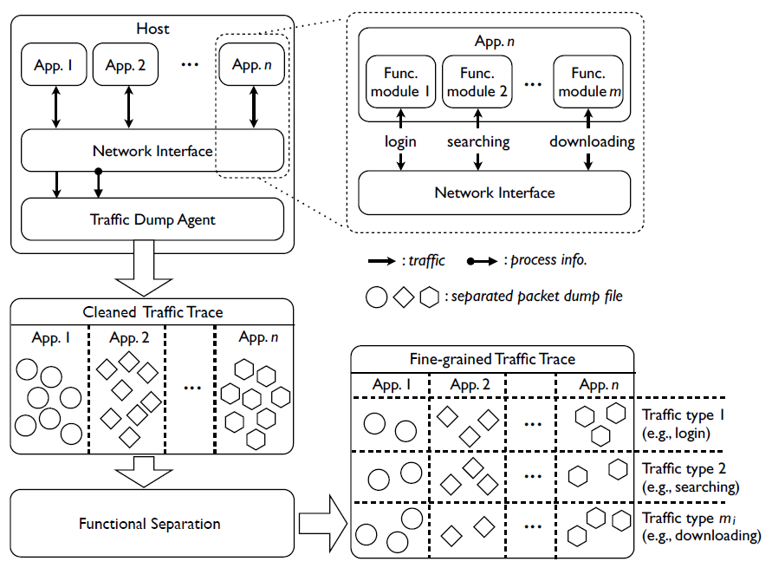
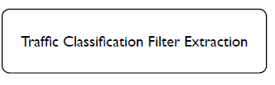

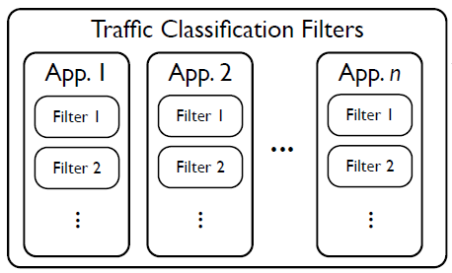
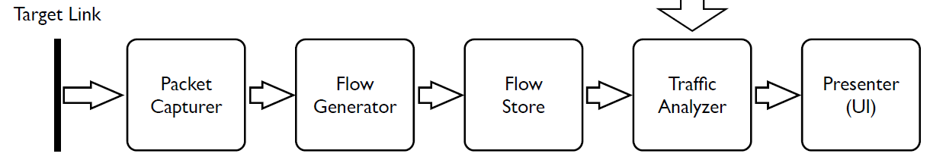
Fine-grained TC Process
Application
Offline process
Online process

Slide 15
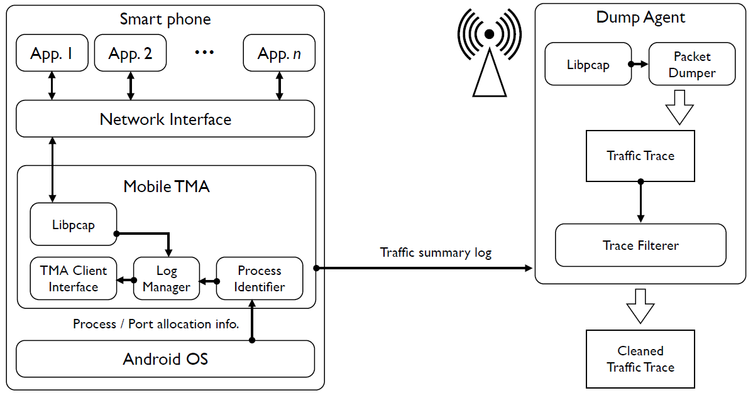
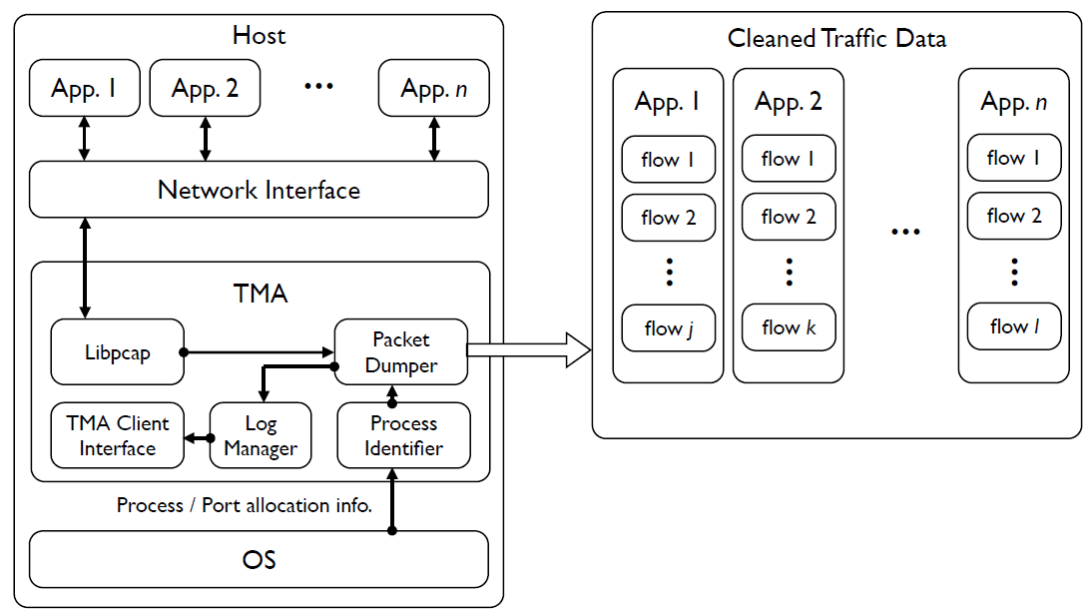
Application Data Collection
Internal structure of mTMA and dump agent
Internal structure of TMA
BACK

Slide 16
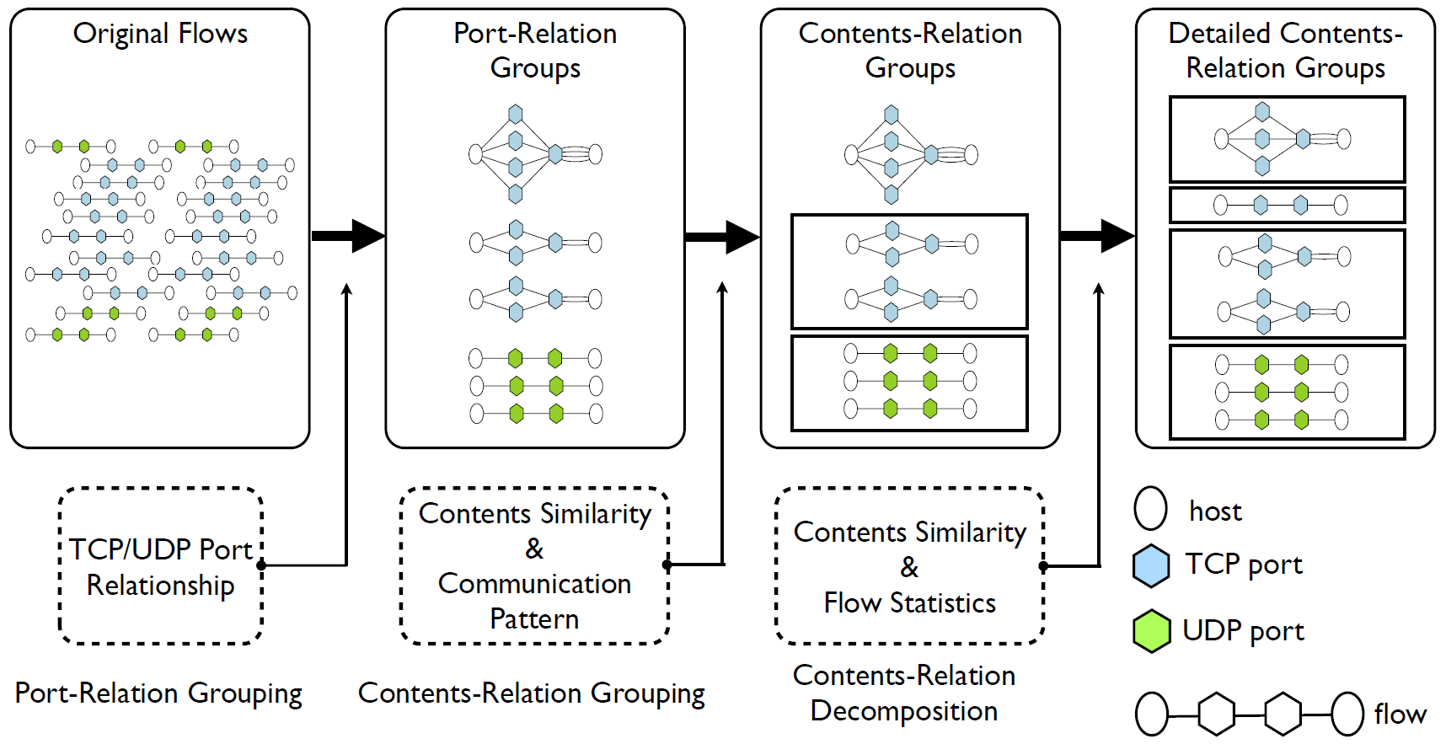
Functional Separation
The Functional Separation consists of 3 consecutive steps
  Port-Relation Grouping (PRG)
  Contents-Relation Grouping (CRG)
  Contents-Relation Decomposition (CRD)

Slide 17
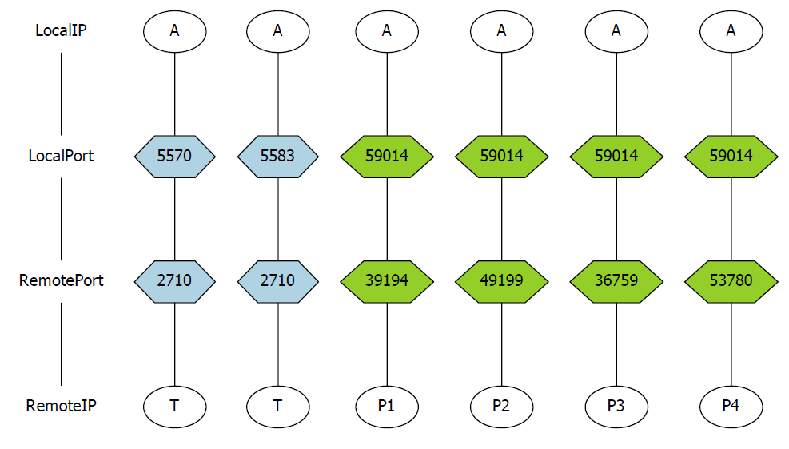
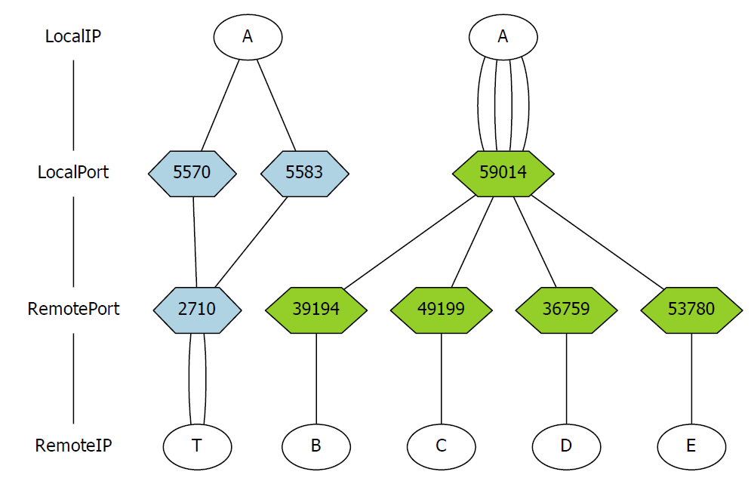
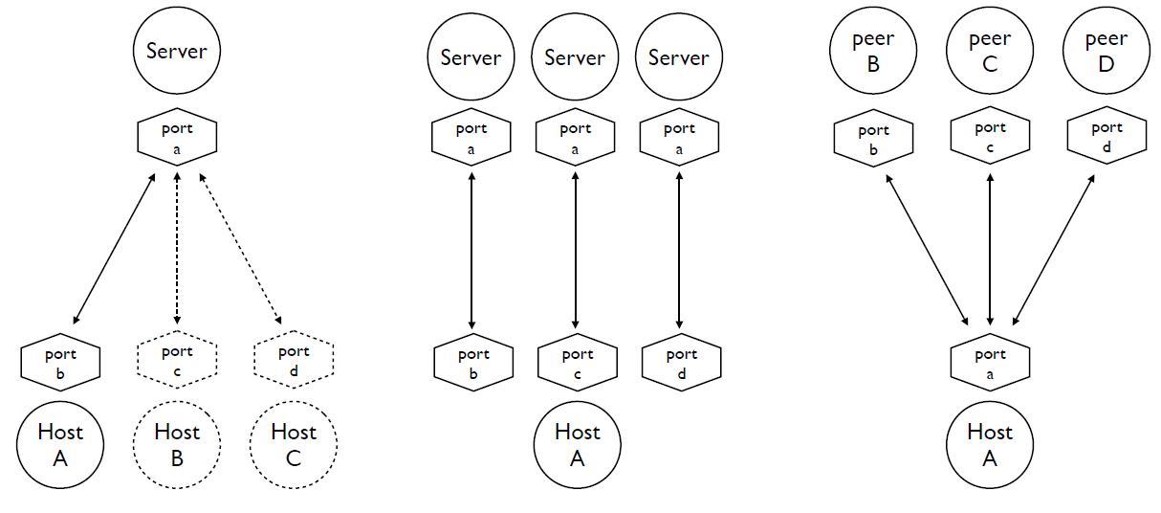

Port-Relation Grouping (PRG)
Group individual flows according to dependency of port number
Port number are treated as indexes without any function-related information
Example of PRG on BitTorrent traffic
Connection behavior of a host

Slide 18
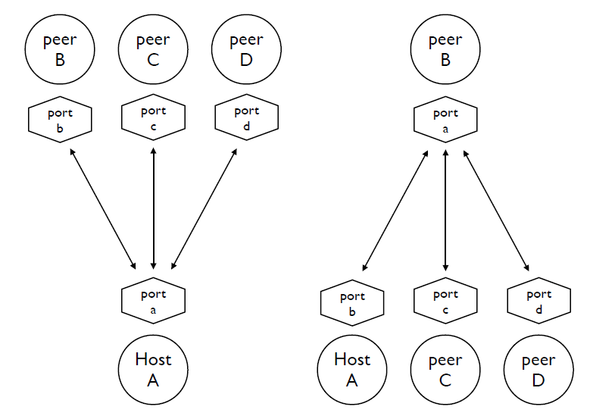
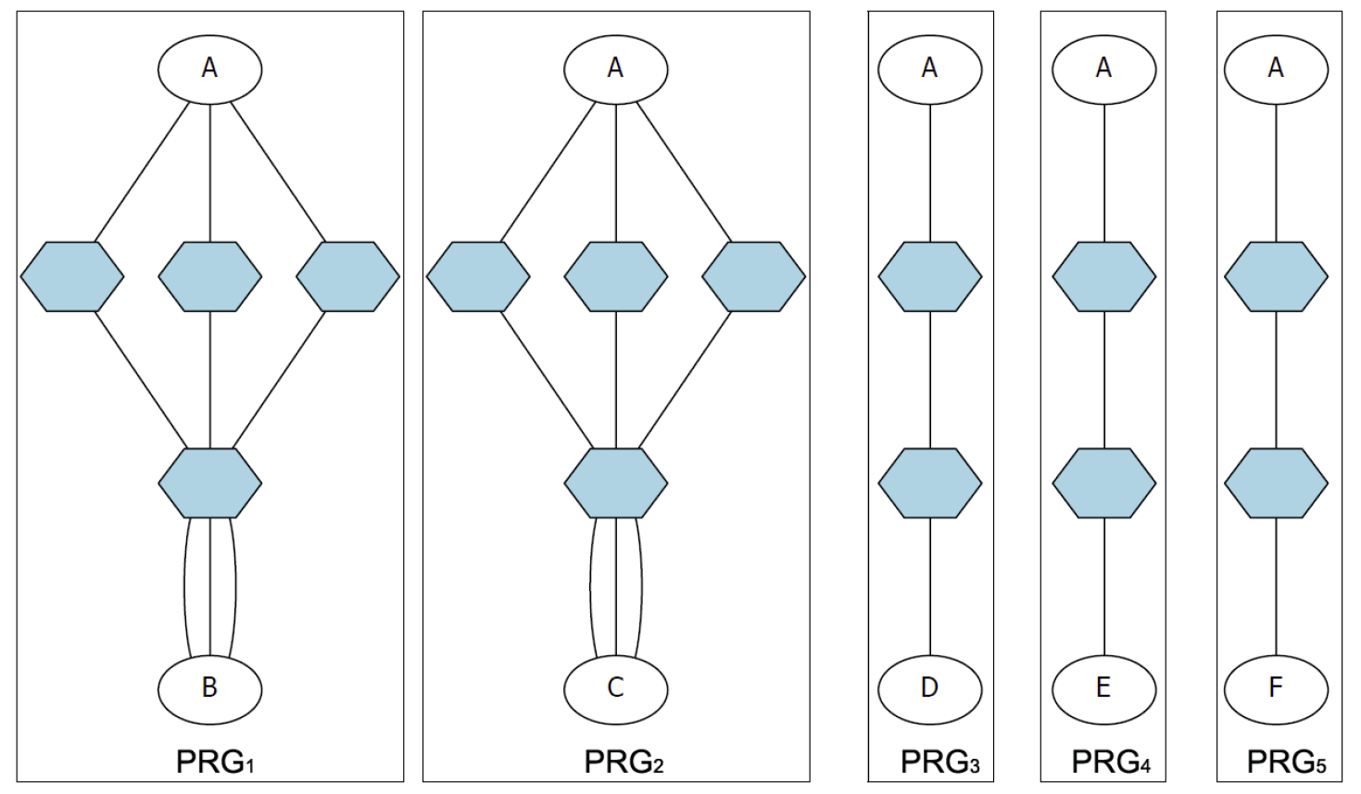
Contents-Relation Grouping (CRG)
Limitations of the PRG algorithm
  Cannot group flows originated from same functionality if flows allocate different port numbers
  Cannot discriminate different functional flows if they allocate same port number
CRG measures the similarity between different PR groups
  Compare the payload contents and measure the similarity between flows and PR groups
  Communication pattern and connection behavior are also considered in CRG
Example of connection patterns
Connection behavior of a P2P host

Slide 19
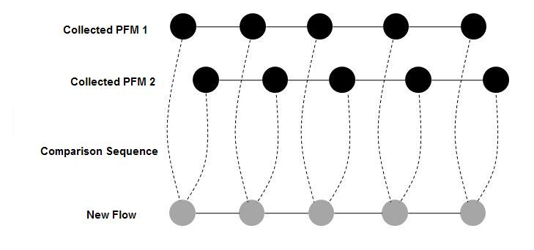
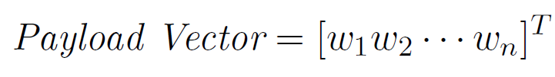

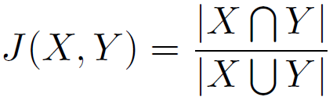

Contents-Relation Grouping (CRG)
1st packet
W₁₁
W₁₂
…
W_{1n}
PFM 1
W₁₁
W₁₂
…
W_{1n}
PFM 2
2nd packet
W₂₁
W₂₂
…
W_{2n}
PFM 3
W₁₁
W₁₂
…
W_{1n}
3rd packet
W₂₁
W₂₂
…
W_{2n}
…
…
…
…
…
W₂₁
W₂₂
…
W_{2n}
k^{th} packet
…
…
…
…
PFM m
W₁₁
W_{k1}
W₁₂
W_{k2}
…
…
W_{1n}
…
…
…
W_{kn}
W_{k1}
W_{k2}
…
…
W₂₁
W₂₂
…
W_{kn}
W_{k1}
W_{k2}
…
W_{2n}
W_{kn}
…
…
…
…
W_{k1}
W_{k2}
…
W_{kn}
Definition of word: a payload data within a i-bytes sliding window
Payload vector conversion:
Payload flow matrix (PFM):
Similarity measure:
Similarity score:

Slide 20
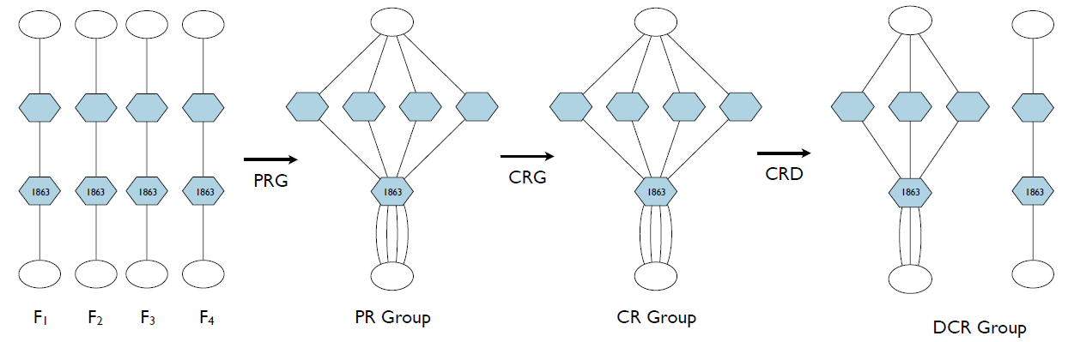
Contents-Relation Decomposition (CRD)
CRD discriminate different functionalities in a CR group based on contents similarity
Example of overall Functional Separation process
BACK

Slide 21
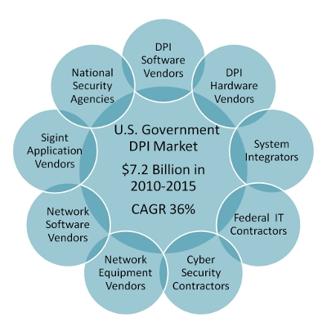
Classification Filter Extraction
Various kinds of classification filters
  Port-number
  Payload signatures
Deep Packet Inspection (DPI) – payload signature
  Known as most accurate classification filter
  Many commercial products adopts DPI
LASER algorithm
  Longest Common Subsequence (LCS) problem
  Detect common patterns shared by traffic data
U.S. Government Market Forecast 2010-2015
  Statistical analysis
  Etc.
Source: Market Research Media
BACK

Slide 22
Validation

Slide 23
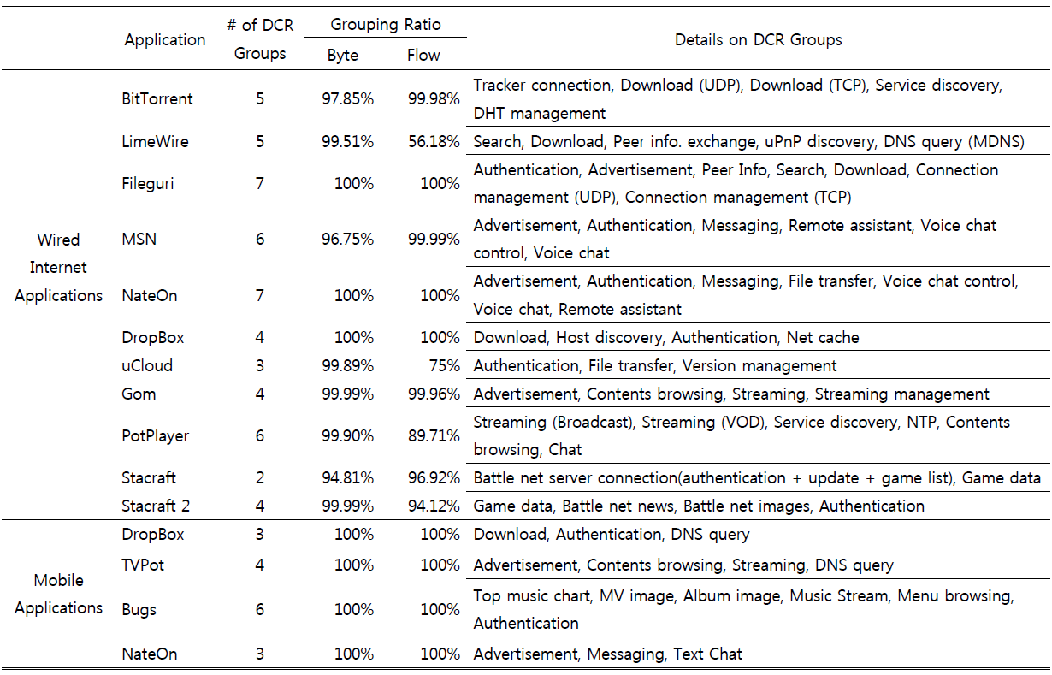
Functional Separation Result

Slide 24
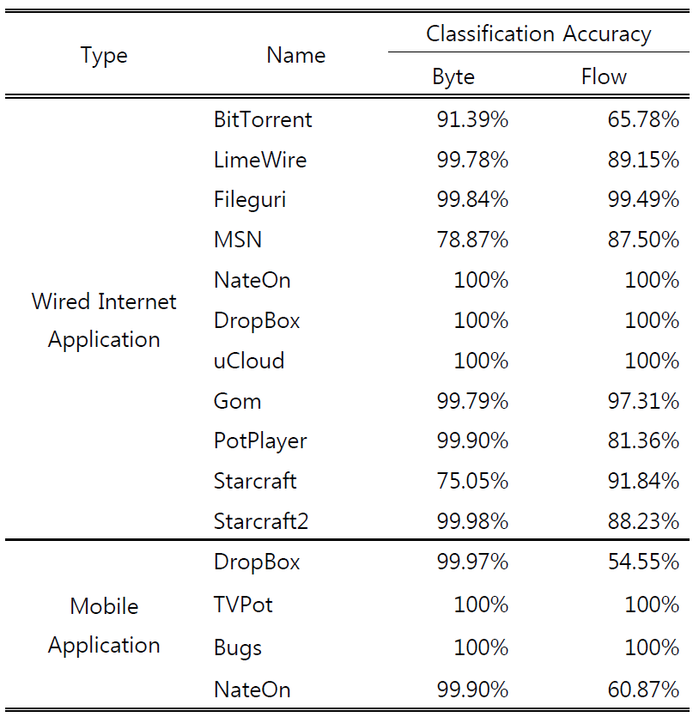
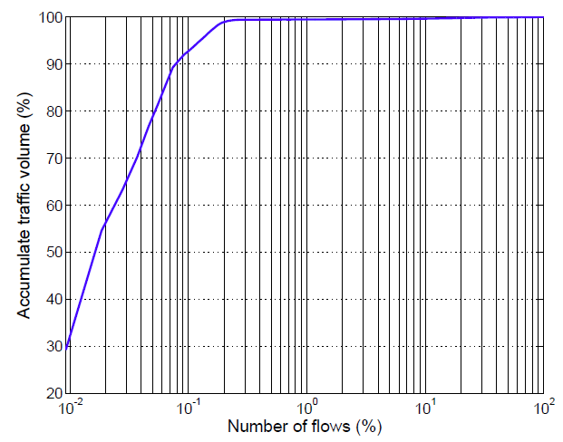
Traffic Classification Result
Low flow accuracy is caused by “Elephants and mice phenomenon”
Misclassified traffic
  Well-known protocols are used as a part of application protocol
  E.g., SSDP in BitTorrent
  E.g, SIP in MSN
  Flows with no payload contents
Contribution of top n % of lfows

Slide 25
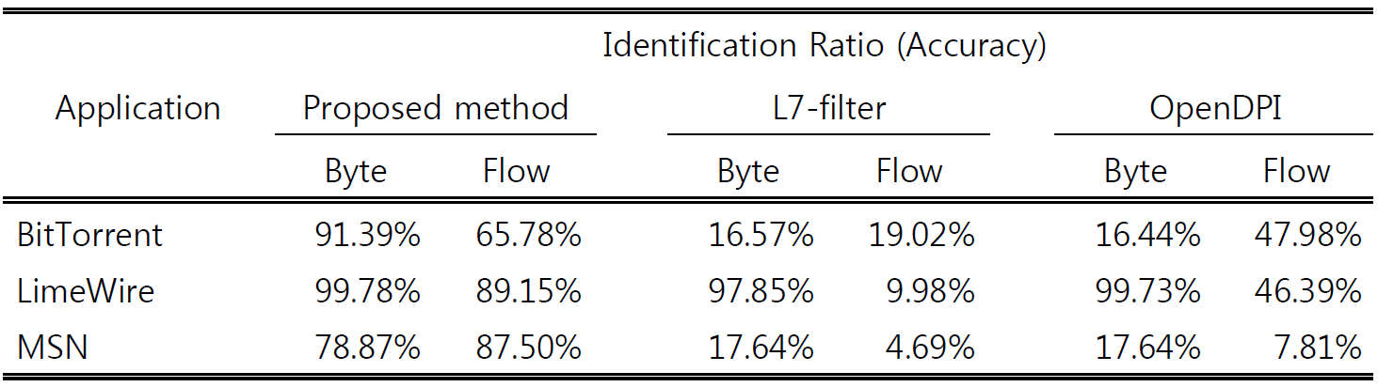
Accuracy Comparison
Comparison with conventional DPI solutions
L7-filter
  Most widely used DPI solution in Linux
  GNU Regular Expression (RE)
  Current version supports 113 application protocols
OpenDPI
  Industry leading DPI engine
  Incorporates connection behavior and statistical analysis
  Current version supports 101 different application protocols

Slide 26
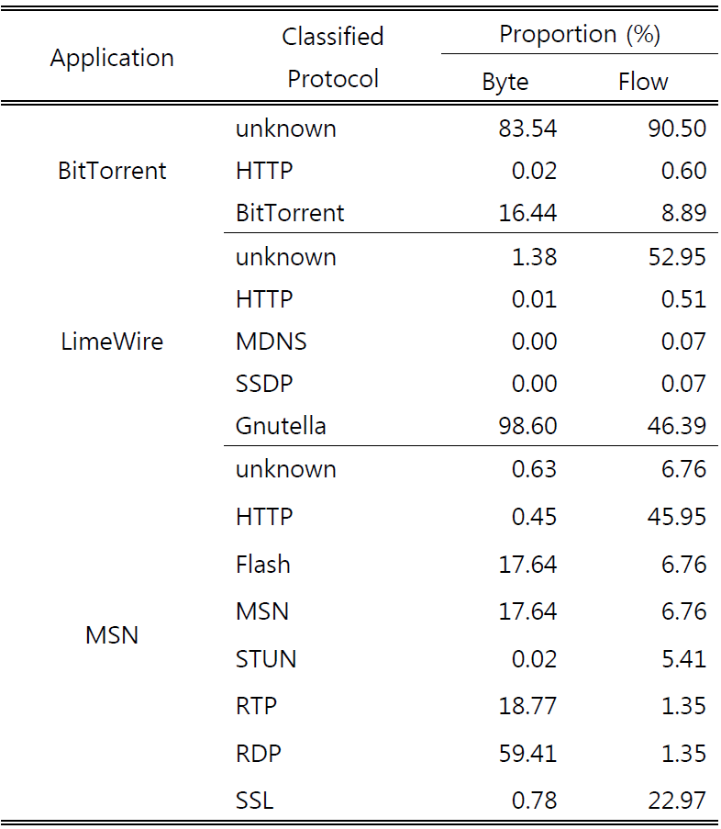
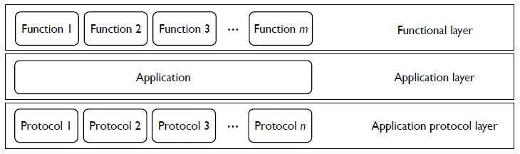
Accuracy Comparison
Sdfsdfasdfasdfasdfwef
An application from the perspective of layer
Detailed result of OpenDPI
  Classify application protocols only into application layers
  Low classification ratio

Slide 27
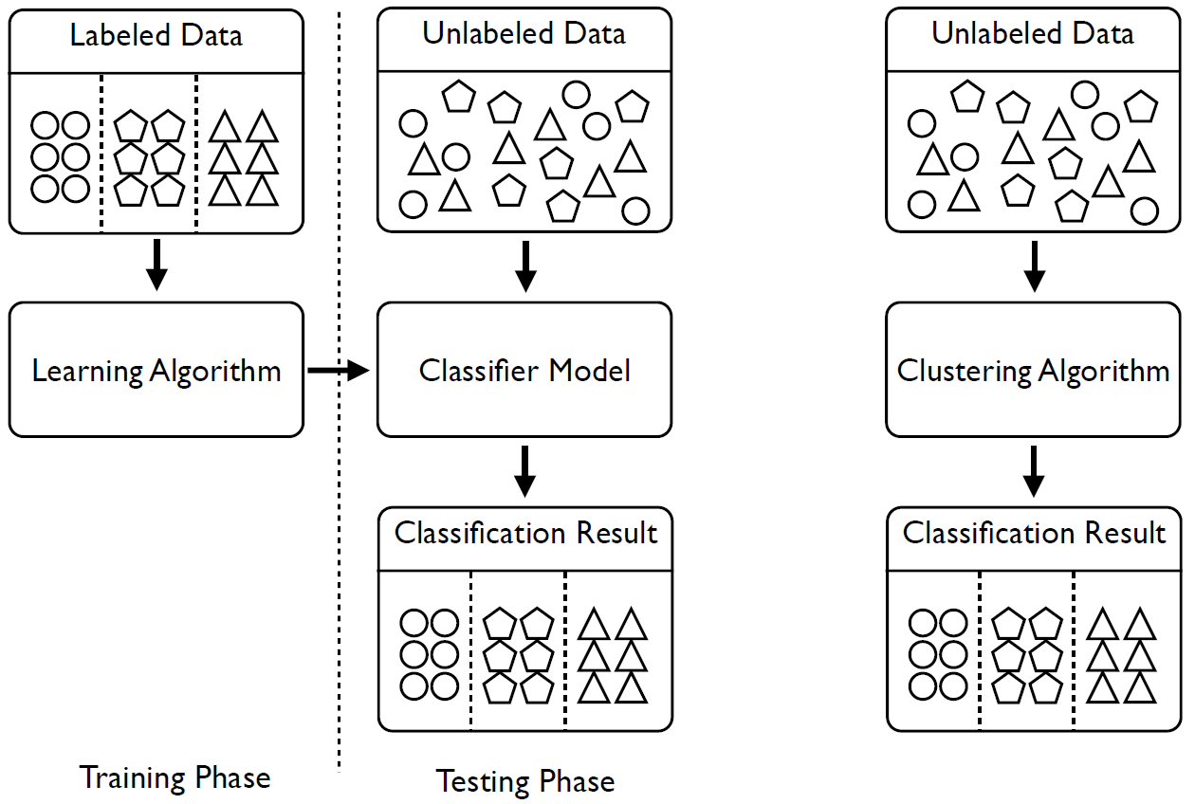
Comparison with Machine Learning
We compared our method with a clustering algorithm
  Functional separation problem: no prior knowledge on functionalities is available
  Number of functionalities is not predefined

Slide 28
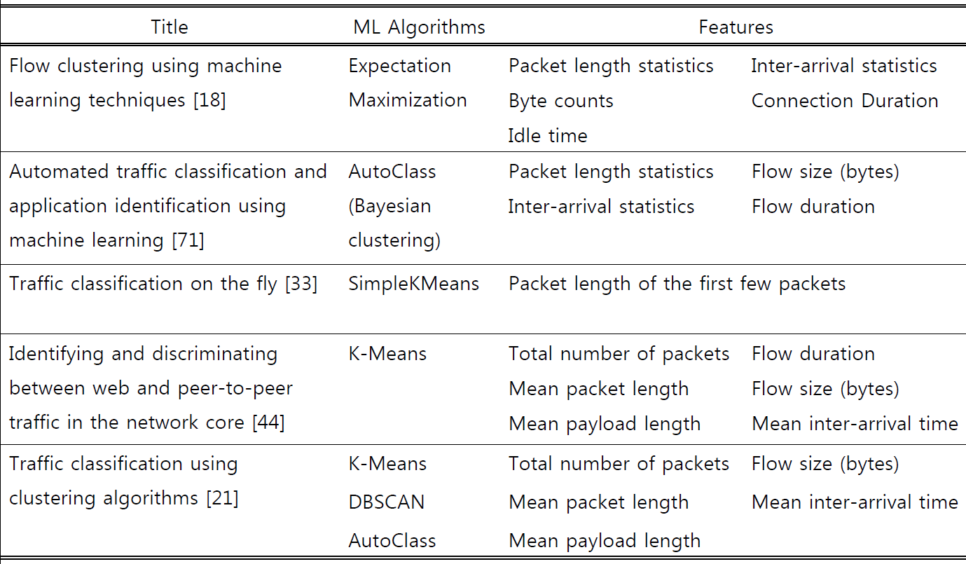
Comparison with Machine Learning
Analyze previous ML-based traffic classification work

Slide 29
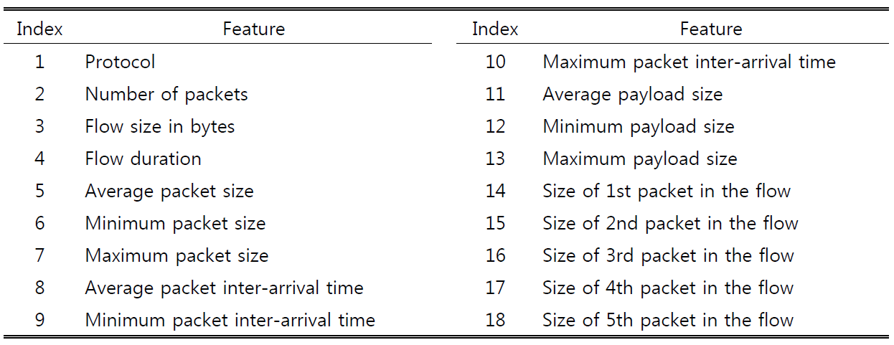
Feature Selection
Relief algorithm
  Instance based feature ranking algorithm
  Mostly successful feature selection method for classification

Slide 30
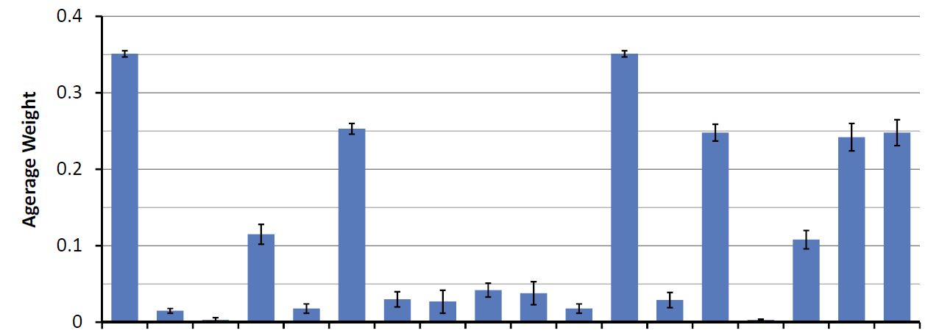
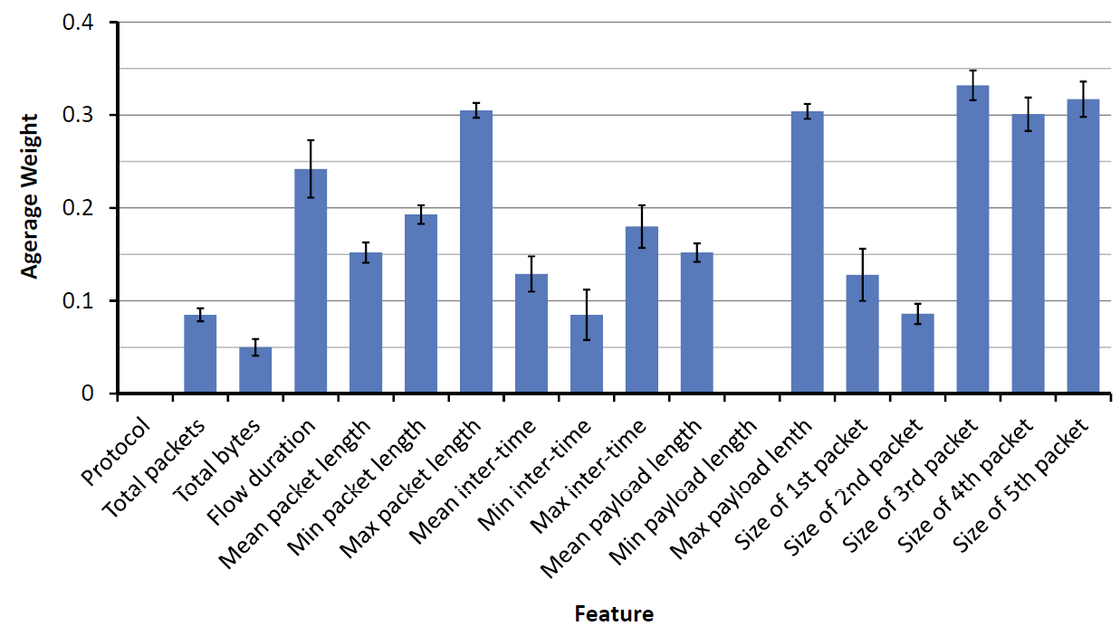
Feature Selection Result

Slide 31
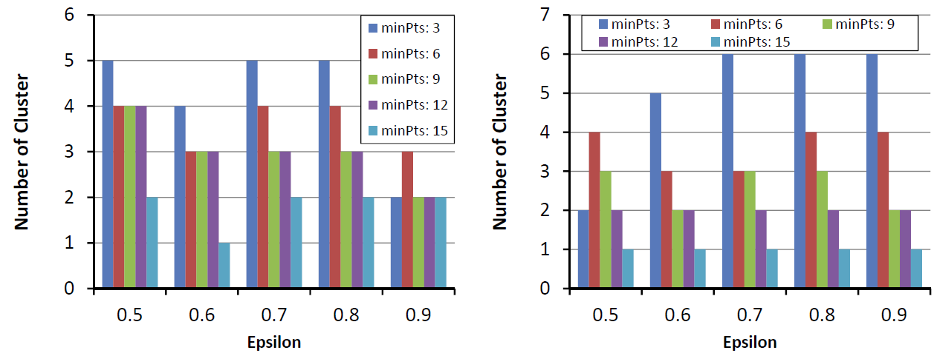
Clustering Algorithm
DBSCAN algorithm
  Density-based clustering algorithm
  Does not require the number of cluster in the dataset
  Can label noise data
Clustering result (number of cluster)
Fileguri – 7 clusters
NateOn – 7 clusters

Slide 32
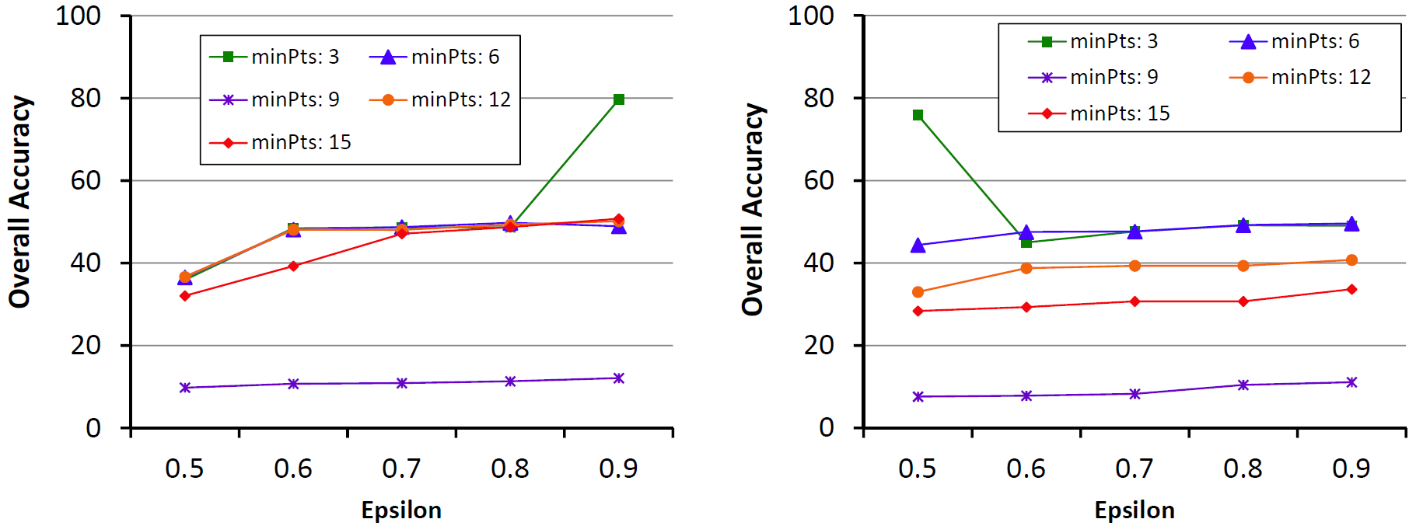
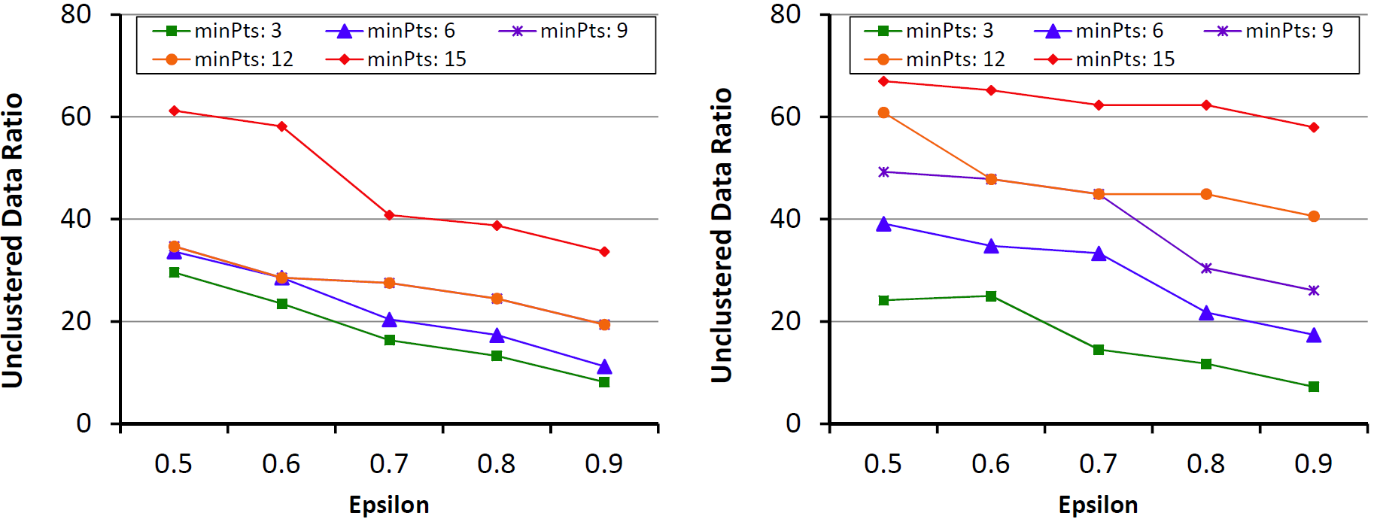
Clustering Result

Slide 33
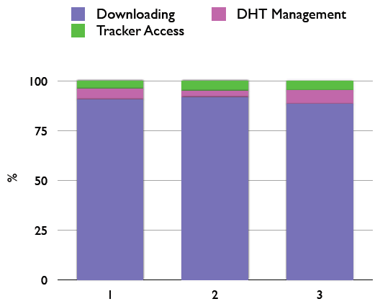
Use Cases of Fine-grained TC
User behavior analysis
  Average search count in P2P application
  Example)
    Fileguri generates about 6,000 transactions in a single keyword search
    Ratio of searching and downloading was 56,392:1
    Average search count: 9.398
Workload analysis according to function
  Crucial issue from the perspective of accounting
  Analyzing amount of undesired traffic

Slide 34
Concluding Remarks

Slide 35
Summary
Major problems in traffic classification
  Achieving high accuracy and completeness
  Classification details are bounded to identifying application protocols
Fine-grained traffic classification
  Achieved high classification accuracy based on functional separation
  Can provide more detailed traffic classification result
Functional separation
  Classify flows according to their origin function
  Consider port dependency, connection pattern, and contents similarity
Validation
  Fine-grained traffic classification outperformed other conventional DPI solutions
  Clustering is not a suitable solution for functional separation problem

Slide 36
Contributions
The limitations of current application traffic classification techniques are described. The absence of sophisticated, but desired, traffic classification scheme is also highlighted.
A unique reference study for application traffic classification is presented
New novel traffic classification scheme and its detailed methods are described
Validate the applicability of clustering algorithm for functional separation problem
A new analyses on traffic classification result are possible with the fine-grained traffic classification

Slide 37
Future Work
Enhancing labeling process of the functional separation algorithm
Applying different classification filters
  Reduce the overhead of deep packet inspection
  Analyze the flexibility of our approach
Increase the knowledge base
  Number of applications
  Characteristics of applications
Lightweight functional separation algorithm for mobile traffic
Further research on user behavior analysis based on fine-grained traffic classification

Slide 38

바쁘신 시간 내주셔서 감사합니다.

Slide 39
Publications (1/2)
International Journal/Magazine Papers (2)
  Byungchul Park, Young J. Won, and Jame Won-Ki Hong, "Toward Fine-grained Traffic Classification", IEEE Communications Magazine, vol. 49, Issue 7, July, 2011. pp. 104-111.
  Young J. Won, Mi-Jung Choi, Byungchul Park, James W. Hong, and John Strassner, "A Novel Approach for Failure Recognition in IP-Based Industrial Control Networks and Systems", Journal of Network and Systems Management (JNSM). Accepted to appear.
International Conference/Workshop Papers (12)
  Yeongrak Choi, Jae Yoon Chung, Byungchul Park, and James Won-Ki Hong, "Automated Classifier Generation for Application Level Mobile Traffic Classification," the 13th IEEE/IFIP Network Operations and Managment Symposium (NOMS 2012), accepted to appear.
  Jae Yoon Chung, Yeongrak Choi, Byungchul Park, and James Won-Ki Hong, "Measurement Analysis of Mobile Traffic in Enterprise Networks," 13th Asia-Pacific Network Operations and Management Symposium (APNOMS 2011), Taipei, Taiwan, Sep. 21-23, 2011. (pdf)
  Jae Yoon Chung, Byungchul Park, Young J. Won, John Strassner, and James W. Hong, "An Effective Similarity Metric for Application Traffic Classification", the 12th IEEE/IFIP Network Operations and Management Symposium (NOMS 2010), Osaka, Japan, Apr. 19-23, 2010. (pdf)
  Seong-Cheol Hong, Jin Kim, Byungchul Park, Young J. Won, and James W. Hong, "Internet Traffic Trend Analysis of a Campus Network", Accepted to be appeared in 15th Asia-Pacific Conference on Communications (APCC 2009), Shanghai, China, Oct. 2009. (pdf)
  Jae Yoon Chung, Byungchul Park, Young J. Won, John Strassner, and James W. Hong, "Traffic Classification Based on Flow Similarity", Accepted to be appeared in 9th IEEE International Workshop on IP Operations and Management (IPOM 2009), Venice, Italy, Oct. 2009. (pdf)
  Byungchul Park, Young J. Won, Hwanjo Yum and James Won-Ki Hong, "Fault Detection in IP-Based Process Control Networks using Data Mining Technique," 11th IFIP/IEEE International Symposium on Integrated Network Management (IM 2009), New York, USA, Jun. 2009. (pdf)

Slide 40
Publications (2/2)
  Byungchul Park, Young J. Won, Mi-jung Choi, Myung-Sup Kim, and James W. Hong, "Empirical Analysis of Application-level Traffic Classification using Supervised Machine Learning," Accepted to be appeared in 11th Asia-Pacific Network Operations and Management Symposium (APNOMS 2008), Beijing, China, Oct. 2008. (pdf)
  Byung-Chul Park, Young J. Won, Myung-Sup Kim, and James Won-Ki Hong. "Towards Automated Application Signature Generation for Traffic Identification," IEEE/IFIP Network Operations and Management Symposium (NOMS 2008), Salvador, Brazil, April 2008. (pdf)
  Young J. Won, Byung-Chul Park, Mi-jung Choi, James W. Hong, Hee-Won Lee, Chan-Kyu Hwang, Jae-Hyoung Yoo, "End-User IPTV Traffic Measurement of Residential Broadband Access Networks," 6th IEEE International Workshop on End-to-End Monitoring Techniques and Services (E2EMON 2008), Salvador, Brazil, April 2008. (pdf)
  Young J. Won, Byung-Chul Park, Mi-Jung Choi, and James Won-Ki Hong. "Service-based Charging Scheme for Mobile Data Networks," 1st KICS International Conference, Yanbian, China, Aug. 23-25, 2007.
  Young J. Won, B.C. Park, S.C. Hong, K.B. Jung, H.T. Ju, James W. Hong, "Measurement Analysis of Mobile Data Networks," Passive and Active Measurement Conference (PAM 2007), Louvain-la-neuve, Belgium, April 5-6, 2007, pp. 223-227. (pdf)
  Young Joon Won, Byung-Chul Park, Myug Sup Kim, Hong-Tek Ju, and James Won-ki Hong, "A Hybrid Approach for Accurate Application Traffic Identification", IEEE/IFIP E2EMON, Vancouver, Canada, April 3, 2006, pp. 1-8. (pdf)
Domestic Journal / Conference Papers (10)

Slide 41
Appendix

Slide 42
Characteristics of
Current Network Applications

Slide 43
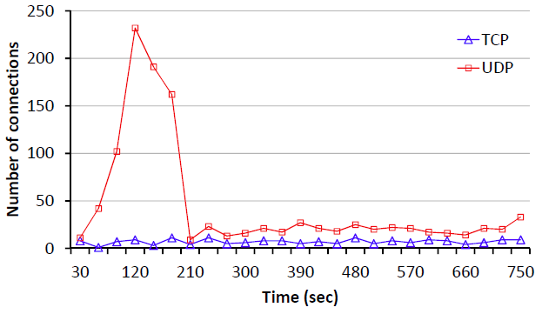
Concurrent Network Connections
Number of concurrent network connections over time
The number of connection varies according to the condition of BitTorrent swarms
a large number of connections are established simultaneously

Slide 44
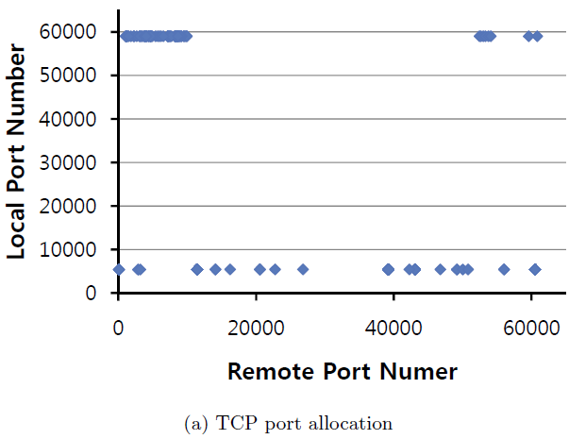
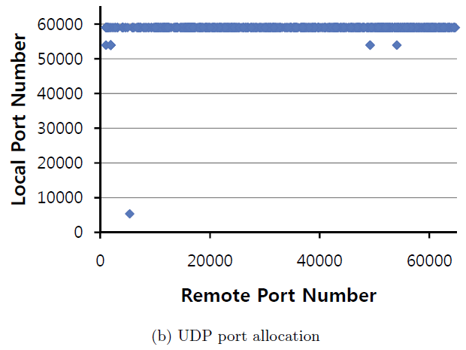
Dynamic Port Allocation
Even though local ports numbers are concentrated in certain ranges, remote port numbers are distributed over broad ranges

Slide 45
Functional Separation

Slide 46
Research Approach
Total Traffic
Undetermined Traffic
Completeness
Increasing number of applications
Coverage
Classified Traffic
Correctly Classified Traffic
Misclassified Traffic
Correctly Classified Traffic
Unclassified Traffic
Detecting various functions in applications
Accuracy

Slide 47
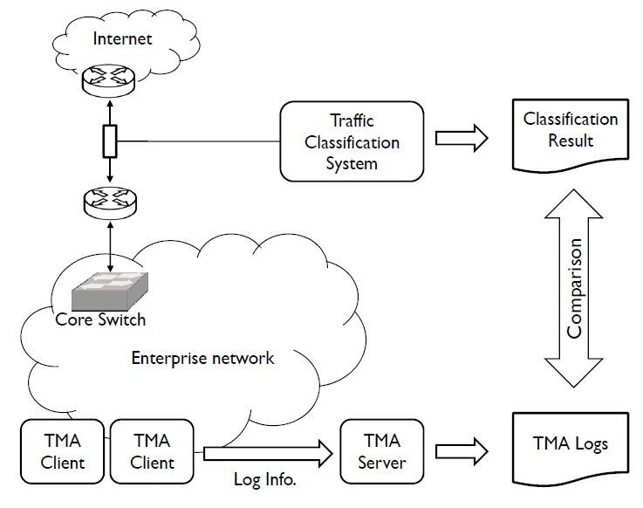
Ground Truth Data

Slide 48
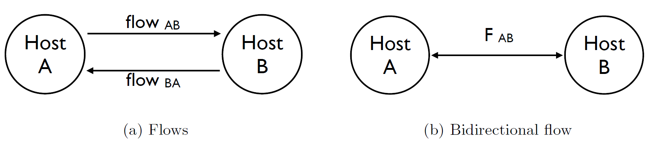
Port-Relation Grouping
Assumptions
  Packets occurring in the close time interval and sharing the same 5-tuple (source IP address, source port, destination IP address, destination port, and protocol) had originated from the same functionality.
  Reverse packets (displacement of 5-tuple information, protocol must be the same) in the close time interval ( ≤ 1 minute) belong to the same functionality

Slide 49
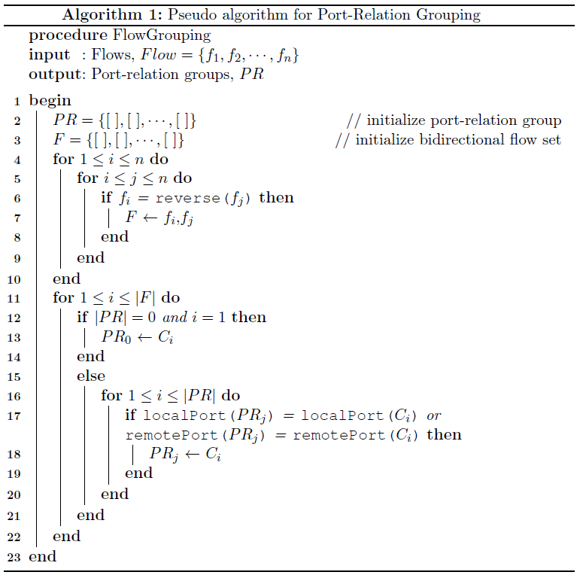
PRG Algorithm

Slide 50
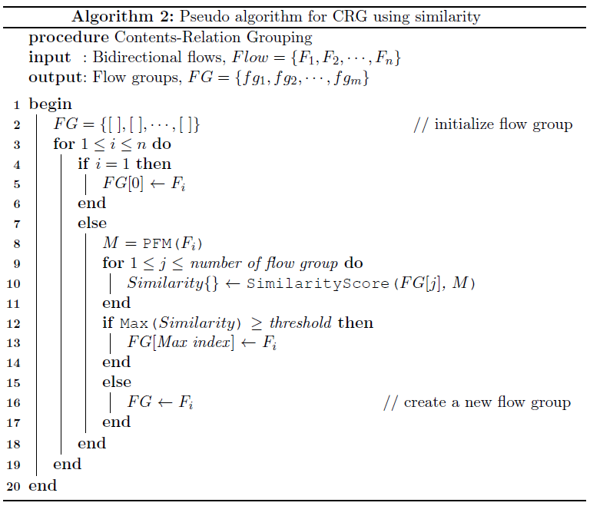
CRG Algorithm

Slide 51
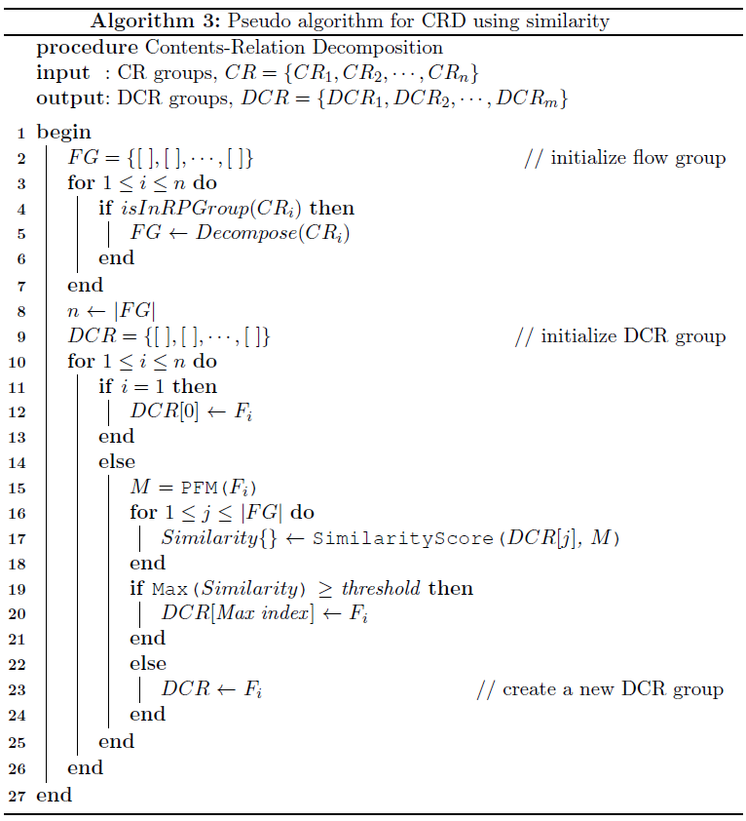
CRD Algorithm

Slide 52
Vector Space Modeling
Vector Space Modeling
  An algebraic model representing text documents as vectors
  Widely used to document classification
    Categorize electronic document based on its content
    (e.g. E-mail spam filtering)
Document classification vs. Traffic classification
  Document classification
    Find documents from stored text documents which satisfy certain
    information queries
  Traffic classification
    Classify network traffic according to the type of application based on
    traffic information

Slide 53
Payload Vector Conversion (1/2)
Definition of word in payload
  Payload data within an i-bytes sliding window
  |Word set| = 2^{(8*sliding window size)}
Definition of payload vector
  A term-frequency vector in NLP
  Term-weighting scheme
    Enhance significant words
    Ignore stop-words
Payload Vector = [w₁ w₂ … w_{n}]^{T}

Slide 54
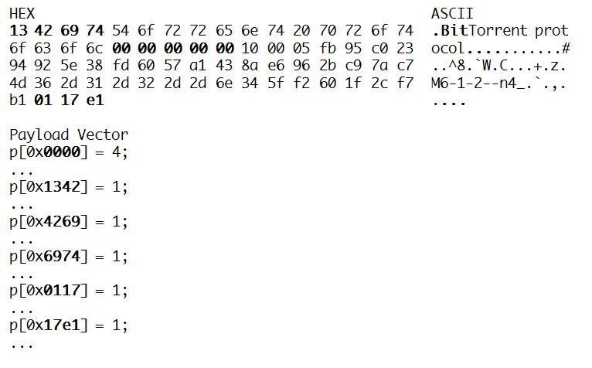
Payload Vector Conversion (2/2)
Word
Word
Word
    The word size is 2 and the word set size is 2¹⁶
      The simplest case for representing the order of content in payloads

Slide 55
Flow Comparison (1/2)
Payload Flow Matrix (PFM)
  k payload vectors in a flow
  Represent a traffic flow
  Definition of PFM
    Payload Flow Matrix (PFM) is
    where p_{i} is payload vector
Collected Payload Flow Matrix (Collected PFM)
  Information about target flows
  Alternative signatures
  Accumulated empirically to enhance signature word
PFM = [p₁ p₂ … p_{k}]^{T}
Collected PFMs = a * new PFM + (1 - a) * Collected PFMs

Slide 56
Flow Comparison (2/2)
1st packet
W₁₁
W₁₂
…
W_{1n}
PFM 1
W₁₁
W₁₂
…
W_{1n}
PFM 2
2nd packet
W₂₁
W₂₂
…
W_{2n}
PFM 3
W₁₁
W₁₂
…
W_{1n}
W₂₁
W₂₂
…
W_{2n}
…
…
…
…
…
W₂₁
W₂₂
…
W_{2n}
k^{th} packet
…
…
…
…
PFM m
W₁₁
W_{k1}
W₁₂
W_{k2}
…
…
W_{1n}
…
…
…
W_{kn}
W_{k1}
W_{k2}
…
…
W₂₁
W₂₂
…
W_{kn}
W_{k1}
W_{k2}
…
W_{2n}
W_{kn}
…
…
…
…
W_{k1}
W_{k2}
…
W_{kn}
Packets are compared sequentially with only the corresponding packet in the other flow
Flow similarity score: summation of the packet similarity values with packet weighting scheme
  Exponentially decreasing weight scheme
  Uniform weight scheme

Slide 57
Classification Filter Extraction

Slide 58
Classification Filter Extraction
Existing application (payload) signature formats
  Common string with fixed offset
  Common string with variable offset
  Sequence of common substrings
Constraints for signature extraction
  Number of packets per flow
  Minimum substring length
  Packet size comparison

Slide 59
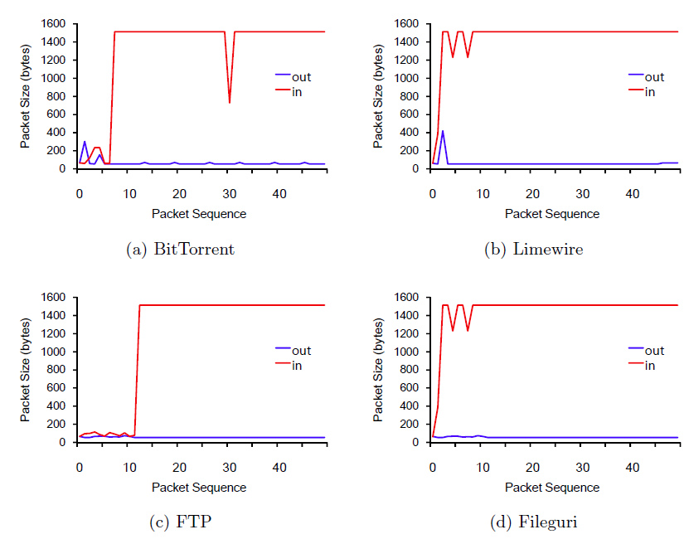
LASER Algorithm

Slide 60
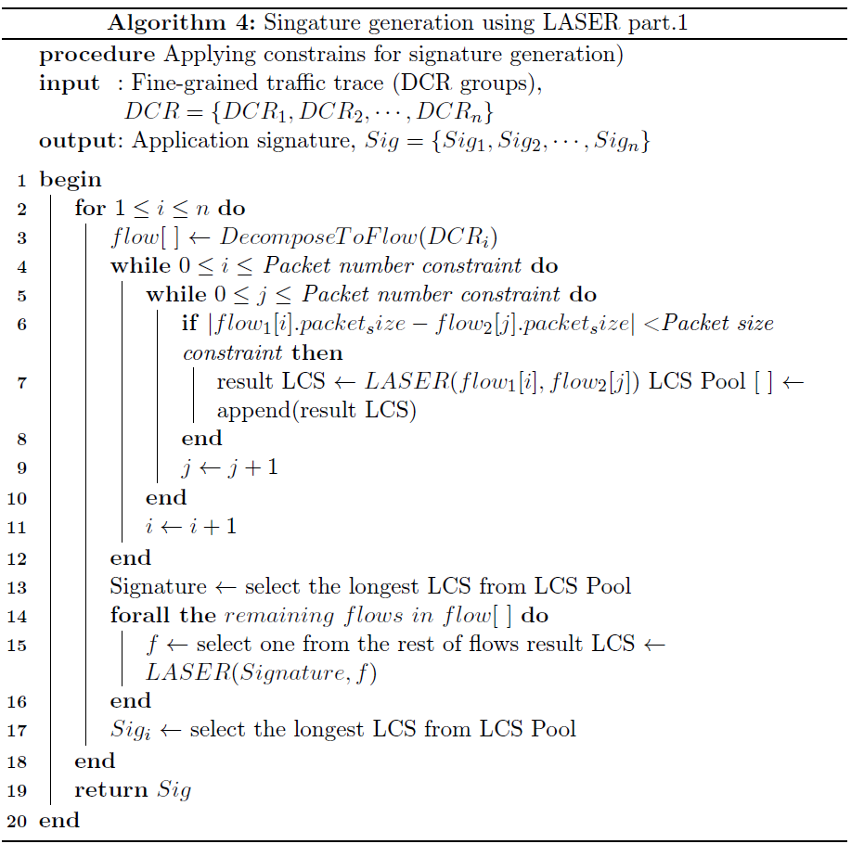
LASER Algorithm

Slide 61
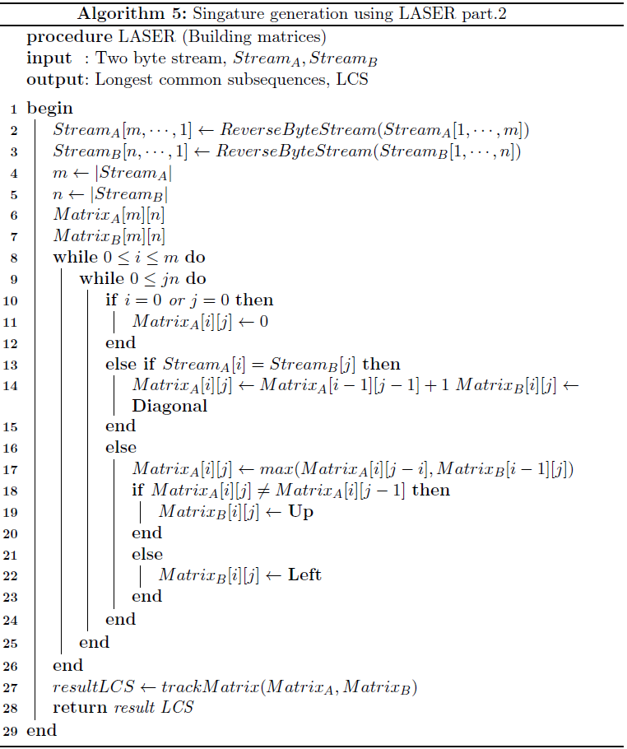
LASER Algorithm

Slide 62
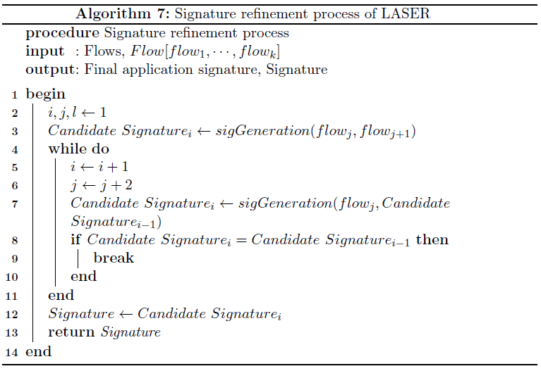
LASER Algorithm

Slide 63
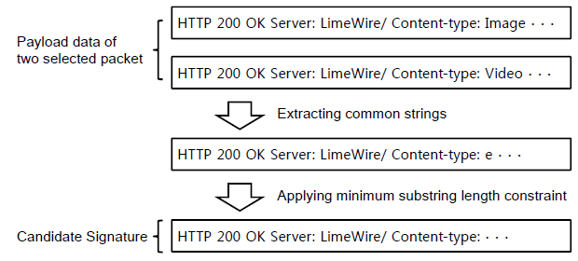
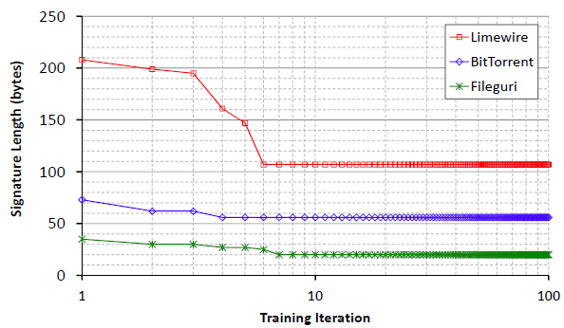
Example

Slide 64

Comparison with Manual Signature
LASER signatures are either identical or close to the signatures from the rest of the methods

Slide 65
Evaluation

Slide 66

Application Selection

Slide 67

Byte Accuracy & Flow Accuracy
Majority of flows are small (< 1,000 bytes)

Slide 68

Elephants and Mice Phenomenon
Small portion of flows occupies majority of total traffic in terms of traffic volume

Slide 69

Traffic Composition
Our method can classify different traffic types within a single application
➔ analyze the usage pattern of an application ➔ user behavior
➔ design future applications

Slide 70

Relief Algorithm
The Relief family of algorithms identifies the importance of features based on the distance of NH and NM
x^{(i)} : i^{th} feature of a data point x
NH^{(i)}(x) and NM^{(i)}(x) : i^{th} feature of nearest hit and nearest miss

Slide 71

Weights of Each Feature

Slide 72

Selected Feature
We have removed features, weight value of which is less than 0.1

Slide 73
DBSCAN Algorithm
Density-based clustering algorithm
Find a number of clusters starting from the estimated density distribution of corresponding nodes
Density-reachable: an object p is directly density-reachable from an object q if both objects are located within a given distance epsilon
Directly density-reachable: an object p is density-reachable from q if the object p is within the epsilon-neighborhood of an object r which is directly density-reachable or density-reachable from q
Cluster: if p is surrounded by sufficiently many points objects which are closer than in terms of distance, p and those objects are considered as a cluster

Slide 74
Fine-grained TC Process
Offline process
Online process
14/38

Slide 75
Fine-grained TC Process
Offline process
Online process
14/38

Slide 76
Fine-grained TC Process
Offline process
Online process
14/38

Slide 77


Connection Visualization

